Slide 1
NCFS Insights
November 4, 2026

Slide 2

Agenda
Functional
Training
Technical
User Engagement
Closing/Q&A

Slide 3

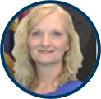


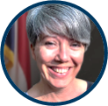
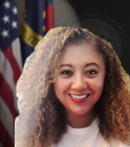
Presenters
Laura Klem
Deputy State Controller
Statewide Accounting
Gwen Earp
Materials Lead
Ram Kuntamukkala
Applications Systems Manager
Thurman Ross
Applications Systems Manager
Dawn Parrish
Learning & Development Special Projects Coordinator
Lena Andrade
NCFS User Engagement
Lead

Slide 4
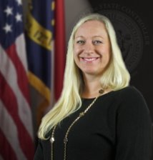
Presenter Spotlight
Laura Klem
North Carolina Financial System
NC Office of the State Controller

Slide 5
Statewide Accounting Update
2026 OSC Financial Conference
December 16 & 17
  Registration is open through December 2 on OSC's website
  Additional conference details, including registration instructions and CPE information, were provided in the 27-10 CPE Announcement memo sent on October 28
  Insights and Updates on:
      State Budget
      Economic Updates
      Information Technology
      Accessibility
      Professional Development
Capital Asset Roundtable
December 10
Discussion and clarification of upcoming capital asset policy changes
Topics include:
  Increased capitalization thresholds effective FY 2027
  Accounting for building additions, repairs, and renovations
  Fully depreciated assets
  Other miscellaneous fixed asset policy topics
  Opportunity for agency questions and discussion
Additional information, including registration details, will be sent soon to statewide financial contacts

Slide 6
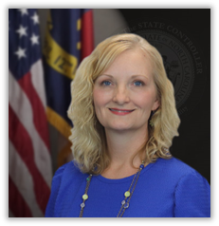
Presenter Spotlight
Gwen Earp
North Carolina Financial System
NC Office of the State Controller

Slide 7
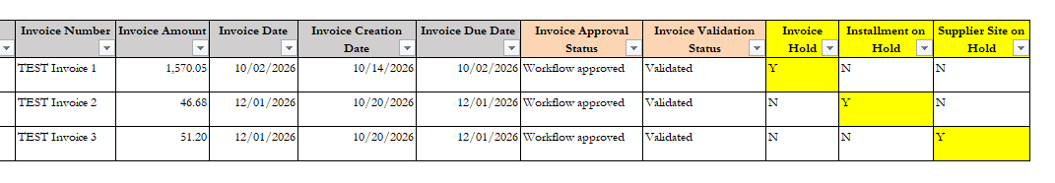
Locating Invoice Holds
There are several ways to locate invoice holds:
Agencies should regularly monitor the RPT-AP-048 NC Unpaid Invoice Status Report to review and take action on invoice holds. This report will also show invoice validation and approval status. This report is the most comprehensive way to see all invoice holds at once.

Slide 8
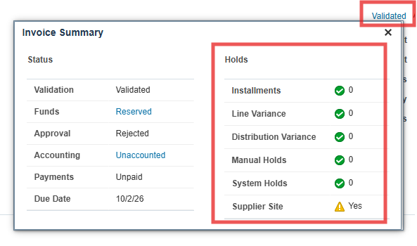
Locating Invoice Holds
Another option from within the invoice edit screen, users can click the blue link in the upper right-hand corner of the invoice, and the pop-up box will show invoice holds.

Slide 9
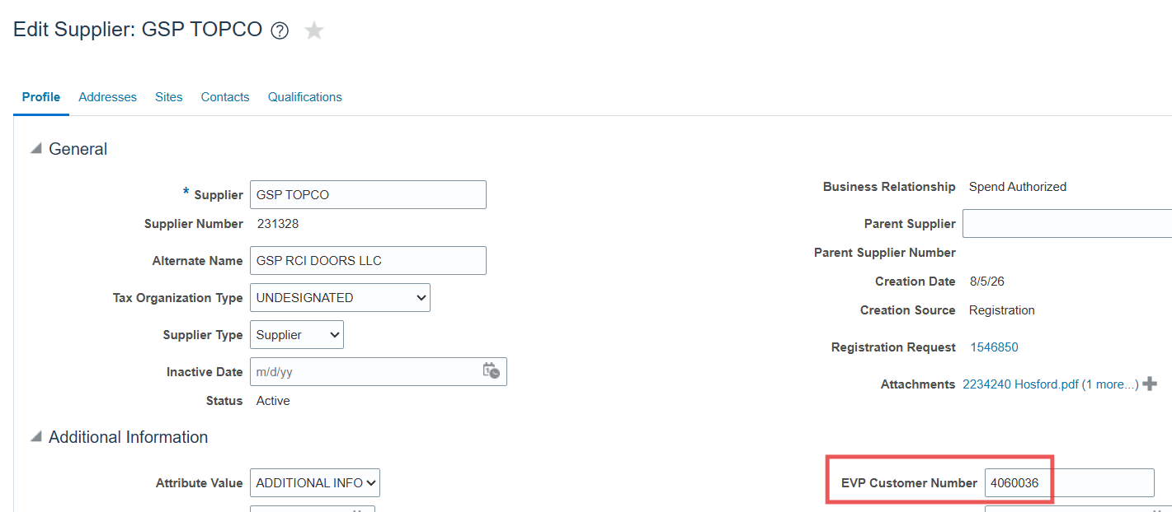
Matching Suppliers in eProcurement to NCFS
NCFS stores the EVP Customer Number on the supplier record that can be searched in eProcurement/EVP. The EVP Customer number and the NCFS Supplier number are tied to the same Tax ID number.

Slide 10
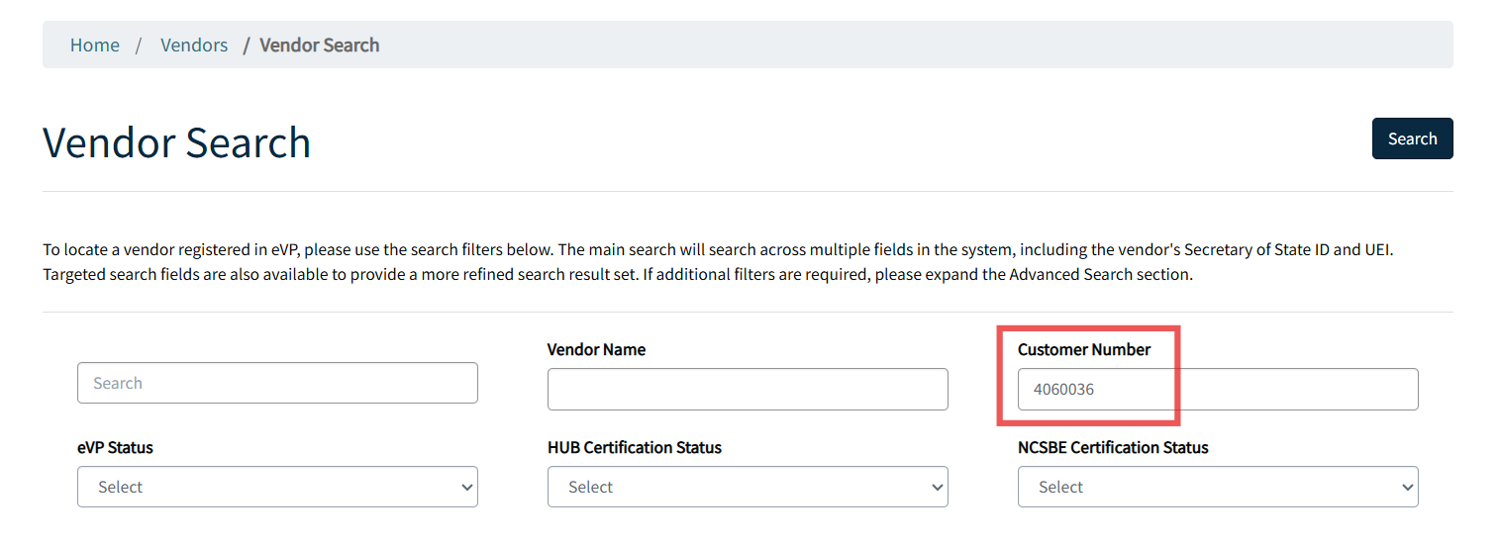
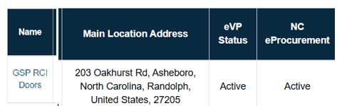
Matching Suppliers in eProcurement to NCFS
eProcurement suppliers register at https://evp.nc.gov/
Users can search for vendors in eProcurement/EVP by Customer Number to confirm that the supplier exists in both eProcurement and NCFS with the same Tax ID Number

Slide 11
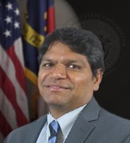
Presenter Spotlight
Ram Kuntamukkala
North Carolina Financial System
NC Office of the State Controller

Slide 12
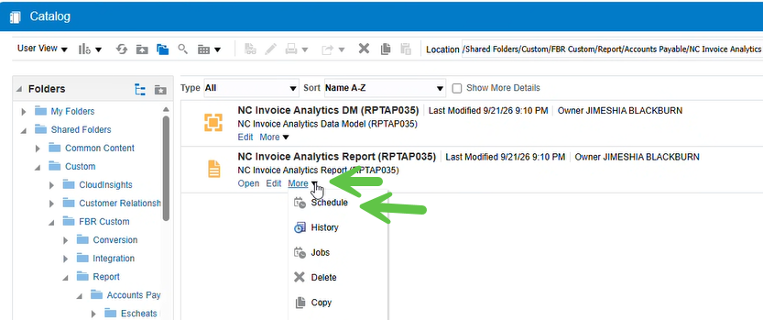
Reporting Issues- BIP Reports ( Parameter Selection)
When scheduling or running a BIP report from the NCFS Reporting screen, please make sure to select the correct Business Unit (BU) before submitting the job.
This helps significantly improve report performance and reduces unnecessary processing.
When you select "More" and click on " Schedule"
Notes:
We have noticed performance issues with some BIP reports, particularly when users run them through the Oracle portal.
To help improve report performance, please keep the following in mind:
Make sure you access only the reports you are authorized to run based on your assigned security roles.
Before running a report in real time or scheduling it, ensure that you make the appropriate parameter selections, especially selecting the correct Business Unit (BU).
As shown in the screenshot above, click More to open the drop-down menu, then select Schedule to proceed to the next screen.

Slide 13
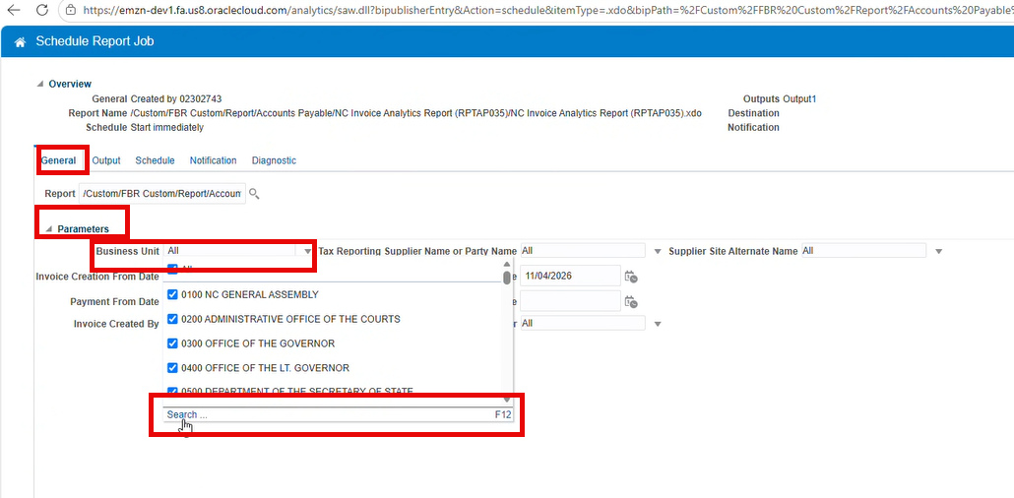
Reporting Issues- BIP Reports ( Parameter Selection)
Go to General->Parameters->Business Unit->Search
Notes:
On this screen, navigate to the General tab and click on Parameters. Please allow some time for the parameters to load, as this may take a few moments.
Once the parameters are displayed, do not select All or your entire Business Unit list. Instead, scroll to the bottom and click the Search option. This will open a new window where you can search for and select the specific Business Unit(s) for which you want to run the report.
Make sure you select only the relevant Business Units before proceeding. This helps avoid processing unnecessary data and improves report performance.

Slide 14
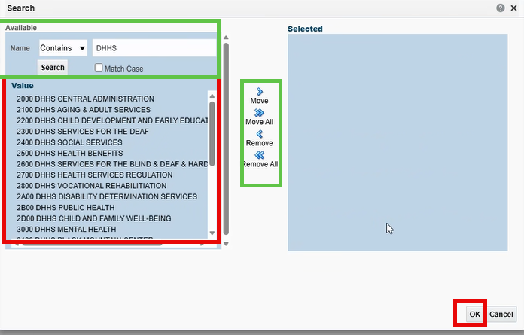
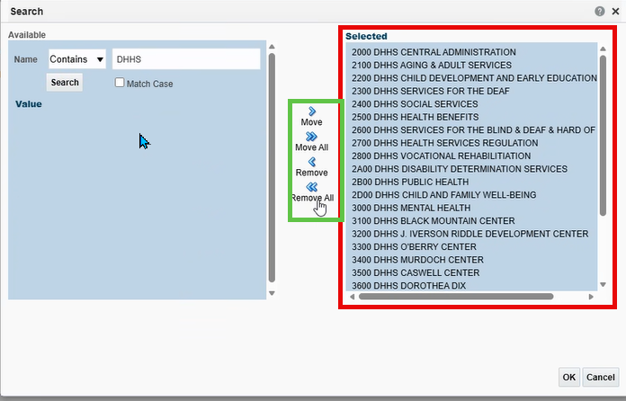
Reporting Issues- BIP Reports ( Parameter Selection)
Make your selection – and move them over to the right side
Verify that your BU now shows up before you submit the job
Notes:
On this screen, follow these steps to select the appropriate agency:
In the Name field at the top-left corner, select Contains from the drop-down.
Enter the agency name you are looking for.
Click Search. The system will display the agencies that you are authorized to access based on your assigned security roles.
Select the appropriate agency or agencies from the search results.
Click the Move button (arrow) in the middle to move your selections to the box on the far right. You can also use Move All if you need to select all the agencies displayed.
Once your selections appear in the right-hand box, click OK to confirm.

Slide 15
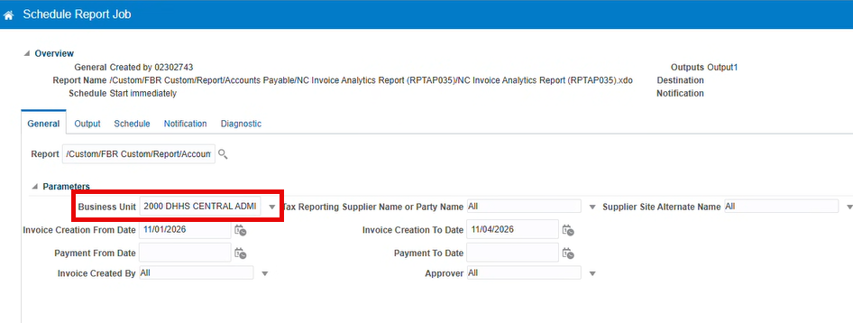
Reporting Issues- BIP Reports ( Parameter Selection)
Make sure , your BU now appears in the Business Unit box and press submit
Notes:
On this screen, verify that the Business Unit(s) you selected on the previous screen are displayed correctly under Parameters.
Once you have confirmed that the correct selections are displayed and all other parameters look good, click Submit to run the report.
The report should now execute with the appropriate data scope, helping improve performance and reduce unnecessary processing.

Slide 16

Presenter Spotlight
Thurman Ross
North Carolina Financial System
NC Office of the State Controller

Slide 17
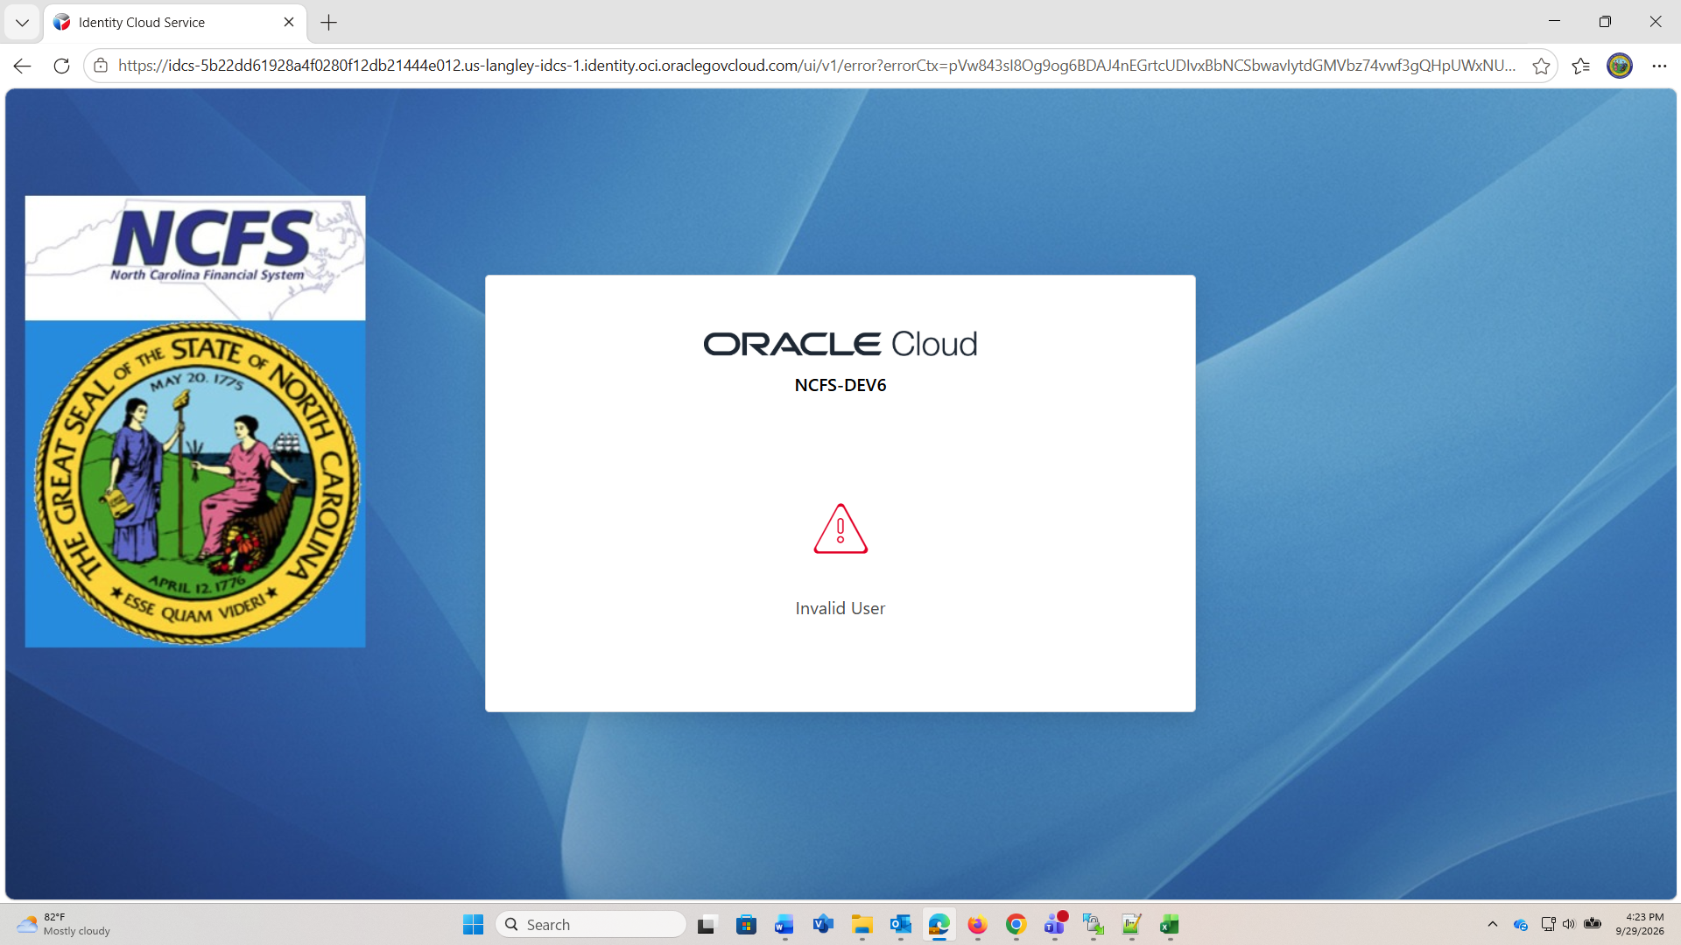
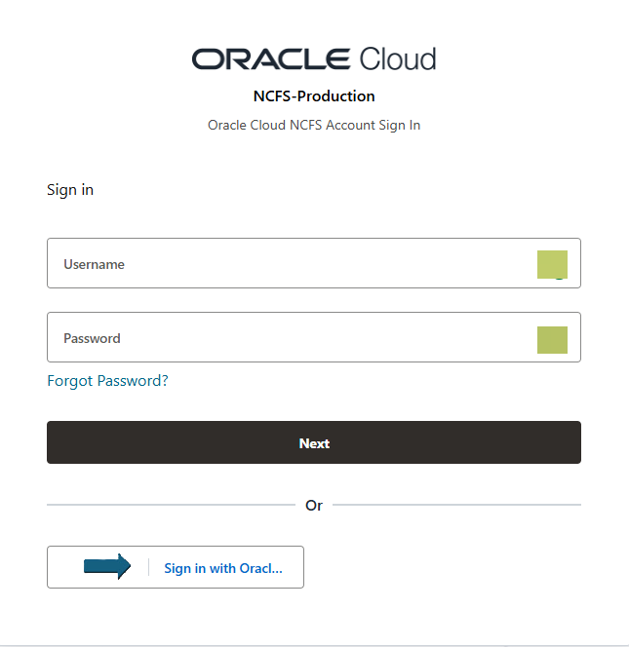

Security Tips
Common NCFS sign in problems
If your browser is on the NCFS sign on screen too long, it can cause the above issue.
Notes:
The next few screens are our TOP 3 reported problems signing into NCFS. This issue occurred on our DEV6 environment, but it can certainly happen in Production as well. The number one cause of this issue is sitting on the sign in screen too long and the SAML cookies time out.

Slide 18

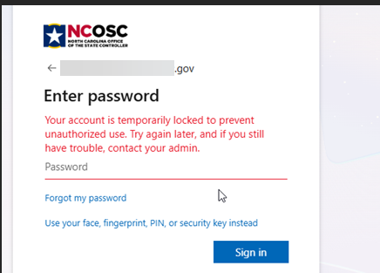
Security Tips
Common NCFS sign in problems
Notes:
Sometimes the previous error will cause this one. But most of the time, this error isn’t a locking issue in NCFS but in NCID, MS AZURE or EADS and we unfortunately can’t help you. We do double check to make sure you aren’t locked in NCFS, but that is rarely the issue on this error, and you either need to contact DIT or your Agency IT Department.

Slide 19
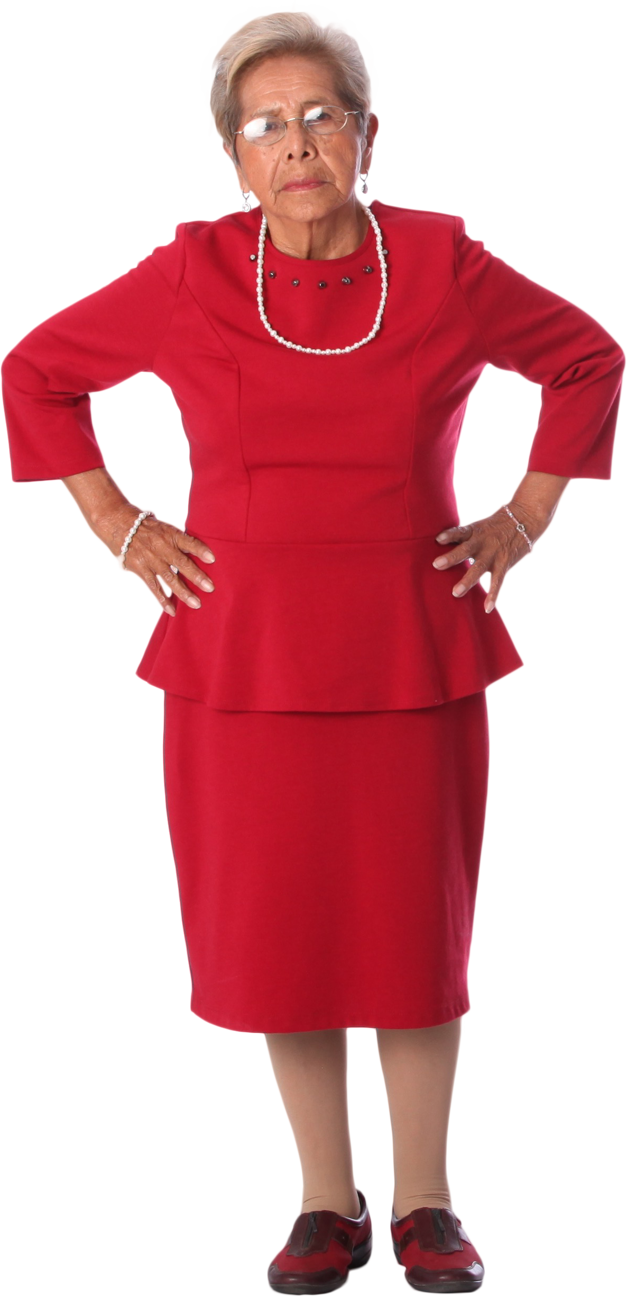
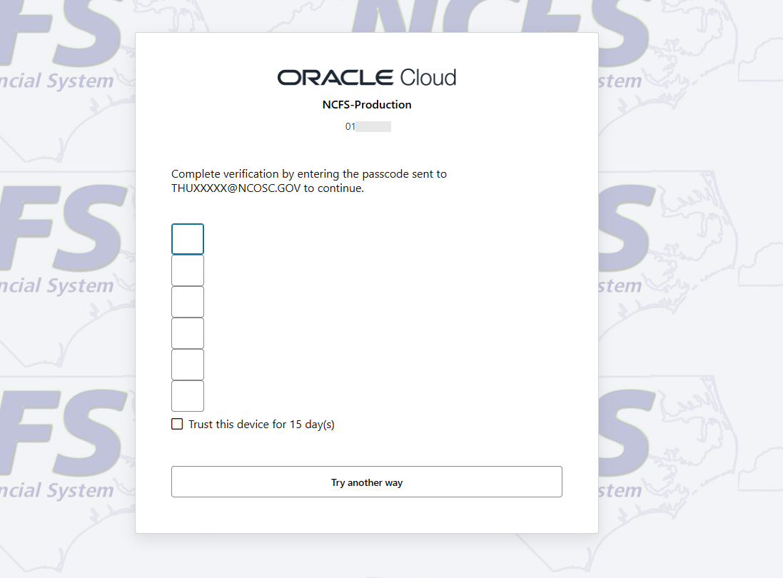
Security Tips
Common NCFS sign in problems
Notes:
You should never get this message….however, I know it has happened. This is a multifactor authentication prompt, but this happens to be Oracle’s prompt and not North Carolina’s DIT prompt. If you ever see this…close your browser, clear your cache and try it again. The issue unfortunately is nothing that we or Oracle can fix, it happens to be a SAML issue, and this message occurs as a “fail safe” by Oracle.

Slide 20
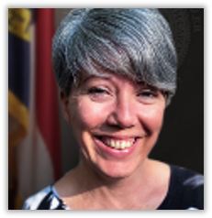
Presenter Spotlight
Dawn Parrish
Communications/Learning & Development
NC Office of the State Controller

Slide 21
Training
Class Pre-Work
  GL100c, IC100c, and FA100
    ADFDI download: Excel Add-On | NCOSC
Notes:
This download is required BEFORE attending the listed classes. Some agencies require their IT assistance and need to handle this before class day. It will soon be turned into a required pre-req WBT.

Slide 22

Presenter Spotlight
Lena Andrade
North Carolina Financial System
NC Office of the State Controller

Slide 23

Fall Engagement Touchpoints
Thanks to all agencies and interface groups who met with our User Engagement team during the Fall touchpoints
Complete post meeting surveys:
  Agency
  Interface groups
Notes:
NCFS agency touchpoints kicked off in September! We schedule ~54 touchpoints twice a year to do check ins with our NCFS users. These touchpoints allow us to share information but also collect information directly from users, as well as feedback on performance and issues (and wins!) that may be occurring in the system. This allows us to evaluate how we are doing from a user interaction perspective and improve process!
Agency touchpoints have wrapped up and overall, the feedback has been great! Thank you for all the support and partnership to ensure we are delivering the best we can.
If you have not yet completed the post meeting survey, please be sure to do so. This survey helps us compare how you are doing each year. Links are in the slide for agencies and interface groups.

Slide 24
OTBI Update
Thank you to everyone who has inquired and reviewed the BI Author security roles/requests for your agency/university.
We appreciate your patience as we continue to work through our technical and security items to ensure that users are accessing appropriate data for their agency/university.

Slide 25
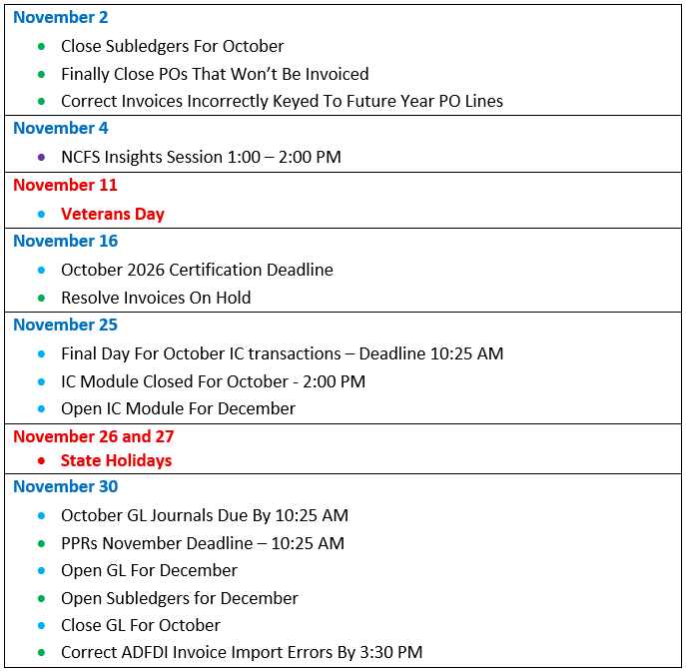
November 2026 Functional Calendar
Key:
Green = Subledgers - Accounts Payable, Fixed Assets, Inventory, and Accounts Receivable
Light Blue = General Ledger and Cash Management Dark Blue = Fixed Assets
Purple = NCFS Insights and Information Sessions | Red = State Holiday
Brown = 2026 ACFR
Calendars can be viewed as a monthly, weekly, or list view.

Slide 26
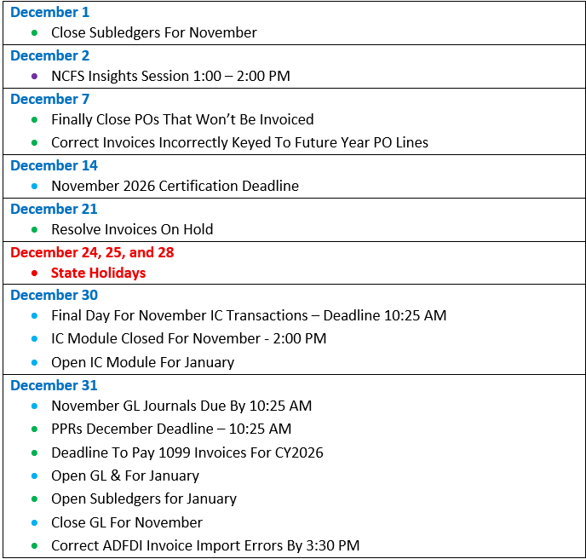
December 2026 Functional Calendar
Key:
Green = Subledgers - Accounts Payable, Fixed Assets, Inventory, and Accounts Receivable
Light Blue = General Ledger and Cash Management Dark Blue = Fixed Assets
Purple = NCFS Insights and Information Sessions | Red = State Holiday
Brown = 2026 ACFR
Calendars can be viewed as a monthly, weekly, or list view.

Slide 27
What’s Next
Session | Date | Time
NCFS 1099 Information Session | November 18, 2026 | 11:00 AM – 12:00 PM
NCFS Insights Session | December 2, 2026 | 1:00 – 2:00 PM
Capital Asset Roundtable | December 10, 2026 | 10:00 AM – 12:00 PM
2026 OSC Financial Conference | December 16 and 17, 2026 | 8:10 AM – 12:00 PM
Reference Links
eProcurement Supplier Registration
Oracle ADFDI Excel Add On
Post Touchpoint Surveys:
Agency
Interface

Slide 28
Thank you
Thank you!
For questions or assistance, contact ncfs@ncosc.gov.

