Slide 1
NCFS Insights
September 2, 2026

Slide 2

Welcome
Housekeeping
Introductions

Slide 3
Agenda
Welcome
Functional
Training
User Engagement
Closing/Q&A

Slide 4
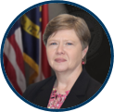
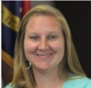
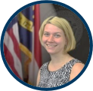

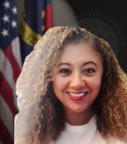
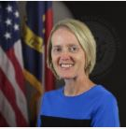
Presenters
Darlene Langston
Finance Lead
Taylor Brumbeloe
NCFS Deputy State Controller
Laura Lee
OSC Training Lead
Michael Euliss
Communications and Training Director
Lena Andrade
NCFS User Engagement
Lead
Jan Prevo
NCFS Project Coordinator

Slide 5
Polling Question
What is your preference for staying connected with the NCFS team?
Touchpoints in the fall and spring of each year
NCFS Insights sessions for sharing updates
OSC Communications webpage
All the above

Slide 6
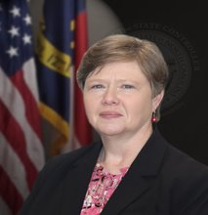
Presenter Spotlight
Darlene Langston
North Carolina Financial System
NC Office of the State Controller

Slide 7
Scheduling Reports
In NCFS, reports are created ad hoc when you run them.
Reports will “time out” if attempting to extract a large quantity of data.
The more you can narrow down the parameters of the report, the less likely you are to receive this message.
We recommend that you schedule large or complex reports.
Walkthrough of scheduling a report
A quick reference guide is available to outline these steps: GEN-05 Schedule Reports and Manage Report Output | NCOSC

Slide 8
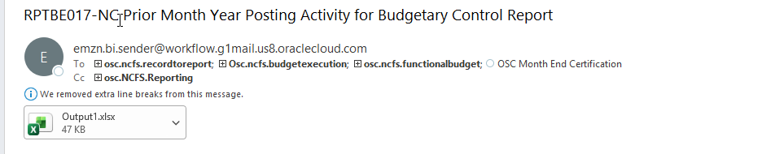
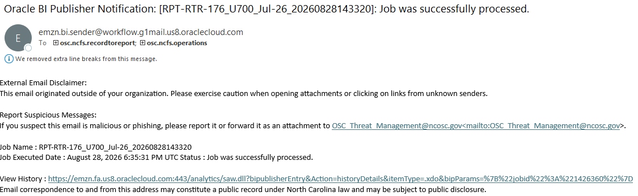
Emailed scheduled reports
Email From : emzn.bi.sender@workflow.g1mail.us8.oraclecloud.com

Slide 9
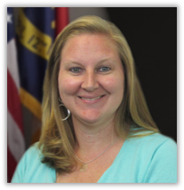
Presenter Spotlight 2
Taylor Brumbeloe
North Carolina Financial System
NC Office of the State Controller

Slide 10
OSBM BRIDGE Project – Phase 1
Phase 1:
Supports development of NC statewide base budget operations
User Acceptance Testing in progress
End User Training happening through August & September
Scheduled to go-live the week of September 21st
All Phase I Base Budget users will be required to complete three BRIDGE training courses:
Introduction to BRIDGE (BRI100) *Self-paced online
Base Budget Creation and Adjustment (BRI200) *Instructor-led
Budget Reporting (BRI300) *Instructor-led
Registration for training sessions is open in the Learning Management System (LMS). Training will continue into the month of September.

Slide 11
OSBM BRIDGE Project – Phases 2 & 3
Phase 2:
Supports budget execution functionality
Currently working to build out through end of calendar year
Scheduled to go-live in July 2027
Phase 3:
Supports Governor’s Recommended Budget processes
Currently working to build out through end of calendar year
Scheduled to go-live in December 2027
Sign up for BRIDGE updates & report any questions or issues on the BRIDGE Budget System webpage!

Slide 12
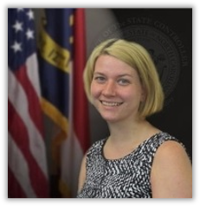
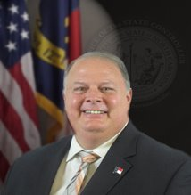
Presenter Spotlight 3
Laura Lee
Michael Euliss
Communications/Learning & Development
NC Office of the State Controller

Slide 13
Training
Training Exceptions: Please ensure NCFS security role training is completed prior to the 60-day security access exception expiration date:
CFO Request for Training Exception: 800.02 Request for Security Access (NCFS)
Follow these steps to sign up for training right away: NCFS Training Success Checklist
Redwood Interface: Web based trainings impacted by the Redwood changes are being updated.

Slide 14
Design and Accessibility Updates
NCOSC.gov

Slide 15
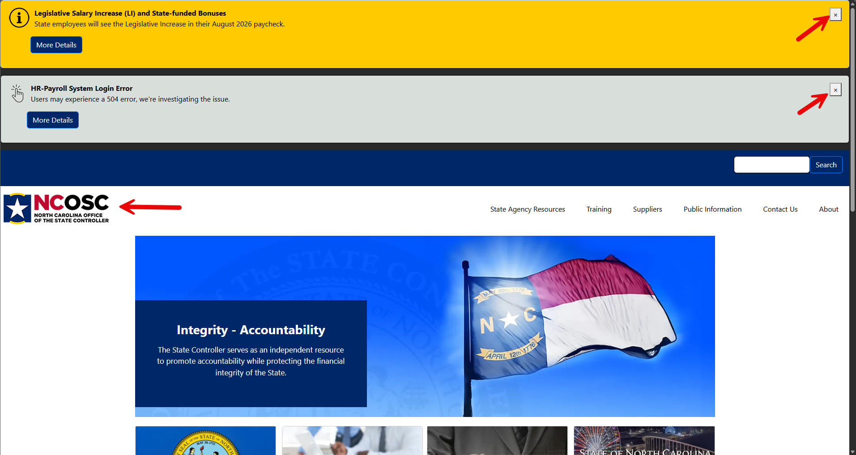
New Look / New Features

Slide 16
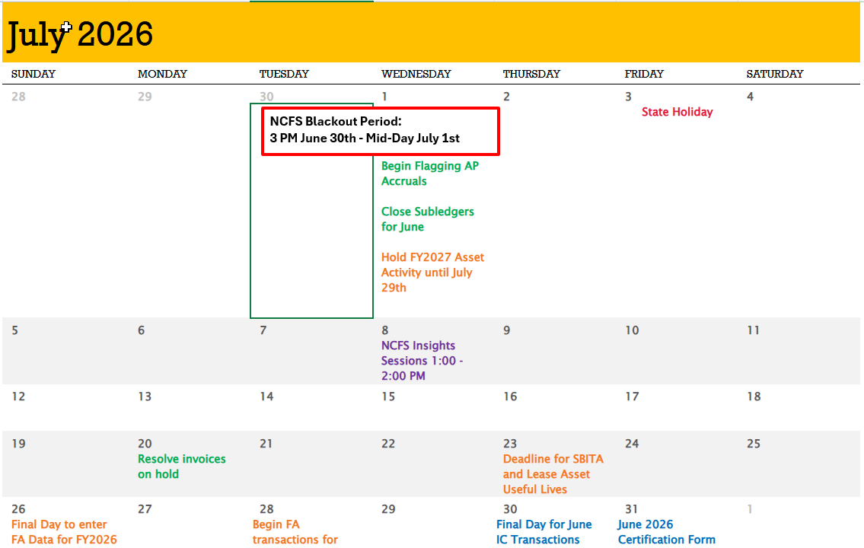
Current NCFS Functional Calendar

Slide 17
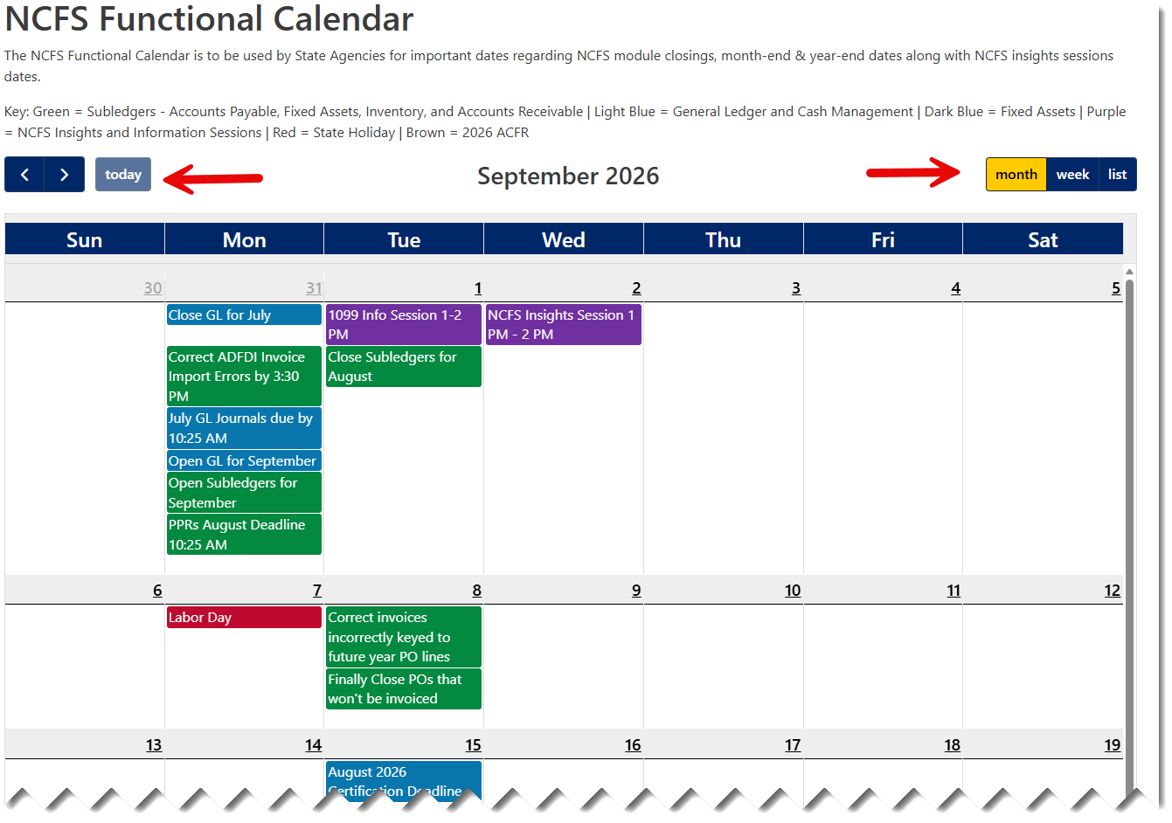
Future Look and Feel

Slide 18
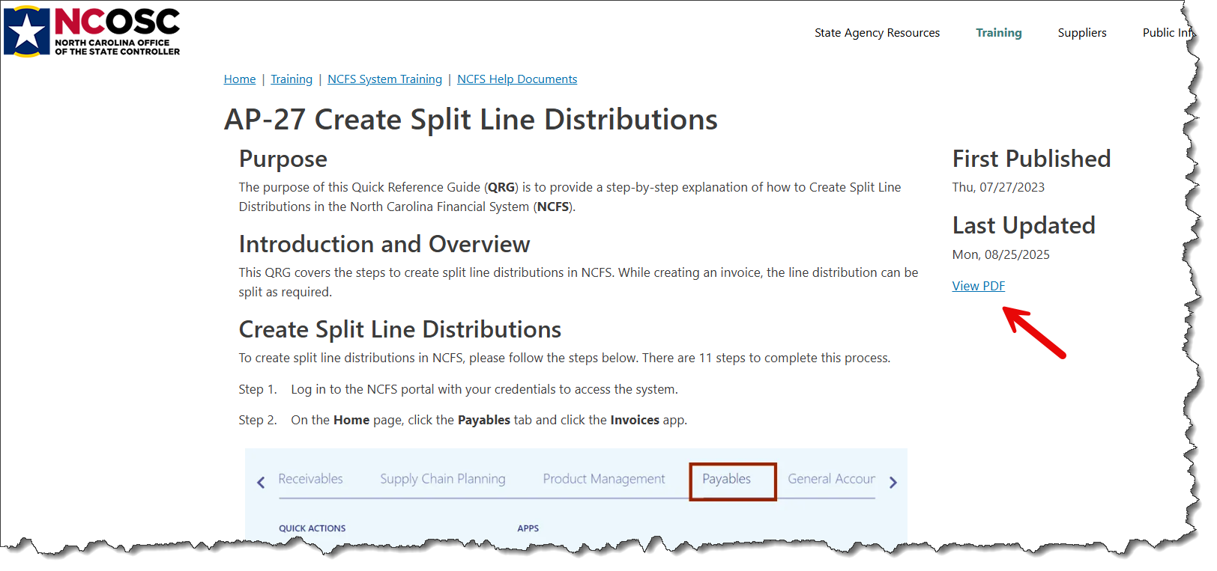
Help Documents – PDF Feature (1 of 3)

Slide 19
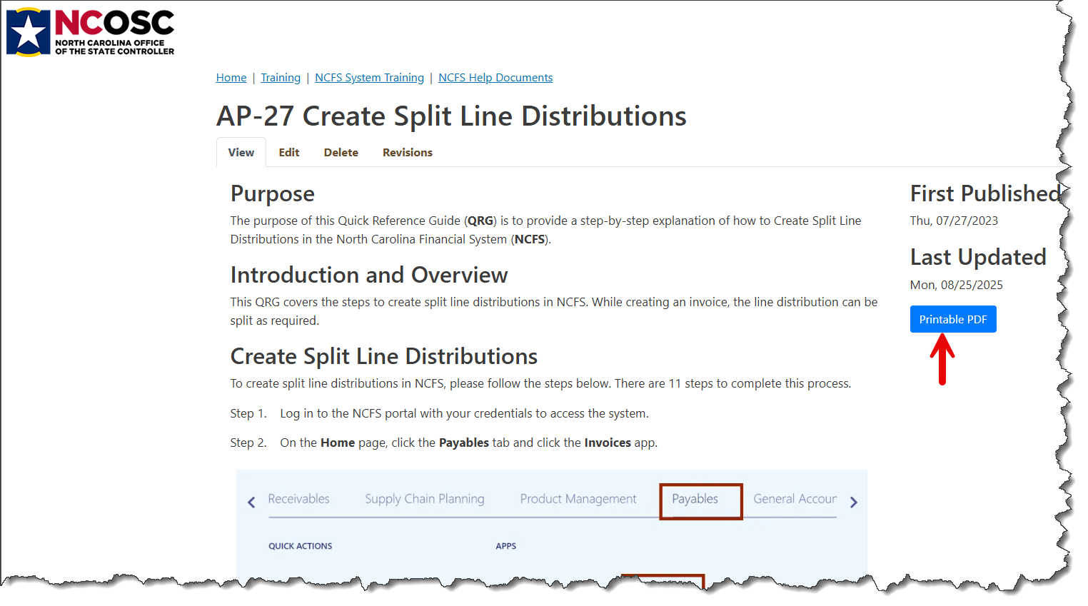
Help Documents – PDF Feature (2 of 3)

Slide 20
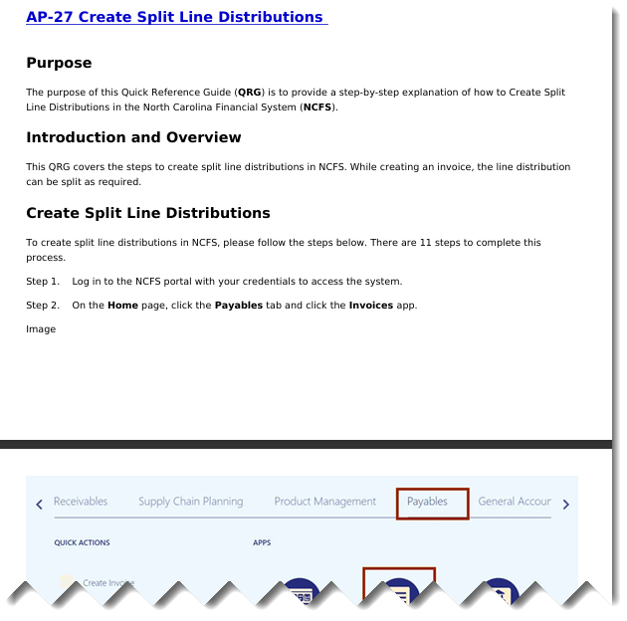
Help Documents – PDF Feature (3 of 3)

Slide 21
Additional New Features
Coming soon – New BEST customer service area
In progress – update and review of all forms for security and accessibility.

Slide 22

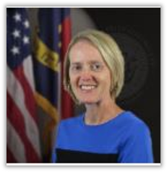
Presenter Spotlight 4
Lena Andrade
Jan Prevo
North Carolina Financial System
NC Office of the State Controller

Slide 23
Fall Engagement Touchpoints
Fall touchpoint emails requesting updated distribution lists comings/goings – have been sent.
~54 Sessions will be held with NCFS Users from September – October across Agencies and Universities.
Invitations will be sent this week.
We will be sharing a pre meeting survey to attendees.
  NCFS Agency Touchpoint Pre-Meeting Survey
  NCFS Interface Touchpoint Pre-Meeting Survey

Slide 24
NCFS Insights Attendance

Slide 25
September 2026 Functional Calendar
Dates | Events
September 1 | Close Subledgers for August 1099 Information Session 1:00 – 2:00 PM
September 2 | NCFS Insights Session 1:00 – 2:00 PM
September 7 | State Holiday
September 8 | Finally Close POs That Won’t Be Invoiced Correct Invoices Incorrectly Keyed To Future Year PO Lines
September 15 | August 2026 Certification Deadline
September 21 | Resolve Invoices On Hold
September 29 | Final Day For August IC transactions – Deadline 10:25 AM IC Module Closed For August Open IC Module For October
September 30 | August GL Journals Due By 10:25 AM PPRs September Deadline – 10:25 AM Open GL & Subledgers For October Close GL For August Correct ADFDI Invoice Import Errors By 3:30 PM

Slide 26
October 2026 Functional Calendar
Dates | Events
October 1 | Close Subledgers for September Begin Escheats Activities In Accordance With DST Guidelines
October 5 | Finally Close POs That Won’t Be Invoiced Correct Invoices Incorrectly Keyed To Future Year PO Lines
October 7 | NCFS Insights Session 1:00 – 2:00 PM
October 14 | September 2026 Certification Deadline
October 19 | Resolve Invoices On Hold
October 29 | Final Day For September IC transactions – Deadline 10:25 AM IC Module Closed For September Open IC Module For November
October 30 | September GL Journals Due By 10:25 AM PPRs October Deadline – 10:25 AM Open GL & Subledgers For November Close GL For September Correct ADFDI Invoice Import Errors By 3:30 PM

Slide 27
What’s Next?
Session | Date | Time
1099 TCC Application Session (NCFS 1099 Reporting Agency CFOs Only) | September 1, 2026 | 1:00 – 2:00 PM
1099 TCC Application Office Hour (NCFS 1099 Reporting Agency CFOs Only) | September 22, 2026 | 1:00 – 2:00 PM
NCFS Escheat Info Session | September 28, 2026 | 1:00 – 2:00 PM
NCFS Insights Session | October 7, 2026 | 1:00 – 2:00 PM
NCFS Fall Touchpoints | September – October 2026

Slide 28
Reference Links
2026 Communications Archives (Insights, Month End, and Fixed Asset Info)
Agency Year-End Info (User Checklist, AP Accrual Sessions)
GEN-05 Schedule Reports and Manage Report Output
NCFS Change Request Intake Form
NCFS IC Contacts – Check your Agency/University/Interface Group and update if needed.
NCFS Functional Calendars
NCFS Gen-11 Reference Links
NCFS Help Documents
NCFS Pre-Built Reports
NCFS Production (Oracle Cloud)
NCFS Resources
NCFS Security Administrators
NCFS Security Roles
NCFS System Training
NCFS Year-End Resources
BRIDGE Updates
BRIDGE Webpage

Slide 29
Thank you
Thank you!
For questions or assistance, contact ncfs@ncosc.gov.

