Slide 1
NCFS CFO Presentation for 2026 1099s
July 28, 2026

Slide 2

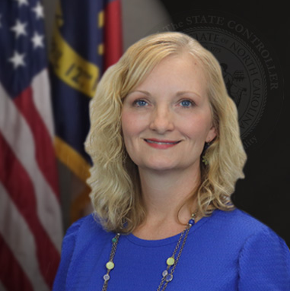




Who is here from OSC today?
Kathy Tolbert
Tax & Cost Allocation Compliance Manager
Gwen Earp
NCFS Materials Manager
Crystal Cole
NCFS Materials Business
Systems Analyst
Jeramee Kerl
Tax Compliance Analyst
Taylor Brumbeloe
NCFS Deputy State Controller
Jennifer Pacheco
Audit, Risk, & Compliance
Director

Slide 3
Why are we here today?
To inform NCFS Agencies of important and major changes regarding 1099 Tax Reporting.
Major changes being rolled out by the IRS are prompting these changes.
  The IRS is retiring the FIRE (Filing Information Returns Electronically) system currently used by OSC to file 1099s electronically on behalf of NCFS agencies.
  Starting tax year 2026, the IRS is requiring that 1099s be submitted to their new IRIS (Information Returns Intake System) portal.

Slide 4
What is changing?
After extensive analysis of the new IRIS portal guidelines, we have determined that it is no longer reasonable for OSC to file 1099s on behalf of agencies.
Starting in early 2027 for the 2026 tax reporting year, each NCFS agency will become responsible for filing their own 1099s using the new IRIS portal.

Slide 5
What was analyzed?
Original 1099 Transmission Process
1099 Corrections Process
IRIS Portal Access
The new IRIS portal only allows for two methods of bulk 1099 tax filing:
1. Application to Application (A2A):The A2A method would require that Oracle send the 1099 reporting information directly to the IRIS portal which Oracle does not currently support due to the complexity and volume of statewide 1099 reporting.
2. Template upload within the IRIS portal: Oracle does support the IRIS template process by providing a csv file of 1099 reporting data by form type (NEC, MISC, G) that can be added to the corresponding IRIS templates for upload in the portal.
Once original 1099s are submitted within the IRIS portal, all 1099 corrections must be done manually within the IRIS portal.
The original IRIS submission creates a record that should be manually selected and edited within the portal.
1099 $0 Correction invoices would no longer be needed in NCFS.
Corrections in the IRIS portal would be available long after the OSC determined corrections filing deadline.
For OSC to continue 1099 filing for NCFS agencies, OSC would require access to each agency’s IRIS portal for original submission and corrections.
This would significantly increase risk and liability for human error.
The IRS only allows a limited number of users to transmit 1099s within the portal.
If there are supplier mismatches during submission, agencies are better equipped to resolve those errors.

Slide 6
New Process Advantages
Control Over Filing Timelines - Agencies will have more control over 1099 timelines and data submission and will not be dependent on OSC for submitting original files and corrections on their behalf. Corrections can be filed immediately within the IRIS portal rather than waiting for the OSC determined correction filing date.
Form Printing - The IRIS portal includes functionality for printing IRS approved 1099 forms in real time once the 1099 is submitted to the IRS. Agencies will not be dependent on OSC to provide updated 1099 forms within our reports for printing.
Filing Extension - Agencies can choose to file a 30-day extension within the portal if needed.
Corrections Process – Agencies would no longer need to record $0 invoices in NCFS to trigger the corrections process. The IRIS portal will also replace the need for manual paper corrections after the OSC correction period has passed.
IRIS Application Process – Application process is easy to complete and typically approved quickly.

Slide 7
How will OSC continue to support NCFS agencies?
OSC will continue to work with Oracle to ensure that the system provided csv file works as expected in conjunction with the IRIS portal upload template.
OSC will continue to support the NCFS 1099 Invoice Maintenance report.
OSC will hold future information sessions regarding:
  TCC (Transmitter Control Code ) Application Information
  The IRIS Portal 1099 filing process
OSC will send reminders and checklists to help agencies get set up for the new process.

Slide 8
Next Steps
Continue to flag 1099 payments in NCFS in a timely manner.
Determine who at your agency will be included on the TCC Application and have access to the IRIS portal.
Prepare to sign a new Delegation of Disbursement Authority with OSC.
Sign up for IRS News Bulletins.
Watch for future 1099 communications and informatiion sessions held by OSC.

Slide 9
Thank you
Thank you!
For question or assistance, contact ncfs@ncosc.gov.

