Slide 1
Information Returns Intake System (IRIS)
Transmittal Control Code (TCC) Application

Slide 2
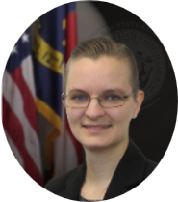
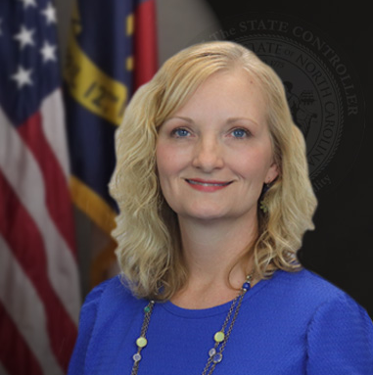

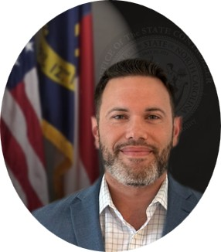
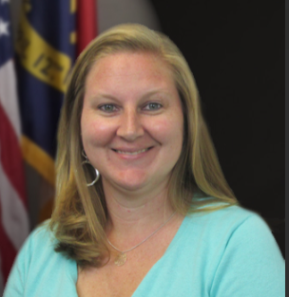

Who is here from OSC today?
Kathy Tolbert
Tax & Cost Allocation Compliance Manager
Gwen Earp
NCFS Materials Manager
Crystal Cole
NCFS Materials Business
Systems Analyst
Jeramee Kerl
Tax Compliance Analyst
Taylor Brumbeloe
NCFS Deputy State Controller
Jennifer Pacheco
Audit, Risk, & Compliance
Director

Slide 3
Summary of 2026 1099 Communications
Starting early 2027 for the 2026 1099 tax reporting year, agencies will be responsible for filing their own 1099s using the new IRIS (Information Returns Intake System).
OSC will continue to add communications, presentations, and recordings to the 1099 Information section of our website, including:
July 28th 2026 CFO Presentation for 2026 1099s (PowerPoint)
NCFS 1099 Process Changes for Tax Year 2026
Agency Steps for 1099 TCC Application
Today’s session is for CFOs (or authorized delegate) with a focus on the Transmitter Control Code (TCC) Application process.

Slide 4
IRIS System and TCC
Starting tax year 2026, the Internal Revenue Service (IRS) is requiring that 1099s be submitted to their new IRIS (Information Returns Intake System) portal.
A Transmitter Control Code (TCC) is a 5-character alphanumeric code that identifies your agency as the submitting entity within IRIS.
Agencies must apply through the IRIS application for TCC. IRS processing may take up to 45 calendar days from submission.
TCCs are not interchangeable between intake systems. An old FIRE (Filing Information Returns Electronically) TCC cannot be used in IRIS.
Key Dates
September 30th – Submit TCC Application to the IRS and complete your Delegation of Disbursement Authority on OSC’s website.
October 1st – Open a ticket with the OSC Contact Center to provide your agency’s TCC tracking number and a list of ROs and ADs for future communications.

Slide 5
Determine Authorized Users
Responsible Officials (ROs)
  ROs are “individuals with responsibility and authority over the business entity”. They are the first point of contact for the IRS and should have the authority to sign on behalf of the agency.
  They can sign original/revised TCC applications, e-file information returns within IRIS, and are responsible for ensuring compliance with all applicable IRS requirements. A minimum of 2 ROs are required for the application.
Authorized Delegates (ADs)
  ADs have the same privileges as an RO except: AD cannot sign the initial TCC application and cannot add/edit/delete an RO. A maximum of 2 individuals allowed, inclusion of these are optional.
Contacts
  Contacts are authorized to e-file information returns within IRIS and must be available for inquiries from the IRS on a daily basis. A minimum of 2 contacts are required.

Slide 6
ID.me Accounts
The IRS requires an ID.me account to access IRS online services (including the TCC application and the IRIS portal).
  An ID.me account provides secure digital identify verification.
  An individual can only have one ID.me account.
All authorized users must have an ID.me account. Please advise applicable personnel to set up an account before adding them to the TCC application.
For more information, please visit these links:
IRS webpage for account creation: Creating an account for IRS.gov
ID.me help article regarding the IRS: IRS and ID.me
ID.me help article: Add a work or business email to your ID.me Wallet

Slide 7
TCC Application
Please first review IRS Publication 5903 (Rev. 12-2024).
A Responsible Official (RO) must initiate the IRIS Application for TCC by following these steps:
  Select the ‘Access IRIS application for TCC’ button on the IRIS application for TCC page on the IRS website.
  Sign in with their ID.me account.
  On the ‘Select Your Organization page’, the RO must select ‘Individual’ until the TCC Application is in “Completed” status.
Reminders:
Submit the TCC Application by September 30th.
IRS processing may take up to 45 calendar days or more from submission.

Slide 8
Overview of Pages in TCC Application
1. Firm Information
2. Application Details
3. Software Packages
Select business structure from drop down menu.
Enter your agency information, including Agency Legal Name and Employer Identification Number (EIN).
Select “No” for the question “Will you participate in the Combined Federal/State Filing (CF/SF) program?”
Select “Issuer” as the role.
Select “Portal” as the transmission method.
This page is not applicable for state agencies.
If this page appears, select “continue” to skip.

Slide 9
Overview of Pages in TCC Application - Continued
4. Authorized Users
5. Application Comments
6. Application Summary
Add the ROs, ADs, and Contacts.
Not required.
Verify all information shown is complete and accurate before selecting “continue”.
7. Application Submission and Terms of Agreement
Each RO must sign the Application Submission page using their 5-digit PIN.
Please screenshot or otherwise note the tracking number you receive once the application is submitted.
After the application moves to “Completed” status, ADs will be able to sign revisions.
When the application has been approved, the IRS will mail a TCC Acceptance Letter.

Slide 10
After TCC Application Submission
Agencies need to complete a new Delegation of Disbursement Authority that includes updated language regarding tax compliance and reporting requirements.
  Please visit the Delegation of Disbursing Authority – Agencies and Universities page.
  Select the “Agencies and Universities Powerform” option to complete the DDA Docusign.
  Submit new DDA by September 30th.
Agencies should email the OSC Contact Center ncfs@ncosc.gov to:
  Provide names and email addresses for your agency’s Responsible Officials.
  Provide names and email addresses for your agency’s Authorized Delegates.
  Provide your TCC Application Tracking Number from the application submission.
  Due October 1st: This information will be used to distribute future 1099 related communications and information session details.

Slide 11
TCC Application Assistance
OSC will also hold a 1099 Application Office Hour Teams meeting on September 22, 2026, at 1pm to answer CFO questions regarding the application process in advance of the September 30, 2026, deadline.
NCFS Contact Center
Email: ncfs@ncosc.gov
919-707-0795
866-292-4314

Slide 12
Thank you
Thank you!
For question or assistance, contact ncfs@ncosc.gov.

