Slide 1
NCFS Insights
August 5, 2026

Slide 2

Welcome
Housekeeping
Introductions

Slide 3
Agenda
Welcome
Functional
Technical
Security
Training
User Engagement
Closing/Q&A

Slide 4
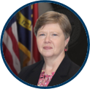

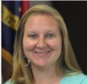
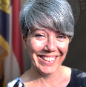

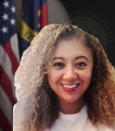
Presenters
Jessica Wilkins
Data Maintenance Lead
Darlene Langston
Finance Lead
Taylor Brumbeloe
NCFS Deputy State Controller
Dawn Parrish
Learning & Development Special Projects Coordinator
Michael Euliss
Communications & Training Director
Lena Andrade
NCFS User Engagement
Lead

Slide 5
Polling Question
Which area best represents where you or your team could use more support?
Year-End
ACFR
NCFS Training (Help Documents, Course Refreshers)

Slide 6
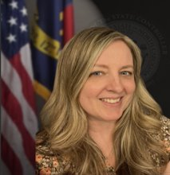
Presenter Spotlight
Jessica Wilkins
North Carolina Financial System
NC Office of the State Controller

Slide 7
ePay Phone Verifications
​For Supplier, Agency, and OSC protection, we implemented this process to help reduce potential payment fraud.
Phone calls are being made for ePay change requests.
  Using verified phone numbers.
  Confirming bank information and change request information.
  Documenting conversations.

Slide 8
ePay Fraud Warning Signs
​Unexpected request to change banking information
Request creating urgency
New email address or slight change to existing email addresses
Payment instructions changed without explanation
New/Different Bank
Refusal to verify by phone
Request to bypass standard process

Slide 9
ePay Reminders
​Review all Supplier Electronic Payment forms prior to sending them to NC OSC for review.
  Ensure all required fields are completed.
  Ensure all required bank documentation is included.
Do not fill out any Supplier forms on behalf of the supplier or make any corrections to the form on behalf of the supplier.​
Do not provide Suppliers with any NCFS system information: TAX ID/EIN number, addresses, bank names or account number details. It is imperative that the supplier provides this information on the Electronic Payment Request form to help prevent fraud.​

Slide 10
ePay Reminders
​Don’t rely solely on email communication – Phone calls can help verify identity and confirm other critical information.
Always send ePay emails and responses to ncfsepay@ncosc.gov and not to individual team members.
Keep OSC in the loop – reach out immediately if you suspect fraud or are unsure of how to communicate with a supplier. Email ncfsepay@ncosc.gov or ncfs@ncosc.gov.

Slide 11
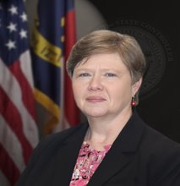
Presenter Spotlight 2
Darlene Langston
North Carolina Financial System
NC Office of the State Controller

Slide 12
August Key Dates
August 3rd - Accounts Payable and Accounts Receivable entries recorded in NCFS.
August 7th (instead of 4th per Laura Klem) – Proprietary funds record all Pension, OPEB and Compensated Absence entries.
August 5th – All lease and Subscription Bases IT Asset entries recorded in NCFS.
August 12th – All transfer and due to/due from related entries recorded in NCFS.
August 14th, 21st, 25th, or 28th - ACFR package due to OSC.

Slide 13
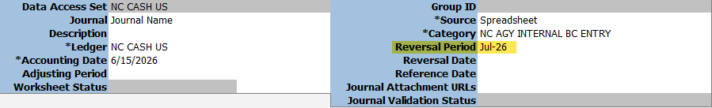
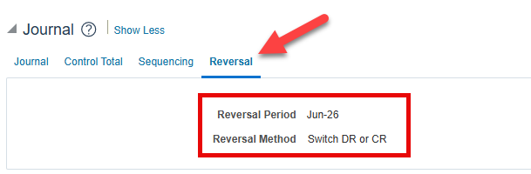
General Ledger – Auto Reversing Journal Entries – Cash Ledger
NC AGY INTERNAL BC category can now be set to automatically reverse in the NC CASH US ledger. The setting can be added on the Journal screen or on the spreadsheet upload.

Slide 14
GL - Auto Reversing Journal Entries – Cash Ledger
Reversal Period: must be for an open period.
Reversal Method: manually, either change the sign or switch DR or CR. For the spreadsheet upload, it defaults to switch DR or CR.
The AutoReverse process occurs at 6:15 a.m. Monday – Friday.
Does not work in the NC ACCRUAL US or NC MODIFIED ACCRUAL US ledger.

Slide 15
GL –Auto Reversing Journal Entries – Accrual Ledgers
NC AGY REVERSING ACCR category should be used for entries to AutoReverse in the NC ACCRUAL US or NC MODIFIED ACCRUAL US ledgers.
Select the Category NC AGY REVERSING ACCR on either the spreadsheet upload or manual journal entry.
When the period of the original journal is closed, all entries with that category will AutoReverse and post in the following period.
OR Enter the reversal period as indicated on the previous slides. Monitor ACFR entries for the 13_Jun-26 period posted late in August or September to the accrual ledgers.
  If the July NC CASH US ledger is closed, the AutoReverse for NC AGY REVERSING ACCR entries will not AutoReverse since they are scheduled to reverse in July.
  You can select Aug-26 or Sep-26 as the reversal period to ensure that the journals reverse properly for the next fiscal year.

Slide 16
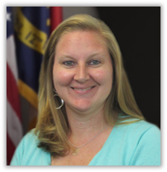
Presenter Spotlight 3
Taylor Brumbeloe
North Carolina Financial System
NC Office of the State Controller

Slide 17
OSBM BRIDGE Project – Phase 1
Phase 1:
Supports development of base budget operations
User Acceptance Testing in progress
End User Training happening through August & September
Scheduled to go-live in September
Additional information regarding specific roll out dates will be shared by the OSBM team in the coming weeks!
All Phase I Base Budget users will be required to complete three BRIDGE training courses:
  Introduction to BRIDGE (BRI100) *Self-paced online
  Base Budget Creation and Adjustment(BRI200) *Instructor-led
  Budget Reporting(BRI300) *Instructor-led
Registration for training sessions will open in the Learning Management System (LMS) beginning in August. More details on course registration will be shared this week!

Slide 18
OSBM BRIDGE Project – Phases 2 & 3
Phase 2:
Supports budget execution functionality
Currently
Scheduled to go-live in July 2027
Phase 3:
Supports Governor’s Recommended Budget processes
Scheduled to go-live in December 2027
Sign up for BRIDGE updates!

Slide 19

Presenter Spotlight 4
Dawn Parrish
North Carolina Financial System
NC Office of the State Controller

Slide 20
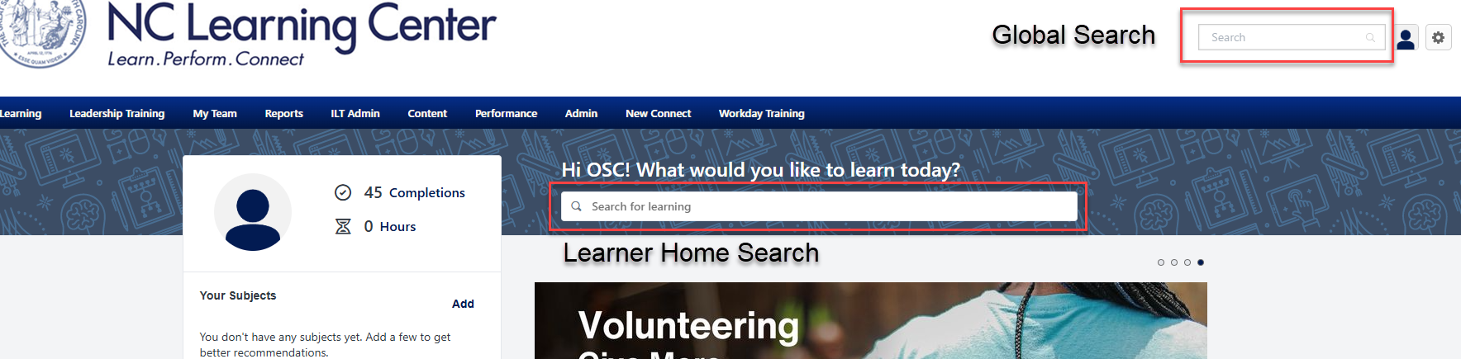
Training – LMS Updates
LMS Learner Home Page
Global Search: search the whole Cornerstone system
Learner Home Search: search for learning and training opportunities

Slide 21
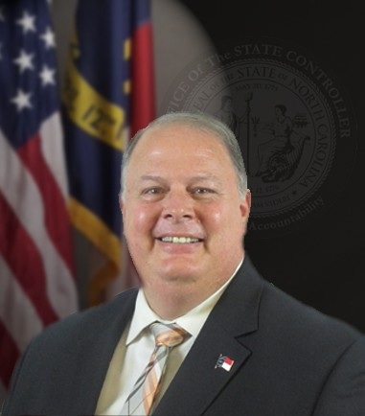
Presenter Spotlight 5
Michael Euliss
North Carolina Financial System
NC Office of the State Controller

Slide 22
Design and Accessibility Updates
NCOSC.gov

Slide 23
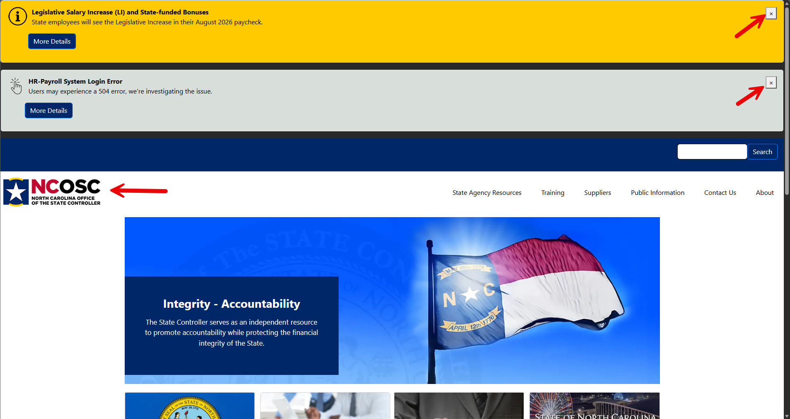
New Look / New Features

Slide 24
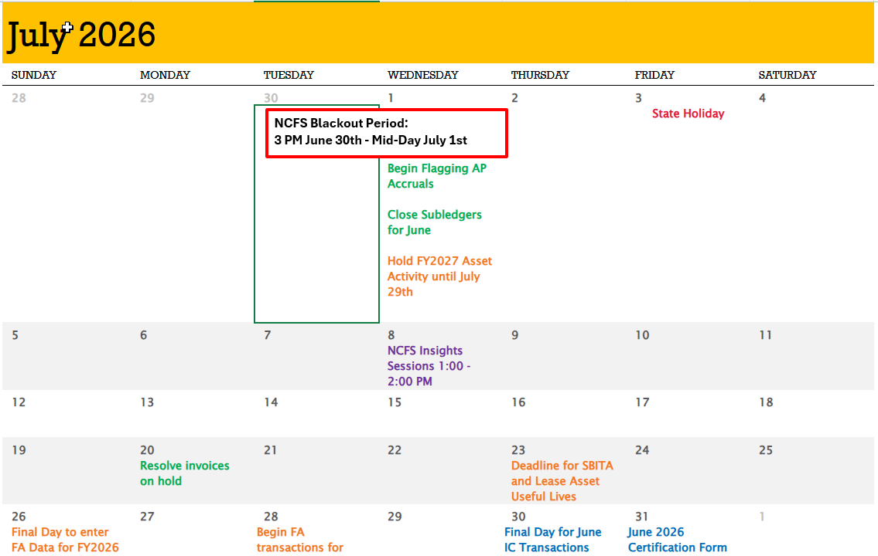
Current NCFS Functional Calendar

Slide 25
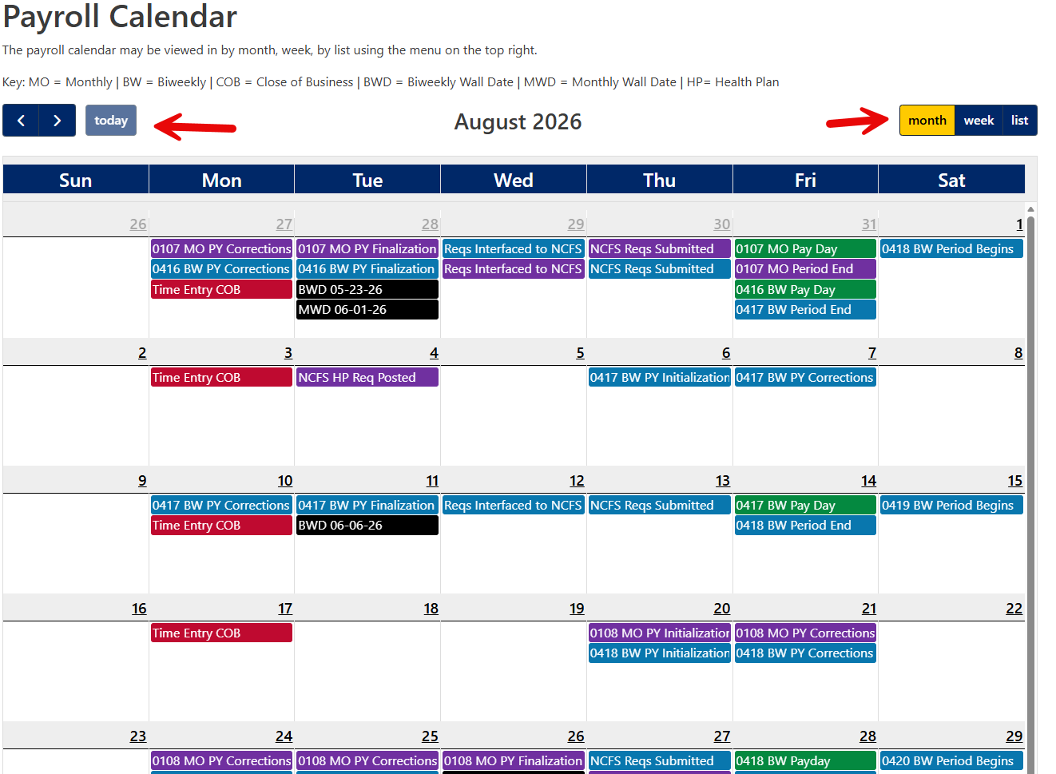
Future Look and Feel

Slide 26
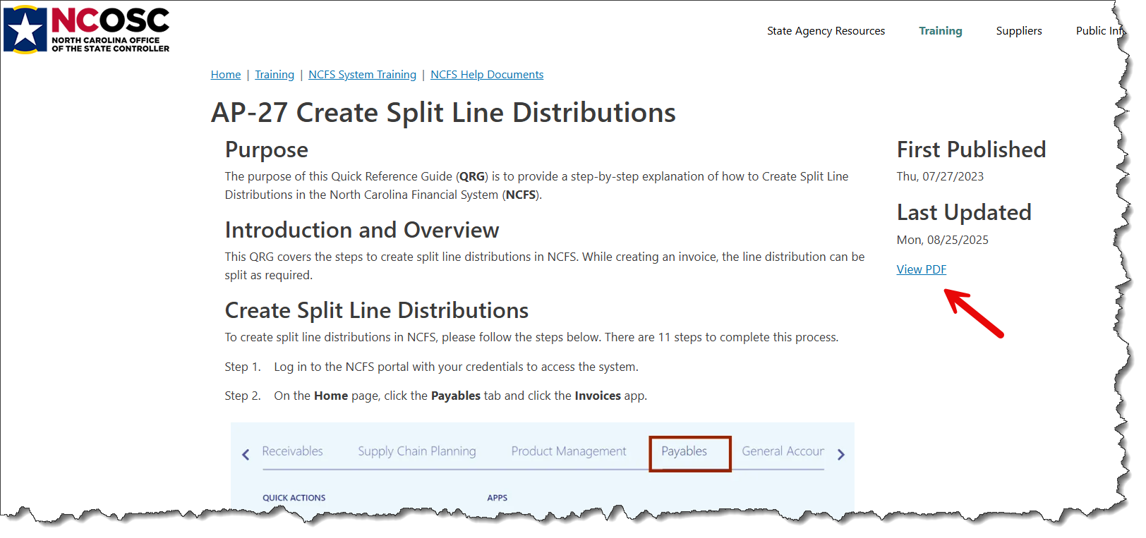
Help Documents – PDF Feature

Slide 27
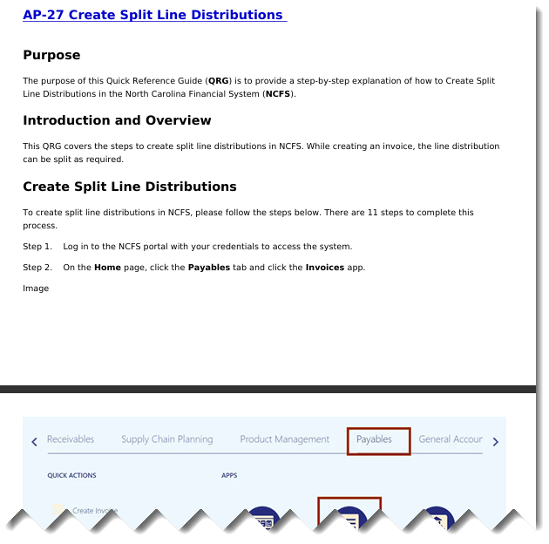
Help Documents – PDF

Slide 28
Additional New Features
Coming soon – New BEST customer service area
Coming soon – New Functional Calendar format
In progress – update and review of all forms for security and accessibility.

Slide 29

Presenter Spotlight 6
Lena Andrade
North Carolina Financial System
NC Office of the State Controller

Slide 30
OTBI Reminder & Fall Engagement Touchpoints
OTBI User Request survey is now closed!
  72 Responses
  67% New OTBI Users / 33% Have prior OTBI experience
Emails to CFOs to review BI Author/OTBI requests
NCFS Help Documents - OTBI
Fall touchpoint emails will be sent mid August
Update distribution lists for touchpoints – comings/goings

Slide 31
NCFS Insights Attendance

Slide 32
August 2026 Functional Calendar
Dates | Events
August 1 | Accrual Entries Should Be Recorded by 8/1
August 3 | Close Subledgers For July Finally Close POs That Won’t Be Invoiced Correct Invoices Incorrectly Keyed To Future Year PO Lines
August 5 | NCFS Insights Session 1:00 – 2:00 PM
August 14 | July 2026 Certification Deadline
August 17 | Resolve Invoices On Hold
August 28 | Final Day For July IC Transactions – Deadline 10:25 AM IC Module Closed For July Open IC Module For September
August 31 | July GL Journals Due By 10:25 AM PPRs August Deadline 10:25 AM Open GL & Subledgers For September Close GL For July Correct ADFDI Invoice Import Errors By 3:30 PM

Slide 33
September 2026 Functional Calendar
Dates | Events
September 1 | Close Subledgers for August
September 2 | NCFS Insights Session 1:00 – 2:00 PM
September 7 | State Holiday
September 8 | Finally Close POs That Won’t Be Invoiced Correct Invoices Incorrectly Keyed To Future Year PO Lines
September 15 | August 2026 Certification Deadline
September 21 | Resolve Invoices On Hold
September 29 | Final Day For August IC transactions – Deadline 10:25 AM IC Module Closed For August Open IC Module For October
September 30 | August GL Journals Due By 10:25 AM PPRs September Deadline – 10:25 AM Open GL & Subledgers For October Close GL For August Correct ADFDI Invoice Import Errors By 3:30 PM

Slide 34
What’s Next?
  NCFS Insights Session – September 2nd 1:00 pm - 2:00 pm
  Fall Touchpoints – September 2026

Slide 35
Reference Links
2026 Communications Archives (Insights, Month End, and Fixed Asset Info)
Agency Year-End Info (User Checklist, AP Accrual Sessions)
GEN-16 Update Print Engine in the Financial Reporting Studio (FRS)
NCFS Change Request Intake Form
NCFS IC Contacts – Check your Agency/University/Interface Group and update if needed.
NCFS Functional Calendars
NCFS Gen-11 Reference Links
NCFS Help Documents
NCFS Newsletter – July 2026
NCFS Pre-Built Reports
NCFS Production (Oracle Cloud)
NCFS Resources
NCFS Security Administrators
NCFS Security Roles
NCFS System Training
NCFS Year-End Resources
OTBI Quick Reference Guides
Quick Tips for ACH Request Processing (ePay Processing)
Smart View Information (QRGs, Presentations, and Recordings)

Slide 36
Thank you
Thank you!
For questions or assistance, contact ncfs@ncosc.gov.

