Slide 1
NCFS Insights
June 3, 2026

Slide 2

Welcome
Housekeeping
Introductions

Slide 3
Agenda
Welcome
Functional
Technical
Security
Training
User Engagement
Closing/Q&A

Slide 4
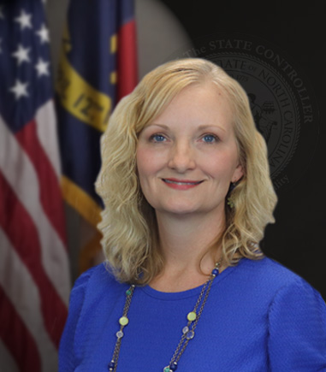
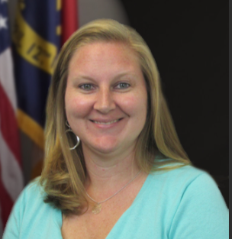
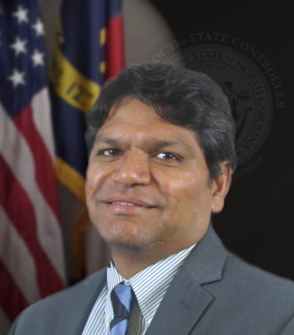

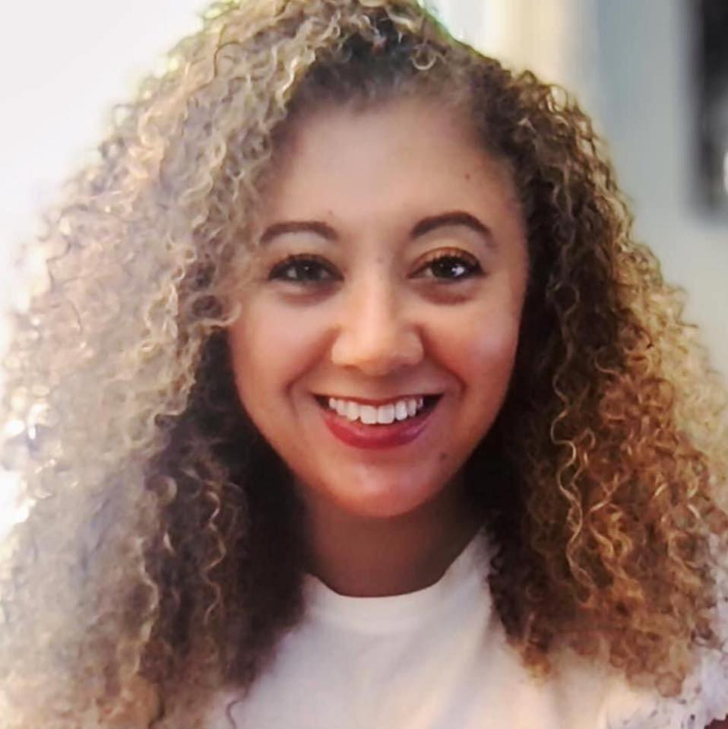
Presenters
Gwen Earp
Business Systems Manager
Taylor Brumbeloe
NCFS Deputy State
Controller
Ram Kuntamukkala
Application Systems Manager
Dawn Parrish
NCFS Training
Lena Andrade
NCFS User Engagement
Lead

Slide 5
Polling Question
What NCFS resources are most helpful in your daily processes?
NCFS Communications Web Page
NCFS Help Documents (Reports, Job Aids, QRGs)
Instructor Led Training Courses
Web Based Training Courses

Slide 6

Materials
Gwen Earp
Business Systems Manager
North Carolina Financial System
NC Office of the State Controller - OSC

Slide 7
June Key Dates
Close out Cash Advances and Resolve Credit Memos by June 19th.
Final June PPR’s Submitted for Approval: 10:25am June 29th - No PPR Approvals: June 30th to July 1st (Resume on July 2nd).
Finally Close POs that should not carry forward to FY27 by 3pm on Tuesday, June 30th.
Approve and Validate all unpaid invoices by 3pm on Tuesday, June 30th.
NCFS Blackout Period: 3pm June 30th to Mid-Day July 1st. No User Access During this period while PO Budget Carry Forward is processing.
No new Requisitions, POs, PO Change Orders, or Receipts from eProcurement during blackout period.
Begin Flagging AP Accruals July 1st.
FY27 Fixed Asset Freeze July 1st to July 28th - Final Day for FY26 Fixed Asset Data is July 26th.

Slide 8
Year-End Updates
The Year End Checklist has been updated on OSC's website.
  Checklist was updated on May 15th to include some OSBM deadlines.
  Please download and use the updated version.
Year End Accrual session will be held Monday, June 15th at 1:00 pm.
  NEW for Accruals:
    The INT-AP-030 Party Payment Interface has been updated to receive accrual codes in the interface.
    This interface is currently used by DHHS, DPS, Agriculture, and Secretary of State.
    OSC emailed the subsystem technical contacts for these agencies on May 15th to let them know this functionality is now available.
    Subsystems will need to test files with NCFS prior to sending accrual codes in July.
    Please submit a ticket to request file layout updates and testing.

Slide 9
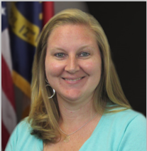
Budget System Replacement Project Updates
Taylor Brumbeloe
Deputy State Controller, NCFS
North Carolina Financial System
NC Office of the State Controller - OSC

Slide 10
BSR Project – What’s New
New Project Name!
The Budget System Replacement Project is now the BRIDGE!
Budget
Reporting and
Integrated
Development,
Governance, and
Execution
Thanks to all who submitted ideas to OSBM! 133 submissions from 28 agencies!

Slide 11
BRIDGE Project Phase 1
Phase 1
  Development of base budget operations for execution of biennial base budget this fall.
  Project management planning & general design phases complete.
  System build work in Oracle EPM is in progress.
  Phase 1 sprints scheduled to conclude in June.
  User Acceptance Testing to be completed in June & July.
  Phase 1 Target Date: September 1, 2026

Slide 12
BRIDGE Project Future Phases
Phase 2 (Budget Execution Functionality) & Phase 3 (Support Governor’s Recommended Budget process)
  Planning & general design are progressing concurrently with Phase 1.
  Planning expected to conclude in June, followed by 6 sprints (~6 months) to work through build out.
  Phase 2 Target Date: July 1, 2027
  Phase 3 Target Date: December 1, 2027

Slide 13
BRIDGE Project Training
OSBM preparing for Statewide BRIDGE training.
Trainers being hired.
Training schedules & logistics will be shared as they become available.

Slide 14
Technical Updates
Ram Kuntamukkala
Applications Systems Manager
North Carolina Financial System
NC Office of the State Controller - OSC

Slide 15
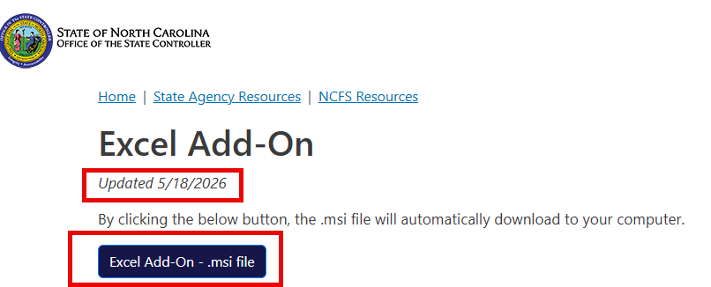
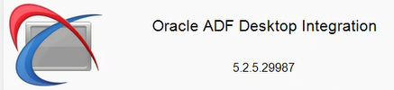
ADFDI Update ( MS-Excel Plugin)
A new version of the ADFDI add-in rolled out by Oracle as part of 26B release.
Excel Add-on and instructions on how to install are available on NCOSC Website.
Once installed you should see the latest version on your desktop excel application.
Agencies may need to contact local IT team for installation assistance.

Slide 16
Training Update
Dawn Parrish
Learning and Development
Special Projects Coordinator
North Carolina Financial System
NC Office of the State Controller - OSC

Slide 17
Training – Updates
Updates
ACC103 in design
CM100
  Request the class: Contact Us | NCOSC
  The class will be assigned to you in LMS.
Security Role Procedure Reminder
What role do you need? NCFS Security Roles | NCOSC
Request the role from your security administrator. NCFS Security Administrators | NCOSC
Take the required training.
The role will be released to your position.

Slide 18
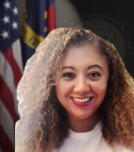
User Engagement
Lena Andrade
NCFS User Engagement Lead
North Carolina Financial System
NC Office of the State Controller - OSC

Slide 19
Feedback by Process Area - Agency

Slide 20
Feedback by Process Area – Interface Groups

Slide 21
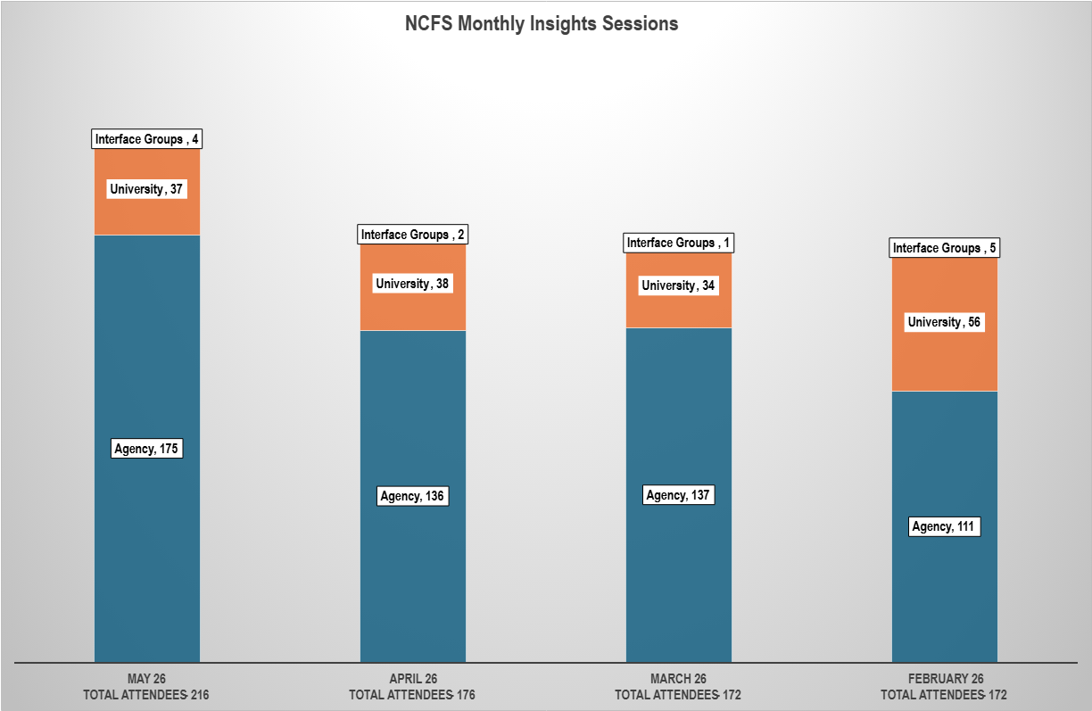
NCFS Insights Training
Session held since Feb 2026: 4
Topics for May included:
Smart View – Overview
ACFR Year End Reporting, Transfers and Reimbursements
Expense & Accounts Payable Updates
CCB Process Updates
NCFS Timeout Updates
Training Demos - Transfers And Adding IC Attachments
Next session: July 8th
NCFS Session Recordings

Slide 22
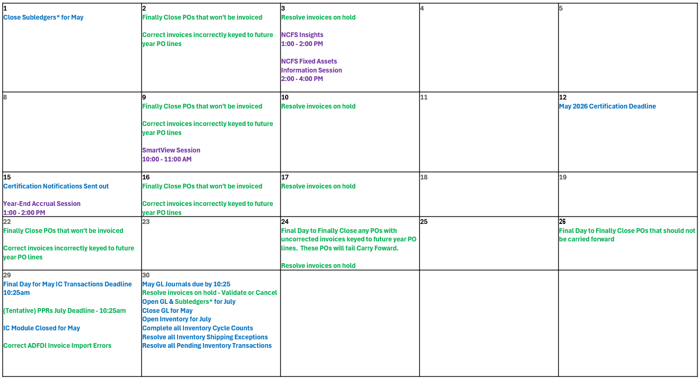
June 2026 Calendar
NCFS Blackout Period 3 PM June 30th - Mid-Day July 1st
*Subledgers – Accounts Payable, Fixed Assets, Inventory, and Accounts Payable

Slide 23
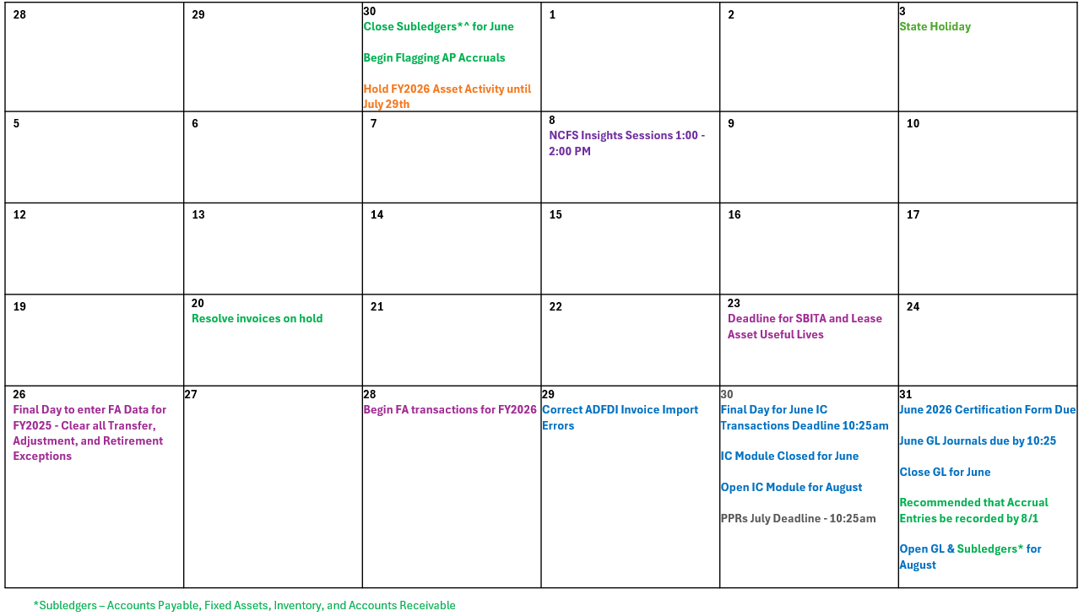
July 2026 Calendar
NCFS Blackout Period 3 PM June 30th - Mid-Day July 1st

Slide 24
What's Next?
  ACFR Planning Conferences – May to July
  NCFS Fixed Assets Session – June 3rd 2:00 pm - 4:00 pm (Immediately following Insights)
  Smart View Session – June 9th 10:00 am – 11:00 am
  Year-End Accruals Session – June 15th 1:00 pm – 2:00 pm
  NCFS Insights Session - July 8th 1:00 pm - 2:00 pm (Note date change from July 1)

Slide 25
Reference Links
ADFDI Excel Add-On
Invoice And PO Clean Up Actions
NCFS Change Request Intake Form
NCFS Communications Web Page
NCFS Pre-Built Reports
NCFS Production (Oracle Cloud)
NCFS Year End Checklist
OSC Year-End Financial Reporting Packages - Home (sharepoint.com)
QRG EX-09 Create and Manage Employee Information
Transfer Reports
IC Contacts - Check your Agency/University/Interface Group and update if needed.
NCFS Functional Calendars
NCFS Gen-11 Reference Links
NCFS Help Documents
NCFS Resources
NCFS Security Administrators
NCFS Security Roles
NCFS System Training

Slide 26
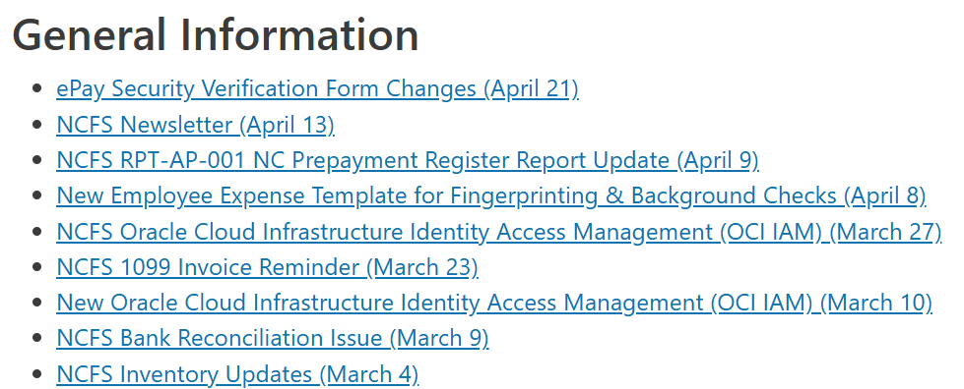
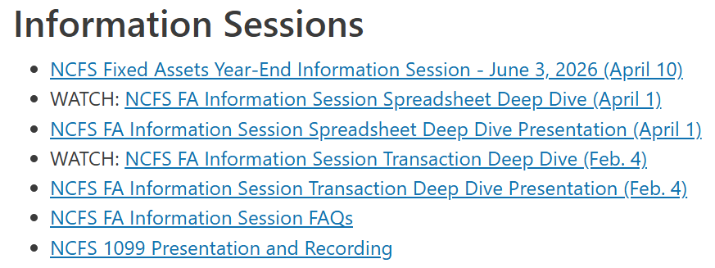
OSC Webpage Resources
Communication Archives

Slide 27

Questions & Answers
Give us your feedback!
Contact us: ncfs@ncosc.gov

