Slide 1
NCFS Fixed Assets Info Session
June 3, 2026

Slide 2

Level Setting
This Info Session is not a training and does not replace official NCFS trainings.
This meeting will be recorded and will be available online.
Please keep your microphone muted.
Please place any questions in the chat.
  Questions will be addressed at designated stopping points.
  Please keep questions general, not agency specific.
  Unanswered questions will be logged for follow up.
This information session is scheduled for 2 hours.

Slide 3
Info Session Topics
Importance of Fixed Assets
ACFR Expectations Regarding Fixed Assets
Fixed Assets Reporting
Fixed Assets Tips and Tricks
Capitalization Threshold Changes

Slide 4
Importance of Fixed Assets

Slide 5
Importance Of Fixed Assets (continued)
Reporting capital assets is required per GASB Codification Section 1400 and 102.01 - Statewide Accounting Policy - Capitalization/Classification.
ACFR worksheet 203
  Proper asset record keeping speeds up creation of ACFR package.
  Sign off at end of worksheet.
Less manual adjustments: Manual adjustments are time consuming.
Proper asset record keeping improves visibility into state spending.
Proper asset record keeping provides insight into what tools/materials need to be replaced.

Slide 6
Fixed Asset Impact To The General Ledger
  Asset depreciation expense account drives multiple accounts: Depreciation Expense Acct, Asset Clearing Acct, Asset Cost Accounting, and Depreciation Reserve
  Manual journal entries are not required; NCFS automatically makes journal updates.
    Errors upstream are automatically erroneous in the General Ledger.
    Payable errors not caught in Assets will be posted and propagated.

Slide 7
Key Asset Terms
Key Term | Definition
Capital Assets | An asset for which the costs to acquire are expensed over the life of that asset rather than in the period that it was incurred. The capitalization threshold amount is greater than or equal to $5,000 for NC.
Expense Assets | Assets acquired by NC under $5,000.
Source Line | A temporary record from an Accounts Payable invoice which is awaiting to be made into an asset. Booking Source line is a record from invoicing that has been flagged as a potential new asset. This means to take the invoice record and post it to the cash book as a full asset.

Slide 8
ACFR Expectations Regarding Fixed Assets

Slide 9
Fixed Asset Tasks Due By Fiscal Year End
  Manage all source lines prior to year end (RPTFA013 + Asset Dashboard).
  Clear all asset type mismatch errors (RPTFA012).
  Complete all adjustments, transfers to different accounts, retirements.
  Confirm all manual adjustments from past FY are in NCFS (restatements).

Slide 10
Year End Fixed Asset Dates
Task | Task Description | Start Date | Complete By Date
Hold FY2027 Asset activity | No FY2027 asset transactions should be placed from 7/1 until 7/28 when the July period opens. Confirm the Depreciation period on your fixed assets dashboard shows Jul-26 before entering FY2027 data. | 7/1 | N/A
Review SBITA and Lease Asset Useful lives and Depreciation | Review your RTU Leave and SBITA assets on the NC SWCAP Assets Report (FA008) to verify the correct useful lives are used for these assets and their LTD depreciation is correct. Submit a help desk ticket (ncfs@ncosc.gov) to correct assets by July 23rd. Additional details: FA-15 Adding an RTU Asset (Leased Asset) | N/A | 7/23
Fixed asset deadline | Last day to enter asset data for fiscal year is July 26. Year ending reports (Fixed Assets Outbound Interface to FCCS) are available. Agencies that miss this deadline should submit a help desk ticket to OSC. | N/A | 7/26
Fixed Assets clear exceptions | Clear all transfer, adjustment, and retirement exceptions by July 26. | N/A | 7/26
Asset retirements completed for FY2026 | Retirements must be completed by the 7/26 deadline. OSC does not have the ability to backdate these transactions. | N/A | 7/26
Asset transfers completed for FY2026 | Transfers to new accounts must be completed by the 7/26 deadline. OSC does not have the ability to backdate these transactions. | N/A | 7/26
Begin FY2027 asset activities | Asset transactions including additions, adjustments, transfers, and retirements for FY2027 assets can begin on July 28th. | N/A | 7/28

Slide 11
Clear Asset Dashboard Exceptions
  Exceptions appear on the asset dashboard whenever errors during a transaction occur.
  Year-End task to manage all exceptions prior to year close.
  Many exceptions require no further action, but action should be considered.
  QRG: FA-16 Removing Exception and Transaction Lines in Fixed Assets
  Demonstration

Slide 12
CIP Assets
  Track outside of NCFS
    Add asset to NCFS once project is complete.
    Decrease from CIP once project is complete.
    ACFR worksheet 202
    102.08 - Statewide Accounting Policy – Buildings Policy
  Maintenance and Repairs
    Expensed regardless of cost if it doesn’t meet criteria for a CIP.
    102.03 - Statewide Accounting Policy - Maintenance

Slide 13
Additions – RTU+SBITA
  Track within NCFS
    Add asset and change useful life to lease term.
    Notify OSC to correct the useful life in the GASB Book.
  105.07 - Statewide Accounting Policy - Leases and SBITAs
  QRG: FA-15 Adding an RTU Asset (Leased Asset)

Slide 14
RTU+SBITA – Manual Depreciation Strategy
  Option to pause depreciation for RTU & SBITA which are unlikely to follow a STL and Half-Year depreciation schedule.
    Add the asset with suspended depreciation. Place a ticket to OSC to suspend depreciation on a posted asset.
    Track outlay outside of NCFS.
    Place a ticket to OSC before Year-End with manual depreciation entry requests.
    QRG: FA-23 Suspend Depreciation of an Asset During Asset Addition

Slide 15
Additions - Grouped Assets
  Grouped Assets are assets whose individual costs are less than the capitalization threshold for an individual asset when purchased as a group of similar assets at or near the same time and the aggregate value is significant.
    A manually added Capitalized Asset representing a group of under capitalization threshold assets where the aggregate value is significant.
    All assets within a Grouped Asset must be of the same asset minor category.
    Professional judgement will be required to determine if a Grouped Asset should be entered.
    Grouped Asset Guidance: GASB IG 2021-1 Question 5.1 Asset Capitalization Policy for Individual Assets with Significant Aggregate Value
  Grouped Asset should be added with the following description formula:
    GROUPED ASSET FY## “Minor Asset Category”
    Example: GROUPED ASSET FY21 EQUIPMENT PC PRINTER

Slide 16
Fixed Assets Reporting

Slide 17
Fixed Assets Reports
  FBR Fixed Assets Outbound Interface to FCCS Report & FBR Fixed Assets Begin Balance Outbound Interface to FCCS Report (INTFA006 + INTFA007)
  NC Asset Type Reconciliation Report (RPTFA012)
  NC Deleted Capitalized Source Lines Report (RPTFA002)
  Asset transaction reports (FA013, FA014, FA016, and FA015)

Slide 18
INT-FA-006 vs INT-FA-007
  Year-End reconciliation reports
  These reports are designed to be combined and viewed together.
  QRG: FA-20 Combining the INT-FA-006 and INT-FA-007
  INT-FA-006
  Displays asset transactions which occurred in the selected fiscal year up to 6/30/XX.
  Reports based on the GASB Book.
  Reports on only Capitalized assets.
  INT-FA-007
  Displays asset beginning balance for selected year as of 7/1/XX.
  Reports based on the GASB Book.
  Reports on only Capitalized assets.

Slide 19
NC Asset Type Reconciliation Report (RPTFA012)
  Used to reconcile asset type (Capitalized or Expensed).
  Compares asset cost to asset type and flags discrepancies.
  Asset type updates are best resolved within the month of addition.
  Asset type mismatches need to be corrected through:
    A deletion of the incorrect asset (ticket to OSC).
    A re-addition of the asset with the correct type.
  A clear report indicates no asset type mismatches.

Slide 20
Asset Type and Relation to GASB
  Asset type in the GASB Book is determined based on its per unit cost and category at the time of addition
    Statewide capitalization threshold is typically $5,000
    Select categories have different thresholds, see below
Capitalization Threshold (If different from $5,000) | Major Category | Minor Category
100,000.00 | COMPUTER SOFTWARE | OTHER COMPUTER SOFTWARE
100,000.00 | OTHER INTANGIBLE ASSETS | OTHER INTANGIBLE ASSETS
400,000.00 | SBITA NETWORK | SBITA OUTLAY-NETWORK
400,000.00 | SBITA SOFTWARE | SBITA OUTLAY-SOFTWARE
100,000.00 | EASEMENT | EASEMENT
10,000.00 | Certain RTU Categories | Certain RTU Categories

Slide 21
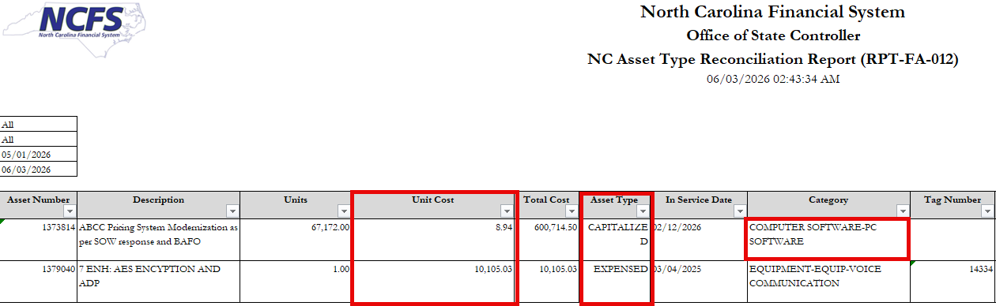
Common Type Mismatch Reasons
  The number of units or cost is incorrect during addition.
  The incorrect type was set in the Cash book.
  The incorrect category was selected.

Slide 22
NC Deleted Capitalized Source Lines Report (RPTFA002)
  Shows Source Lines (temporary records) which were deleted from NCFS and were above the capitalization threshold.
  Deleted capitalized Source Lines need to be manually added to NCFS.
    Certain exceptions exist where a Source Line may be properly deleted.
    Contact your assigned analyst for input and advice.
  A clear report indicates no deleted capitalized Source Lines.

Slide 23
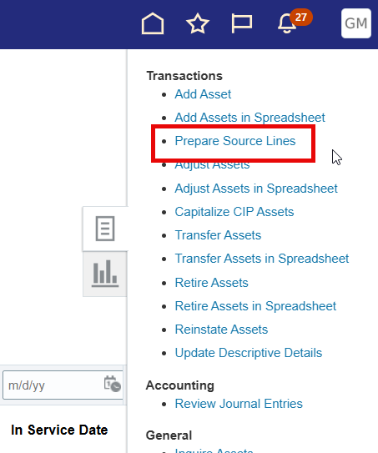
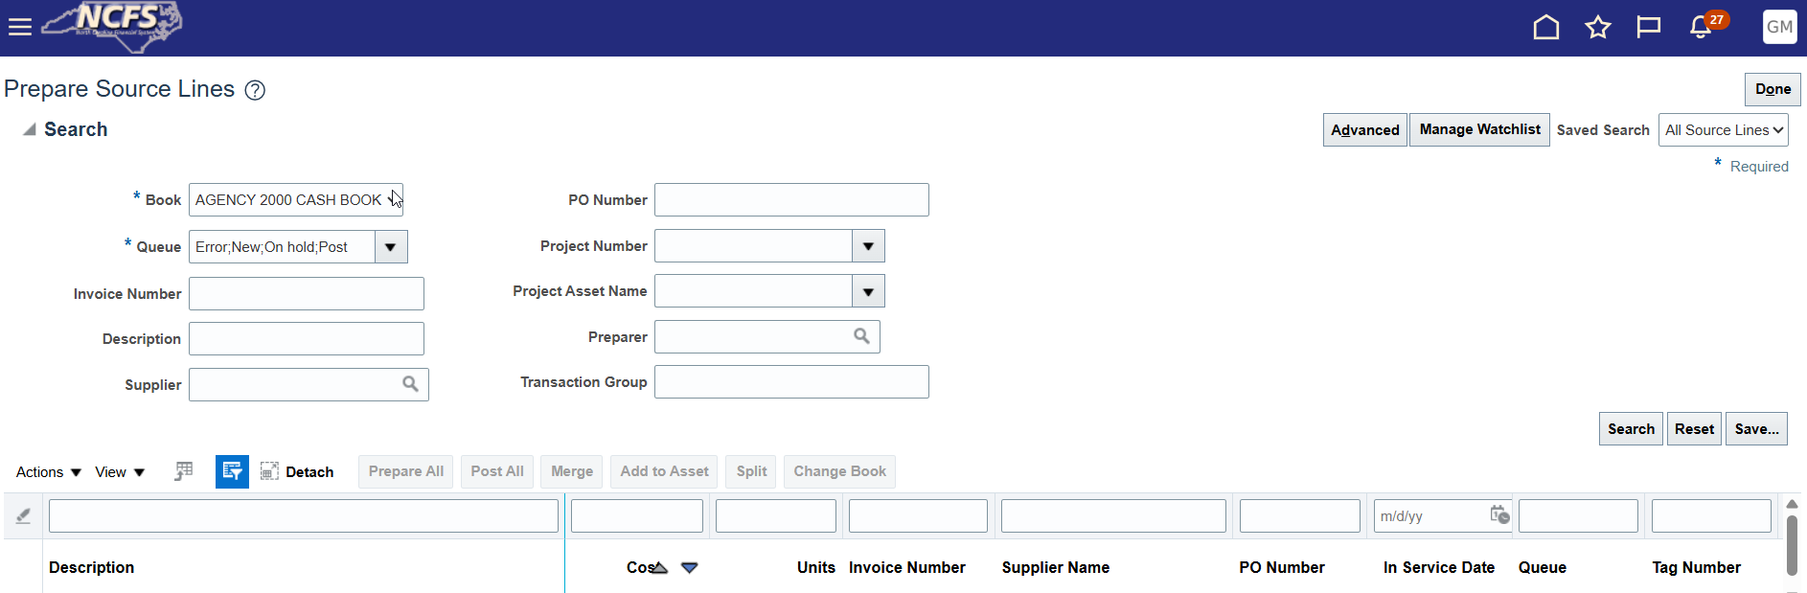
Prepare Source Lines Task
  Prepare Source Lines task allows you to manage and edit all source lines.
  QRG around editing previously deleted source lines: FA-22 Editing Previously Deleted Source Lines

Slide 24
Asset Transaction Reports
  These reports are your primary source for auditing and reconciliation outside of year end.
  Transaction reports include:
    NC Asset Additions by Agency Report (RPTFA013): Also include Source Lines
    NC Asset Adjustments by Agency Report (RPTFA014)
    NC Asset Transfers by Agency Report (RPTFA015)
    NC Asset Retirement by Agency Report (RPTFA016): Also includes Reinstatements
  Note that an asset will only show on the report with its latest transactions.
    Example: Asset 1234 was added to NCFS then adjusted in cost.
    Asset 1234 will only show on RPTFA014, not on RPTFA013.

Slide 25
Fixed Assets Tips and Tricks

Slide 26
Queue Status
Queue Status | Description
New | The record is newly created and is yet to be finalized.
On Hold | Set by User. This status is a “flag” to hold on completing the transaction.
Delete | Upon setting this status, the transaction line will be deleted once submitted or posted.
Error | Set by NCFS. This status is a noted that NCFS prevented transaction submission due to missing information or other.
Book Changed | Set by OSC. Transaction line was moved across books.
Post | Transaction is ready to be finalized. Upon posting/submission, transaction will process.

Slide 27
Active Asset Transactions And Updates
Asset Transfer
Asset Adjustment
Update Descriptive Details
Depreciation expense account information
Location information
Assigned employee
Adjust number of units
Asset cost
Estimated life and in-service date
Change category
Transfer Source Lines
Asset description
Tag number
Serial number, manufacturer, model number
Additional details
Attachments

Slide 28
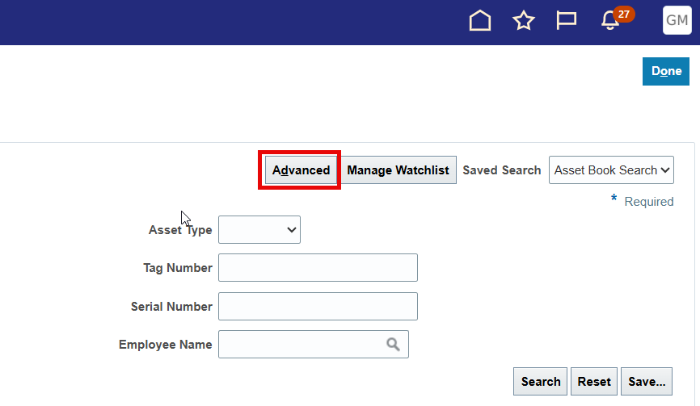
Advanced Search
  Toggle Basic or Advanced Search by clicking the Advanced or Basic button.
  Advanced search enables more inquiry actions and fields.
  Advanced setting can be saved as default inquiry view.

Slide 29
Communications Archive
  2026 Communications Archives
  Includes Information Session recordings, NCFS newsletters, Year-End checklists, and more.
  NCFS FA Information Session Transaction Deep Dive
    Video: NCFS FA Information Session Transaction Deep Dive (Feb. 4)
    NCFS FA Information Session Transaction Deep Dive Presentation (Feb. 4)
  NCFS FA Information Session Spreadsheet Deep Dive
    Video: NCFS FA Information Session Spreadsheet Deep Dive (April 1)
    NCFS FA Information Session Spreadsheet Deep Dive Presentation (April 1)

Slide 30
Questions?

Slide 31
Capitalization Threshold Changes
Starting 7/28/2026, FY27

Slide 32
FY27 Capitalization Threshold Change
Asset Class | Current Capitalization Threshold | July 1, 2026 Capitalization Threshold
Buildings | $5,000 | $100,000
Land Machinery and equipment Art, literature, and other artifacts General infrastructure Computer software | $5,000 | $10,000
Internally generated computer software | $1,000,000 | $1,000,000
Other intangible assets | $100,000 | $100,000
Right-to-use – Buildings Right-to-use-Land Right-to-use – machinery and equipment Right-to-use – general infrastructure | $10,000 | $10,000
Subscription assets (SBITAs) | $400,000 | $400,000
  Beginning 7/28/26, first day of FY27 for Fixed Assets.
  Effective for accounting date 7/1/2026.

Slide 33
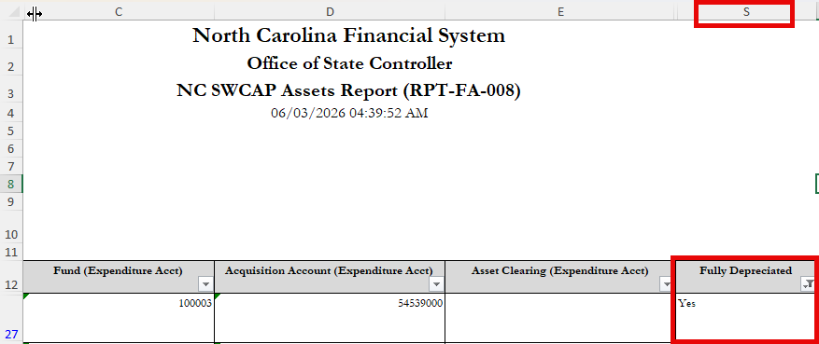
Capitalization Threshold Tasks
OSC Capital Assets Survey
  OSC is evaluating if default useful lives need to be adjusted.
  Please complete the above survey by 6/19/2026.
Review list of active, fully depreciated assets.
  OSC will provide your fully depreciated list.
  Due by 6/30/2026.
  RPT-FA-008 can give a head start.

Slide 34
Final Questions?

Slide 35
Questions, Requests, or Other
Key Takeaway
When in doubt, contact OSC: NCFS@ncosc.gov!

Slide 36
Thank you!

