Slide 1
NCFS Insights
May 6, 2026

Slide 2

Welcome
Housekeeping
Introductions

Slide 3
Agenda
Welcome
Functional
Technical
Security
Training
OCM
Closing/Q&A

Slide 4
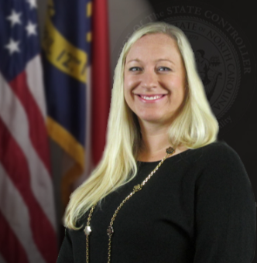
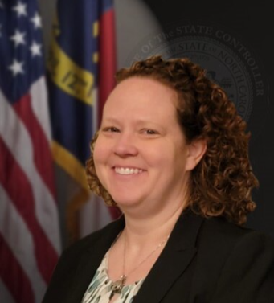
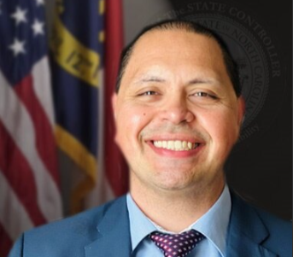
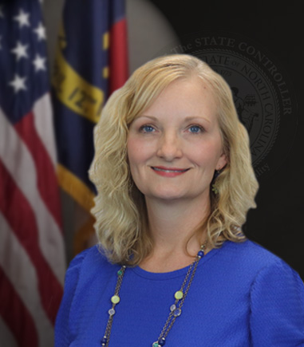
Presenters
Denise Langston
Business Systems Analyst
Laura Klem
Deputy State Controller
Jacob Taitague
Business Systems Manager
Gwen Earp
Business Systems Manager

Slide 5
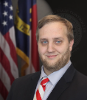

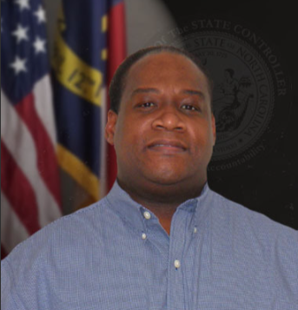
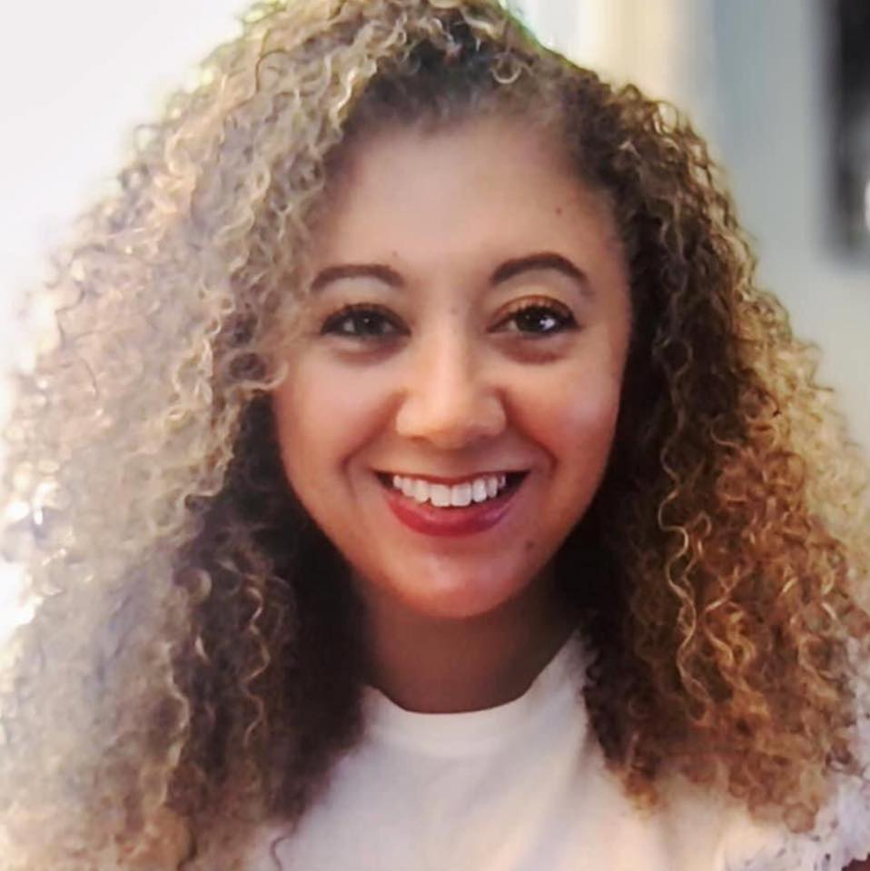
Presenters (cont.)
Frank Newsom
Business Systems Analyst
Thurman Ross
Security Manager
Anthony Taylor
NCFS Training
Lena Andrade
NCFS User Engagement
Lead

Slide 6
Polling Question
How would you rate your readiness for upcoming year-end activities?

Slide 7


SmartView
Denise Langston
Business Systems Analyst
North Carolina Financial System
NC Office of the State Controller - OSC

Slide 8
Smart View - Overview
Oracle Smart View is an add-on to Excel where you can view, arrange, and share data.
Used to view data from the ACFR reports obtained from the FRS folder in the NCFS.
Great tool for analyzing account balances and compiling information to complete ACFR packages.
Available for those with the NC ACFR Reports ALL security role.
Training on June 9th at 10:00 a.m. (Invites coming soon)

Slide 9
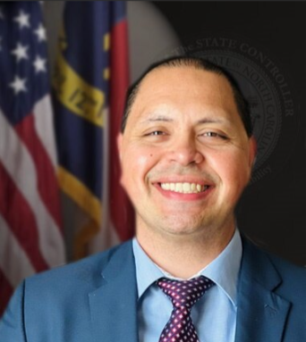
ACFR
Laura Klem
Deputy State Controller
Jacob Taitague
Business Systems Manager
North Carolina Financial System
NC Office of the State Controller - OSC

Slide 10
ACFR Year End Reporting (1 of 3)
Annual Comprehensive Financial Report package
Posted on SharePoint April 30^{th.}
The package worksheets, narratives, instructions, checklists and other year-end ACFR resources can be found at OSC Year-End Financial Reporting Packages - Home (sharepoint.com)
Due Dates:
  Tier 1: August 14th
  Tier 2: August 21st
  Tier 3: August 25th
  Tier 4: August 28th
  Upload the year-end package to OSC’s Year-end Financial SharePoint site
  OSC Year-End Financial Reporting Packages - Home (sharepoint.com).

Slide 11
ACFR Year End Reporting (2 of 3)
Prepare
Planning conferences will be hosted May to early July.
Prepare and reconcile information early – ensure transactions agree between both parties.
  Transfers (reimbursements)
  Due to & Due Froms
Analyze expected variances for MD&A purposes early.
Review prior year issues/errors.
Look for new efficiencies.
  Accuracy
  Review financial statements and package worksheets.
    Understanding the ledgers – cash should be the same across all ledgers.
  Utilize OSC package review checklists to ensure information is correct.

Slide 12
ACFR Year End Reporting (3 of 3)
Training
Ask questions early.
Attend trainings and applicable meetings.
  Significant Variances
  GASB 103 emphasizes the important of explaining significant variances in detail.
    Changing the 625 worksheet.
    MD&A memos and how we request information is updating.
  Pay attention to significant variances that are below your dollar threshold but is a 100% or 0% change.

Slide 13
ACFR Year End Reporting - Transfers
Non-Exchange Transaction
Nothing of value was received in exchange for funds.
No product or service produced or provided.
Legislation or Legal authorization.
Reconciling Transfers
Critical Components
  Account – Transfer vs Non transfer accounts.
  Budget Fund and Interfund.
  Amount
  Communication between providers and receivers.

Slide 14
ACFR Year End Reporting – Transfers (cont.)
Important Transfer information
Reclass of transfers will generate unmatched transfers.
Transfers Between Primary Government and Component Units.
  Reclass out of transfer accounts.
  Use Expenditure/Revenue Accounts.
  Invalid tab on 168.
RPT 168
Transfer Reports
Contact Jacob.Taitague@ncosc.gov

Slide 15
ACFR Year End Reporting - Reimbursements
Exchange Transaction
One fund pays for expenditures of another fund.
Understanding that the appropriate payment will be reimbursed at later date.
Use:
Governmental or Proprietary funds including Universities
  Universities and proprietary funds must reclass to expenditures at year end.
  Only Governmental Funds can have balance in these accounts at year end.
Reimbursement of Prior year Expenditures
  If crosses fiscal years use this account.
Reporting:
BD – 701: Grouped with Revenue Accounts.
GAAP Reports (52G, 53P) – Grouped with relevant expenditure account.

Slide 16
Materials
Gwen Earp
Business Systems Manager
North Carolina Financial System
NC Office of the State Controller - OSC

Slide 17
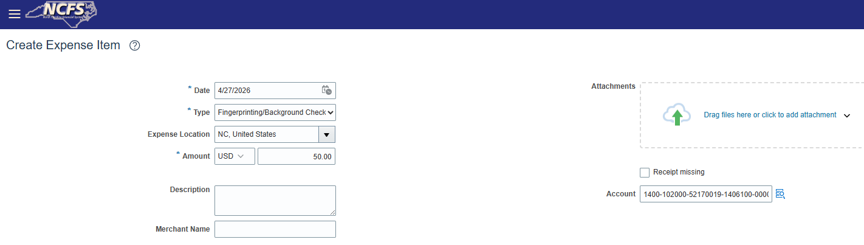
Expense Updates
New Fingerprint Background Check Expense Template
A new employee expense template has been enabled in NCFS that can be used to reimburse employees for Fingerprinting and Background Check expenses. This template is available to all NCFS business units and requires a receipt attachment. This template defaults 52170019 ADM-EMPLOYEE BACKGRND CK as the natural account.

Slide 18
Expense Updates (cont.)
NC Employee Expense Data Manager Role
Many agencies currently do not have any users with this role and OSC suggests each agency assign this role to 1-2 trusted employees.
Role allows limited access to manage employee data required for NCFS transaction, including the ability to add/update employee bank account or change manager for the purpose of expense approvals.
  Training requirements for NC Employee Expense Data Manager role
  QRG EX-09 Create and Manage Employee Information
While uncommon, this role is useful when the employee bank account interface from HR Payroll rejects a bank account that already exists in the system.
  This happens when:
    An employee already exists as an ePay supplier in NCFS.
    Employee shares a bank account with another state employee that already exists in NCFS.

Slide 19
Accounts Payable Updates
RPT-AP-001 NC Prepayment Register Report Update
The RPT-AP-001 NC Prepayment Register Report was recently updated to exclude invoices with a supplier site hold and invoices that were partially accounted, as these invoices would not be eligible for payment. RPT-AP-001 should now reflect the invoices available to be picked up in a PPR.
Since the RPT-AP-001 is a real time report, there are valid business reasons why your RPT-AP-001 may not reflect the totals picked up in your PPR.
  If invoices continue to be entered, validated, approved, and accounted after the RPT-AP-001 is run, those new invoices will be picked up in your PPR and will not be reflected on your RPT-AP-001 report.
  Create accounting runs each hour at the top of the hour and again at 10:25 a.m. If create accounting runs between the time the RPT-AP-001 is run and the time a PPR is submitted, additional invoices will be picked up in your PPR that were not included on your RPT-AP-001 report.
Suggestions for successful use of the RPT-AP-001 for cash planning purposes include:
  Pause invoice keying and approval in advance of running the RPT-AP-001.
  Allow create accounting to run at the top of the hour.
  Run RPT-AP-001.
  Complete PPR submission before allowing invoice entry and approval to continue.

Slide 20
Year End Updates
The Year End Checklist has been posted to OSC's website.
  OSC will update the checklist and send a communication once the final dates are received from OSBM.
There are several items that agencies can be working on now.
  Finally Close POs that shouldn't carry forward to next FY.
  Check for Invoices keyed to future year PO lines and make corrections.
  Resolve credit memos and close employee advances.
  Resolve invoice hold and validate invoices.
    Additional documentation for completing these steps can be found on OSC's website - Invoice And PO Clean Up Actions.
Year End Accrual session will be held Monday, June 15th at 1:00 pm.
  Invitations will go out soon to your AP Invoice Management, GL Journal Entry/Approval, FA Asset Accountant, and ACFR Reports users.

Slide 21
NCFS Change Control Board (CCB)
Frank Newsom
Business Systems Analyst
North Carolina Financial System
NC Office of the State Controller - OSC

Slide 22
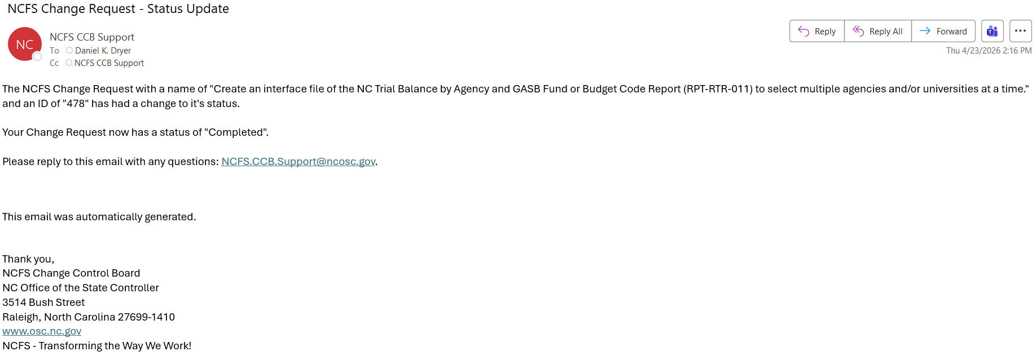
CCB Process Update
Notification process for changes to Change Requests has been improved.
Whenever a CCB item’s status is changed, an automatic email will be generated.
Ensures more consistent updates around your requests.
Email Subject will always be “NCFS Change Request – Status Update”.
Request creation form and status definitions can be found here: NCFS Change Request Intake Form.
NCFS.CCB.Support@ncosc.gov email box is the best contact for information requests around a CCB item.

Slide 23
CCB Statistics – Activity for Past 6 Months
136 Change Requests have had activity over the last 6 months
  Top Change category was Enhancement (75 total)
    OSC – NCFS placed 43 of the Enhancement requests (57%)
The DAC Manufacturing project accounted for 30 of the requests.
Requests included:
  Report improvements – 44
  Interface updates – 25
  System Updates or Legislative Mandates – 9
Requestors | Percentage
OSC - NCFS | 50
Agencies | 25
DAC Manufacturing | 22
Universities | 3

Slide 24

System Timeout
Thurman Ross
Security Manager
North Carolina Financial System
NC Office of the State Controller - OSC

Slide 25
NCFS Timeout
8 Hours Validity
NCFS duration is eight hours. This means that once a user logs in, they can access the system for up to eight hours with that login session. After eight hours, the system will require the user to reauthenticate their identity ensuring the safety and security of user accounts.
1 Hour Inactivity Timeout
After one hour of inactivity the user will be automatically logged out of the system. If there are no interactions or activity from the user for one hour, the system will log the user out to protect the user’s data if they accidentally leave their account information open.
30 Minutes Idle Session Timeout
Like inactivity time out, the idle session timeout deals with the period of inactivity. This refers to no activity on the user device while the NCFS screen is in a desktop view, such as no mouse movements, clicks, or keyboard strokes. If the user does not interact with the system in any way for 30 minutes, NCFS will log out the user.

Slide 26
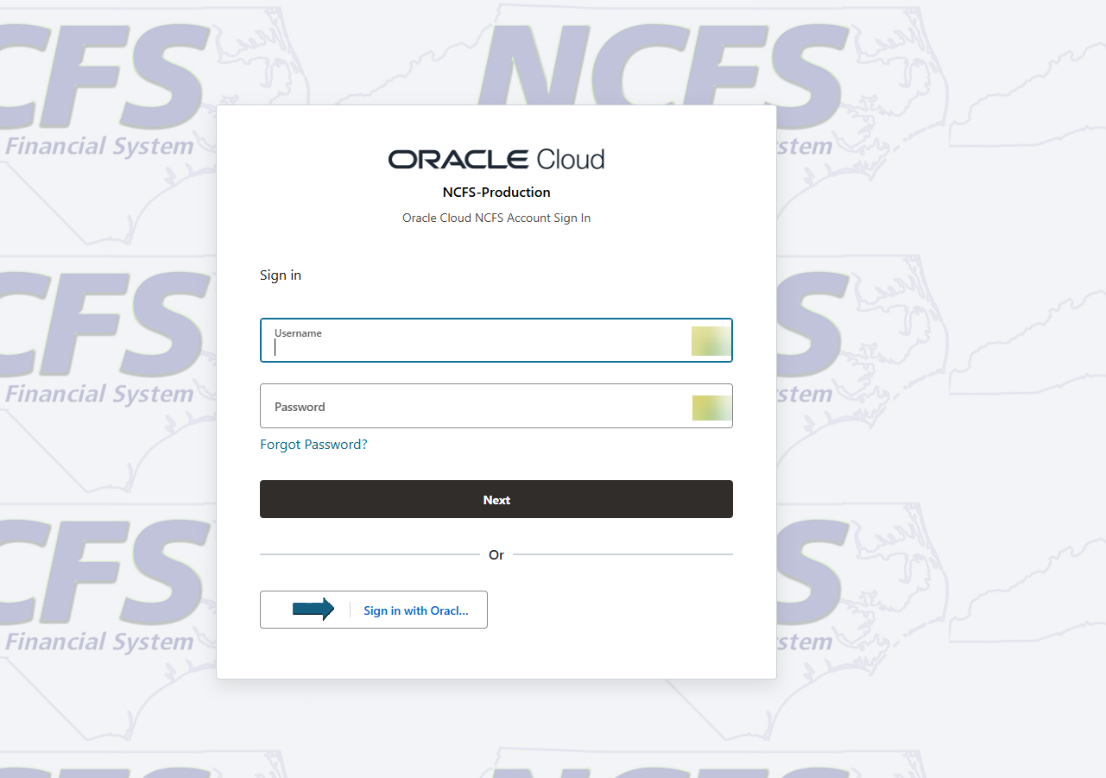
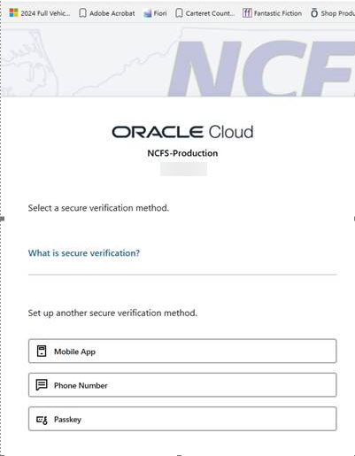
NCFS Browser Cookie Timeout
To correct this known issue with Oracle simply click on the saved browser link again.
NCFS Production (Oracle Cloud)
Correct sign-in method using DIT MFA
Idle time out shows incorrect (Oracle default) sign-in method

Slide 27
Adding IC Attachments (Receiver)
Anthony Taylor
NCFS Training
North Carolina Financial System
NC Office of the State Controller - OSC

Slide 28
Training – Updates
Updates
OTBI Reporting
ACC102 Accelerator
MFG Security Roles for DAC
Transfers
Searching from the Provider role will return transfers that were either created by you or on behalf of your assigned agency. Searching from the Receiver role will return transfers that have been routed to your agency for reviewing and approving.
Bell Icon
Intercompany Transfer Overview
Intercompany Inquire
Manage Approvals
Accurate COA – NC Chart of Accounts Combinations Report (RPTRTR157)
NC AP IGO Payment Transfer Report (RPTCM048)

Slide 29
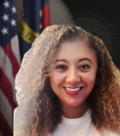
User Engagement
Lena Andrade
NCFS User Engagement Lead
North Carolina Financial System
NC Office of the State Controller - OSC

Slide 30
NCFS Spring Touchpoints
Conducted 33 Agency touchpoints during the month of March.
Conducted 21 University/Interface touchpoints during month of April.
Overall feedback has been positive. Teams are more comfortable in the system; support has been great.
These sessions will continue in the Fall 2026. We will continue to discuss issues, share updates, and review specific areas that NCFS users may still find challenging.

Slide 31
NCFS Spring Touchpoints (cont.)
Wins:
NCFS teams very responsive and knowledgeable to requests.
Monthly Insights sessions.
More comfortable with the system and how it works. Big improvement from NCAS.
Challenges | Solutions
Universities/Indirect groups were not aware that there were two processing runs each day for entries. | Direct staff to the processing run schedule located on the web.
Continue to add more training to include reporting. | Utilize OTBI, Pre-Built WBTs
Printing of PDFs from Web | OSC team is currently working on this during the accessibility transition.
Transfer attachments | Demo during May Insights.
Dynamic Insertion | Train staff to use correct codes. Advisory funds checking is in place.

Slide 32
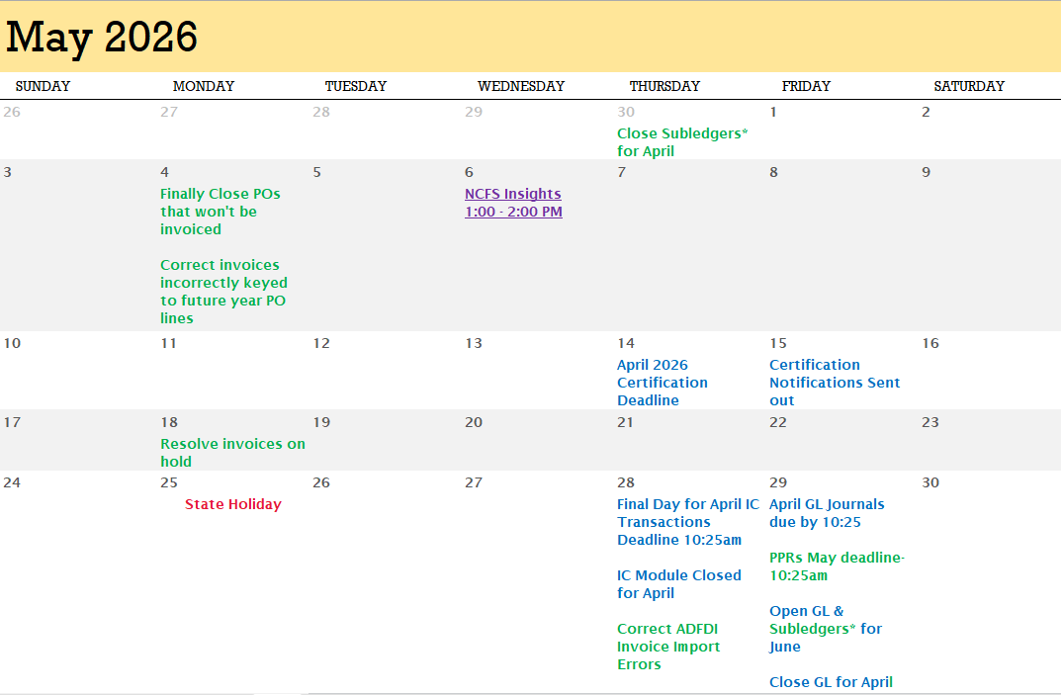
May 2026 Calendar

Slide 33
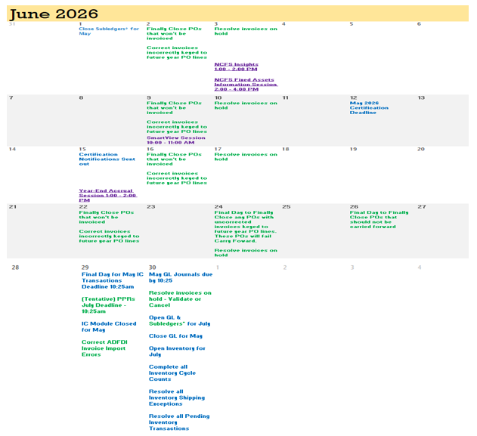
June 2026 Calendar
Keep up with what’s happening! Visit the NCFS Newsletter web page for more information.

Slide 34
What's Next?
  ACFR Planning Conferences – May → July
  NCFS Insights Session - June 3rd 1:00 pm - 2:00 pm
  NCFS Fixed Assets Session – June 3rd 2:00 pm - 4:00 pm
  Smart View Session – June 9th 10:00 am – 11:00 am (Invites coming soon)
  Year-End Accruals Session – June 15th 1:00 pm – 2:00 pm (Invites coming soon)

Slide 35
Reference Links
Invoice And PO Clean Up Actions
May and June 2026 Functional Calendar
NC Employee Expense Data Manager Role
NCFS Change Request Intake Form
NCFS Communications Web Page
NCFS Pre-Built Reports
NCFS Production (Oracle Cloud)
NCFS Year End Checklist
OSC Year-End Financial Reporting Packages - Home (sharepoint.com)
QRG EX-09 Create and Manage Employee Information
Transfer Reports

Slide 36

Q&A
Give us your feedback!
Contact us: ncfs@ncosc.gov

Slide 37
Useful Links
NCFS IC Contacts – Check your Agency/University/Interface Group and update if needed.
NCFS 2026 Communications
NCFS Functional Calendars
NCFS Gen-11 Reference Links
NCFS Help Documents
NCFS Resources
NCFS System Training
NCFS Year End Checklist

