Slide 1
NCFS Insights
April 1, 2026

Slide 2

Welcome
Housekeeping
Introductions

Slide 3
Agenda
Welcome
Functional
Technical
Security
Training
OCM
Closing/Q&A

Slide 4

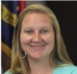
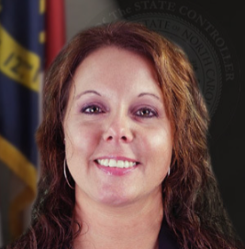
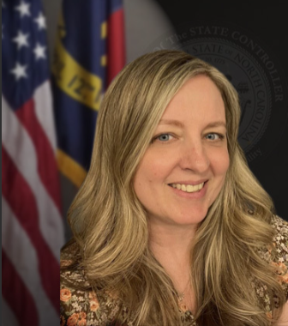

NCFS Insights - Presenters
Lena Andrade
NCFS Engagement Lead
Taylor Brumbeloe
Deputy State Controller
Jessica Wilkins
Data Maintenance Manager
Priscilla Roberts
Business Systems Analyst
Laura Lee
OSC Training Manager

Slide 5
Icebreaker
Polling Question:
Which module of NCFS do you use most?

Slide 6


EPay
Jessica Wilkins
Data Maintenance Manager
North Carolina Financial System
NC Office of the State Controller - OSC

Slide 7
Review of the ePay Process
Supplier should complete the Supplier Electronic Payment Request form
Email completed form and a voided check, bank statement, or bank authorization letter (on bank letterhead, signed by bank representative) to ncfsepay@ncosc.gov
If Agency receives request, review for completeness before sending to OSC
If Supplier Electronic Payment Request form has been approved by the DM Team – supplier will receive a Security Verification Form to complete
Agencies can assist the supplier if needed
Data Maintenance team will review completed questions based on information in NCFS
If Supplier Electronic Payment Request form is incomplete or incorrect, DM Team will reject and notify the supplier
If ePay is on file for another site or agency, ePay details are added to new site upon request via NCFS ticket
Data Maintenance team will email the supplier (and copy the agency contact if available) once ePay setup has been completed

Slide 8
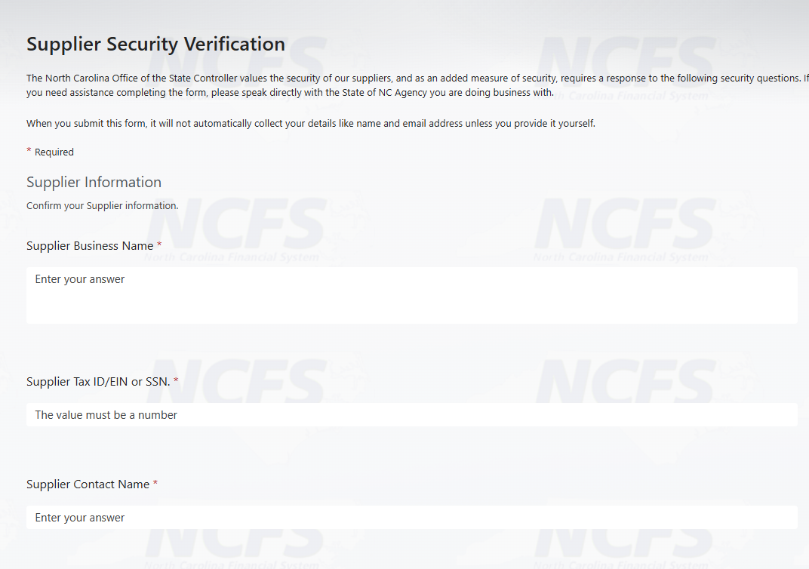
Updates to the Security Verification Form
For Supplier, Agency, and OSC protection, this form is used to reduce potential fraud for payments
Link to form is sent to Supplier only after the ePay Request form and supporting bank documentation have been approved

Slide 9
Updates to ePay Inactivation Request Process
Suppliers should now email their ePay inactivation request to the ncfs@ncosc.gov
Include the following information:
Supplier’s name
TAX ID/EIN number
Site you are requesting be inactivated
Once your request has been completed, you will receive a response to with your Incident number from ncfs@ncosc.gov.

Slide 10
ePay Reminders
Review all Supplier Electronic Payment form requests to ensure all required fields on the form are completed, prior to sending them to NC OSC for review.
Do not provide Suppliers any NCFS system information: TAX ID/EIN number, addresses, bank names or account number details in the system. It is imperative that the supplier provides this information on the Electronic Payment Request form to help prevent fraud.
Attach the required supporting bank document with all request forms.
Deposit Authorizations are only acceptable when signed and dated by bank employee
Agencies can assist suppliers with completing the Security Verification form, but it is important that Suppliers complete and submit the form
Always send emails and responses to ncfsepay@ncosc.gov and not to individual team members

Slide 11
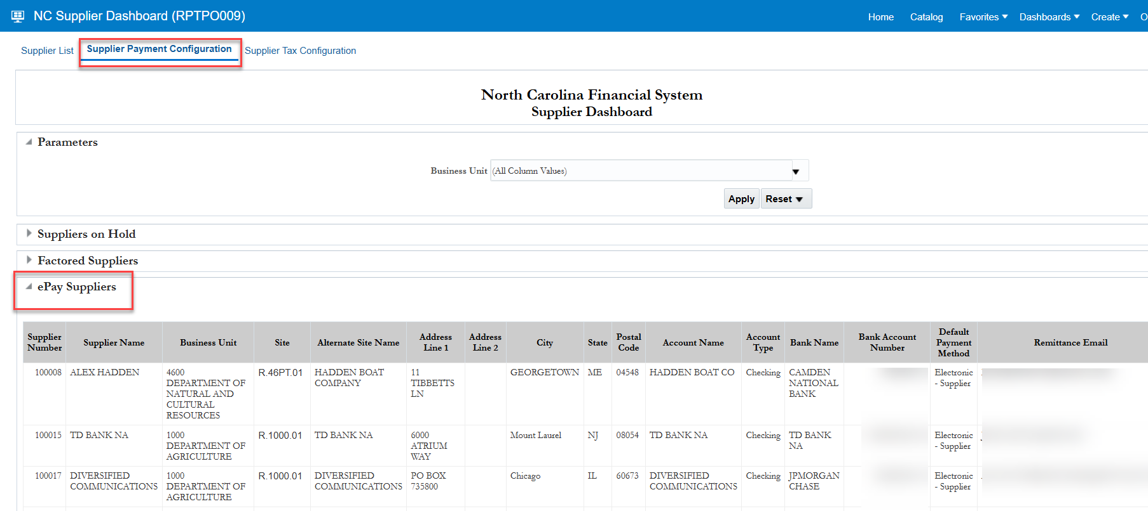
ePay Reminders
Review Supplier ACH status updates by utilizing the NC ePay Suppliers Report (RPTPO009) under Tools>Reports and Analytics

Slide 12
ePay Links
Supplier Reports in NCFS
Electronic Payment Request form
Electronic Additional information
Electronic Process Help

Slide 13
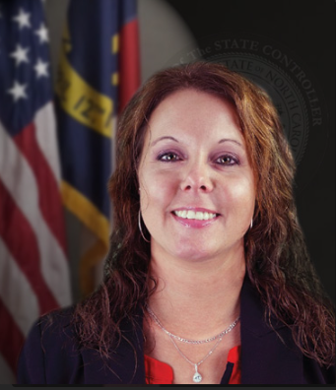
Chart Maintenance - Disable
Priscilla Roberts
Finance Team
North Carolina Financial System
NC Office of the State Controller - OSC

Slide 14
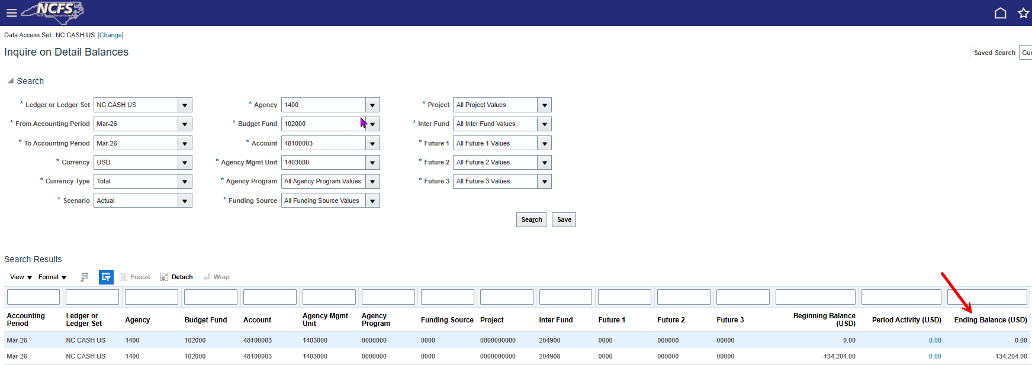
Disable Account Combinations
Prior to disabling account combinations:
Search Inquire on Detail Balance screen to verify you have no ending balances.
Ending Balances – Submit a journal entry to move the ending balances to an account combination that is enabled.
User Tip: Key what you see
Negative Ending Balance – Key a Debit
Positive Ending Balance – Key a Credit

Slide 15
Disable Account Combinations
Agency Account Combination Template
Three Tabs:
Instructions – Guide for completing account combination spreadsheet
Account Combinations – Active spreadsheet for your request
Sample – Reference model for a correctly formatted request
To disable: N for Enabled and Allow Posting

Slide 16
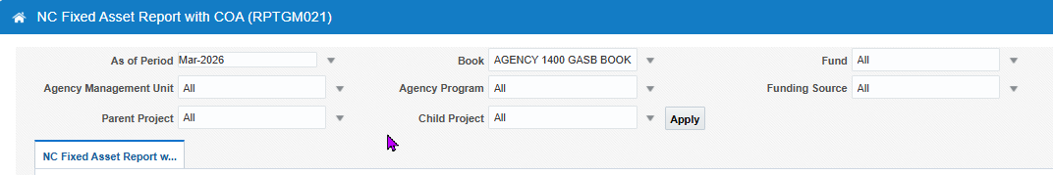
Disable Segment Values
Prior to disabling a segment value:
Search Inquire on Detail Balance screen to verify you have no ending balances.
Ending Balances – Submit a journal entry to move the ending balances to a segment value that is enabled
NC Fixed Asset Report with COA (RPT-GM-021)
Active Fixed Assets – Transfer or Retire

Slide 17
Disable Segment Values
Segment Value Templates
Four Tabs:
Instructions – Guide on how to complete the Current spreadsheet
Segment Value Current – Active spreadsheet for your request
Sample – Reference model for a correctly formatted request
Parent – Provides the parent value for all Agencies
Segment Value Current Tab
Action Codes - Add, Move, Prop Update
Summary, Enabled, Allow Posting, Allow Budgeting
No

Slide 18
Useful Links
NCFS Chart of Account Maintenance
QRG-50 Inquire Detail Balance

Slide 19
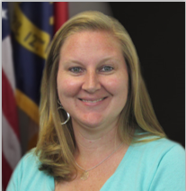
Year End & BSR Project Updates
Taylor Brumbeloe
Deputy State Controller, NCFS
North Carolina Financial System
NC Office of the State Controller - OSC

Slide 20
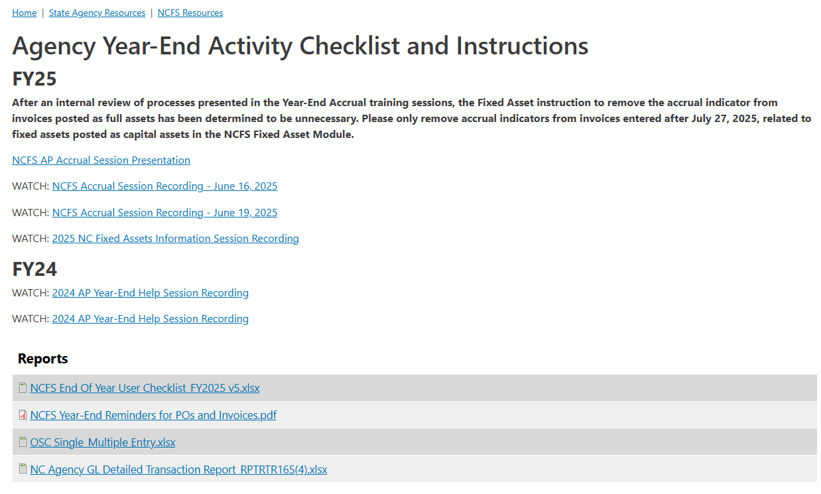
Fiscal Year 2026 Closeout
Fiscal Year End is June 30th
Review the Year End Checklist and dates to refamiliarize yourself with the tasks and timelines
Updated checklist will be published by early April

Slide 21
Fiscal Year End – Info Sessions
Accrual Session (AP & GL)
June 2026
Fixed Assets
April 2026
Monthly NCFS Insights
April → July
Smart View Session
June 9, 2026
June 2026

Slide 22
Budget System Replacement Project
Funding received in October 2025 to replace legacy statewide budget system - IBIS
Oracle Enterprise Performance Management (EPM) selected as software solution
Deloitte selected as Implementation Partner

Slide 23
Budget System Replacement Project
Phase 1:
Development of base budget operations for execution of the biennial base budget
Target Date: September 1, 2026
Phase 2:
Development of budget execution operations including budget certification activities, budget revisions, carryforwards and the allotment process
Target Date: July 1, 2027
Phase 3:
Development of Governor’s Recommended Budget processes, performance management & other functionalities
Target Date: December 1, 2027

Slide 24
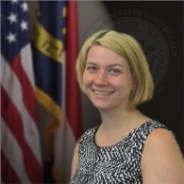
NCFS Training
Laura Lee
OSC Training Manager
North Carolina Financial System
NC Office of the State Controller - OSC

Slide 25
Training Updates
GL103 conversion to Web Based Training
New OTBI WBT in development
AP206 recently published
CM-13 QRG updated to include Multi Journal spreadsheet upload
Post Class Survey
Each course has a survey sent to participants after the course and then a few weeks out. Please complete these surveys.

Slide 26

Organizational Change Management
Lena Andrade
NCFS Engagement Lead
North Carolina Financial System
NC Office of the State Controller - OSC

Slide 27
NCFS Spring Touchpoints
Conducted 33 Agency touchpoints during the month of March
Overall feedback has been positive as teams have been more comfortable in the system; support has been great
University/Interface Orgs (23) touchpoints are scheduled to begin mid April
We will continue to discuss issues, share updates and review specific areas that agencies may still find challenging
Reminder: Complete the Touchpoint survey prior to the meeting

Slide 28
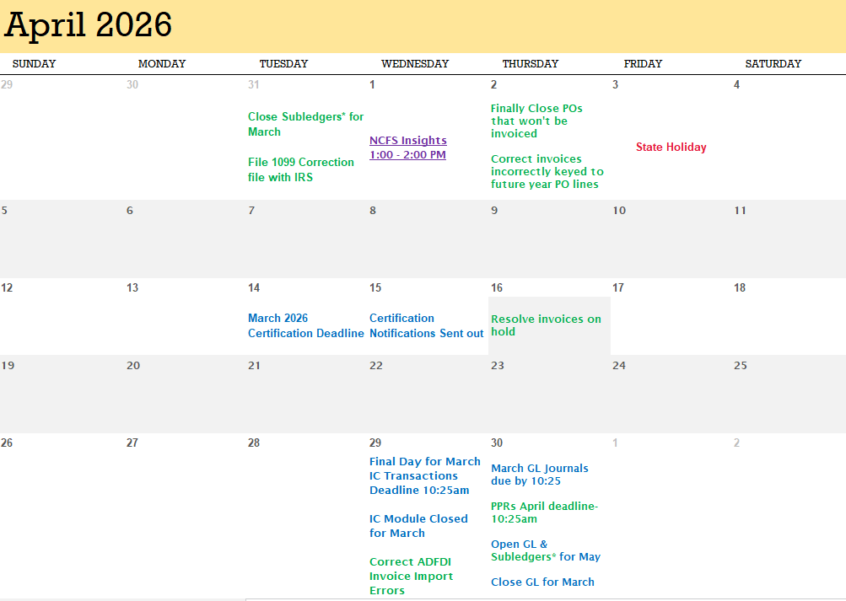
April 2026 Functional Calendar

Slide 29
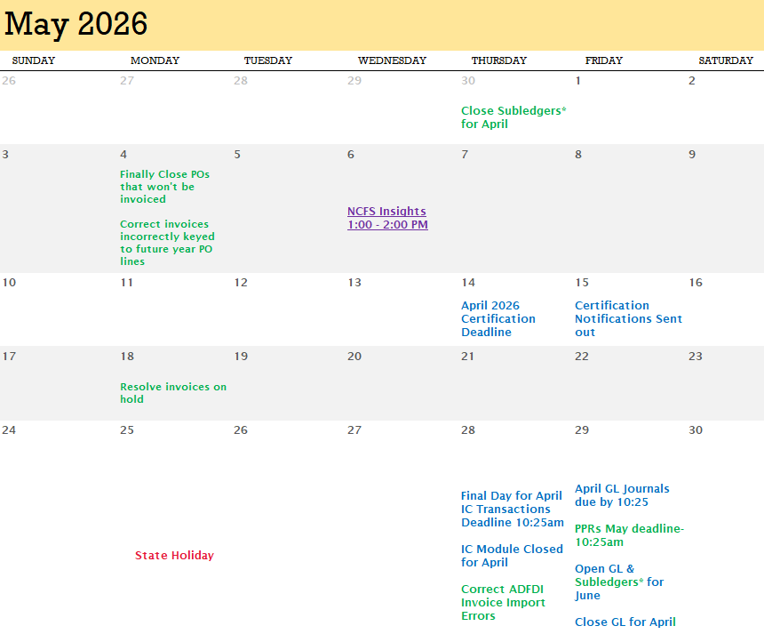
May 2026 Functional Calendar

Slide 30
NCFS 2026 Communications Page
General Information
NCFS Interest Allocation Deposit Date Change (Jan. 5)
DSS Sunset (Jan. 8, 26)
NCFS 1099 Reminders (Jan. 15, 21, 28, 29)
NCFS Newsletter (Jan. 20)
NCFS 1099 Correction Invoices Reminder (Feb. 4, 18, March 11)
NCFS Issue Being Addressed (Feb. 26)
NCFS Inventory Updates (March 4)
NCFS Bank Reconciliation Issue (March 9)
New Oracle Cloud Infrastructure Identity Access Management (OCI IAM) (March 10)
NCFS 1099 Invoice Reminder (March 23)
NCFS Oracle Cloud Infrastructure Identity Access Management (OCI IAM) (March 27)

Slide 31
NCFS 2026 Communications Page
Information Sessions
NCFS FA Information Spreadsheet Deep Dive (Feb. 19, March 30)
WATCH: NCFS FA Information Session Transaction Deep Dive
NCFS FA Information Session Transaction Deep Dive Presentation (Feb. 4)
NCFS FA Information Session FAQs
NCFS 1099 Presentation and Recording
NCFS 1099 Information Session (Jan. 20)
NCFS Fixed Assets Information Session (Jan. 8)
Month End Closing
NCFS February and March (March 27, 30, 31)
NCFS January and February (Feb. 23, 26, 27)
NCFS December 2025 and January 2026 (Jan. 23, 28, 29, 30)
NCFS Insights Sessions
WATCH: NCFS Insights (March)
NCFS Insights Presentation (March 4)
WATCH: NCFS Insights (February)
NCFS Insights Presentation (Feb. 4)

Slide 32
Useful Links
NCFS IC Contacts – Check your Agency/University/Interface Group and update if needed.
NCFS 2026 Communications
NCFS Functional Calendars
NCFS Gen-11 Reference Links
NCFS Help Documents
NCFS Resources
NCFS System Training
NCFS Year End Checklist
ePay Email
Electronic Payment Request Form
Electronic Additional Information
Electronic Process Help
Supplier Reports in NCFS
NCFS COA Maintenance
GL-50 Inquire Detail Balance
Contact Us or ncfs@ncosc.gov

Slide 33
What's Next?
NCFS Fixed Assets Session – April 1st, 2:00 pm - 4:00 pm
NCFS Newsletter – April
NCFS Touchpoints – April/May
NCFS Insights Session - May 6th, 1:00 pm - 2:00 pm
ACFR Planning Conferences - May

Slide 34

Q&A
Give us your feedback!
Contact us: ncfs@ncosc.gov

