Slide 1



Month End Balancing and Certification

Slide 2


Month End Balancing & Certification
Darlene Langston
Shereen Tawfik
Haley Ashley
Slide 2

Slide 3

Agenda
Certification Deadline Reminder
*NEW* Month End Checklist for Users
Walkthrough of OSC’s suggestion for easy reconciliation
Other Issues Identified to Address
Enhancements NCFS Contact
Questions and Answer Session
Resources
Slide 3

Slide 4
Certification Deadline
Certification forms should be submitted to OSC by the 10th working day into the next period to be counted on time.
Ex: October 2024 certification deadline would be due on November 14th 2024
NCFS Functional Calendar
After quarterly certifications forms have been submitted, OSBM also approves for certification, which can result in additional time to process these certifications.
Year-End deadline (June & June CIs) are typically communicated in the Spring of the fiscal year.
Slide 4

Slide 5
Month End Checklist
Slide 5

Slide 6
Simplify Monthly Reconciliation
This method can be utilized on a computer drive for your agency or on an agency SharePoint as well.
Create the Excel recon workbook by compiling the reconciliation template(s) for each type of budget code for your agency.
Pull the required reconciliation reports per each template and link your recon workbook to the correct report cell by utilizing excel formulas.
Save your templates and report names the EXACT same way each month for the reconciliation formulas to automatically populate once you save in the correct folder for that month.
Slide 6

Slide 7
Other Issues Identified to Address
Auto-post deadline
Use of wrong journal category
Canceling invoices after rejected IC batches
Reversing a Journal Entry
IC Transactions
Slide 7

Slide 8
1. Auto-post deadline
The General Ledger module should not be open for more
than two periods (Current & Prior).
When entering a prior period transaction make sure that you are using the last day of the prior month, as the auto post job only picks up transactions within 60 days window.
Posting for all deposit journals is at 9:45am M-F.
Posting for requisition and transfers is at 1:00pm M-F.
Posting for NC INTERNAL AGY BC entries is at 5:30am and 9:45am, and 1:00pm M-F.
Posting for Interface Journals is at 1:20pm M-F. Recently, we have also added an additional 5:30am for Interface Journals.
NCFS DAILY PROCESSING SCHEDULE LINK HERE
Slide 8

Slide 9
2. Use of Wrong Journal Category
To avoid balancing issues at month end when posting cash transactions make sure that you are only using deposit & pay type categories when posting cash transactions.
Do not use journal category “NC Internal AGY BC” on any transactions that include the cash account and are moving funds within different budget codes.
Only use the “NC Internal AGY BC” category to reclass cash between budget funds that are within the same budget code.
Slide 9

Slide 10
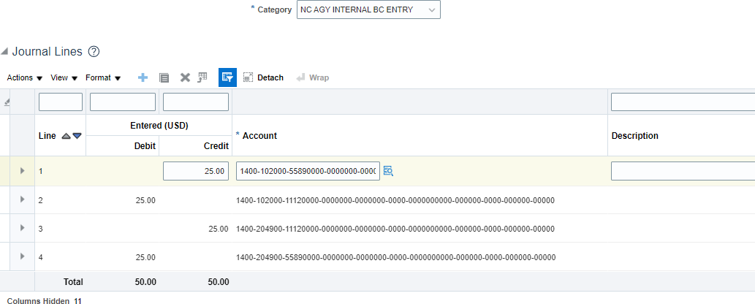
Use of Wrong Journal Category Incorrect Example
Incorrect Reclass Entry Example
Slide 10

Slide 11
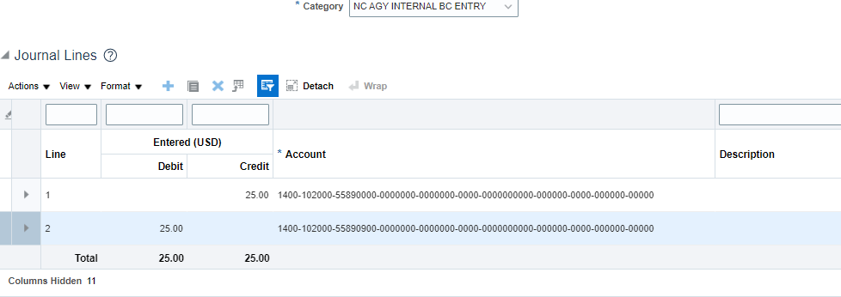
Use of Journal Category Correct Example
Correct Reclass Entry Example
Slide 11

Slide 12
3. Canceling Invoices After Rejected IC Batches
When an IGO payment is rejected, and “rejection reviewed” action is selected on the IC transfer, the payment in the AP module will need to be voided in the same period to avoid balancing issues on your BD704.
Ex BD704 balance and Inquire on details balances screen shown next two slides
It is crucial that staff who completes the IC “rejection reviewed” action to communicate with AP staff to have the payment voided in the same period, since AP cannot back date the transactions.
To void payments, please submit a ticket to NCFS@ncosc.gov
Slide 12

Slide 13
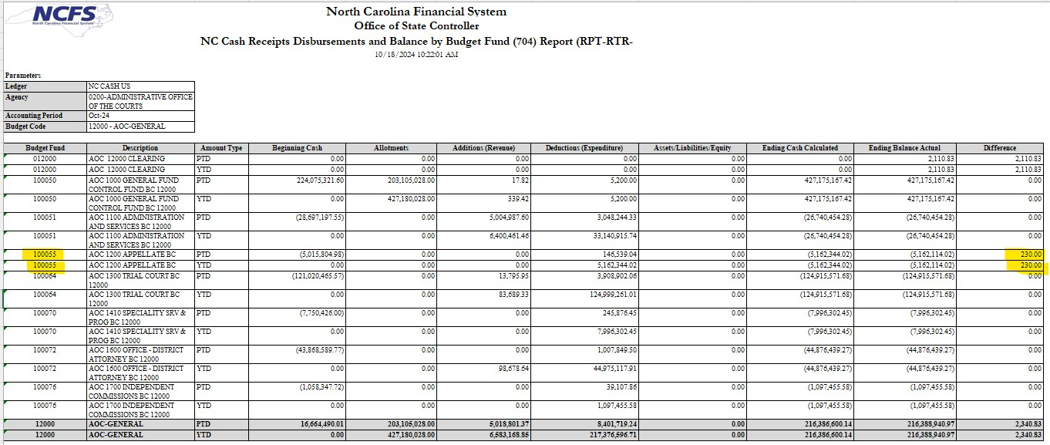
Canceling Invoices After Rejected IC Batches Balance Issue
Example of balancing issue on BD704
Slide 13

Slide 14
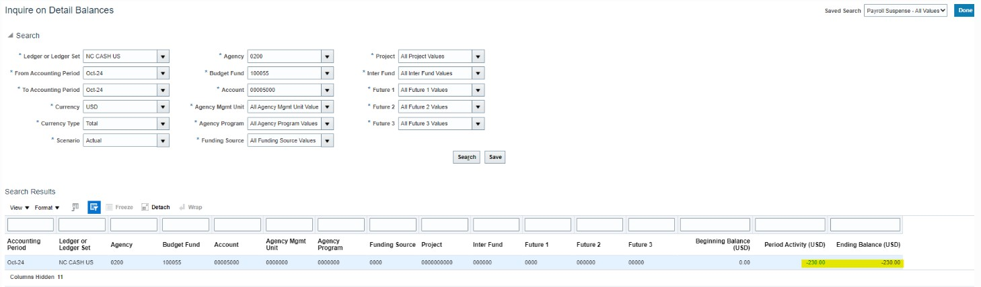
Canceling Invoices After Rejected IC Batches on Detail Balances
Example of balancing issue on “Inquire on Detail Balances”
Slide 14

Slide 15
4. Reversing a Journal Entry
When reversing a journal entry, you should never change the accounting distribution. How it was recorded originally is how it should be reversed. Changes to the accounting distribution on a reversal create issues during month end reconciliation.
Example of reversal journal next two slides
QRG: GL-04 REVERSE JOURNALS
Slide 15

Slide 16
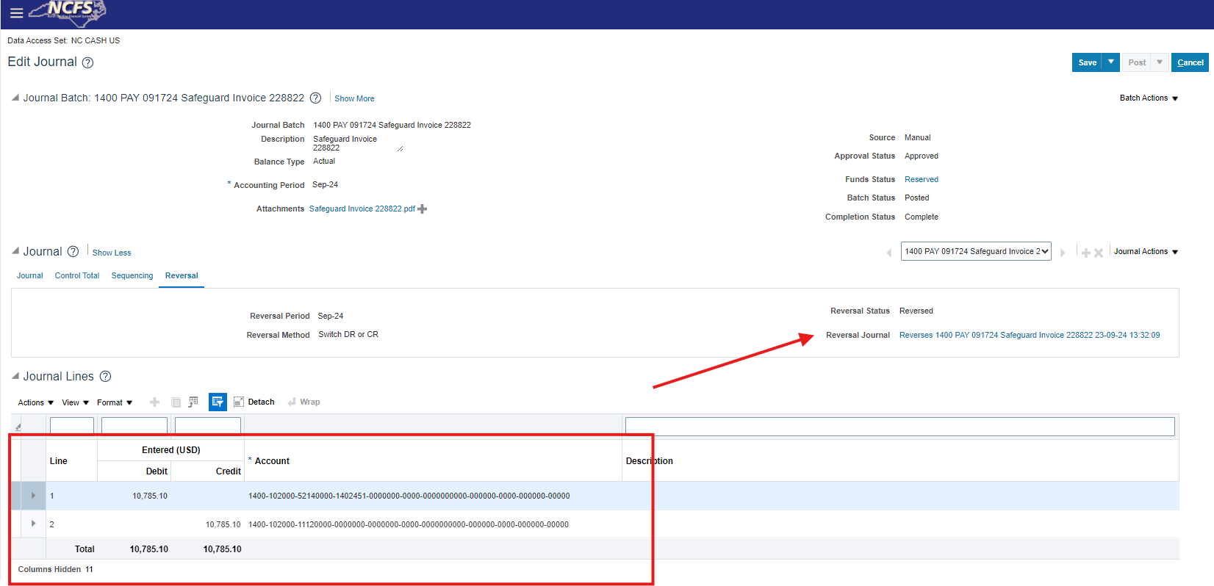
Original Journal Once Reversal is Submitted
Slide 16

Slide 17
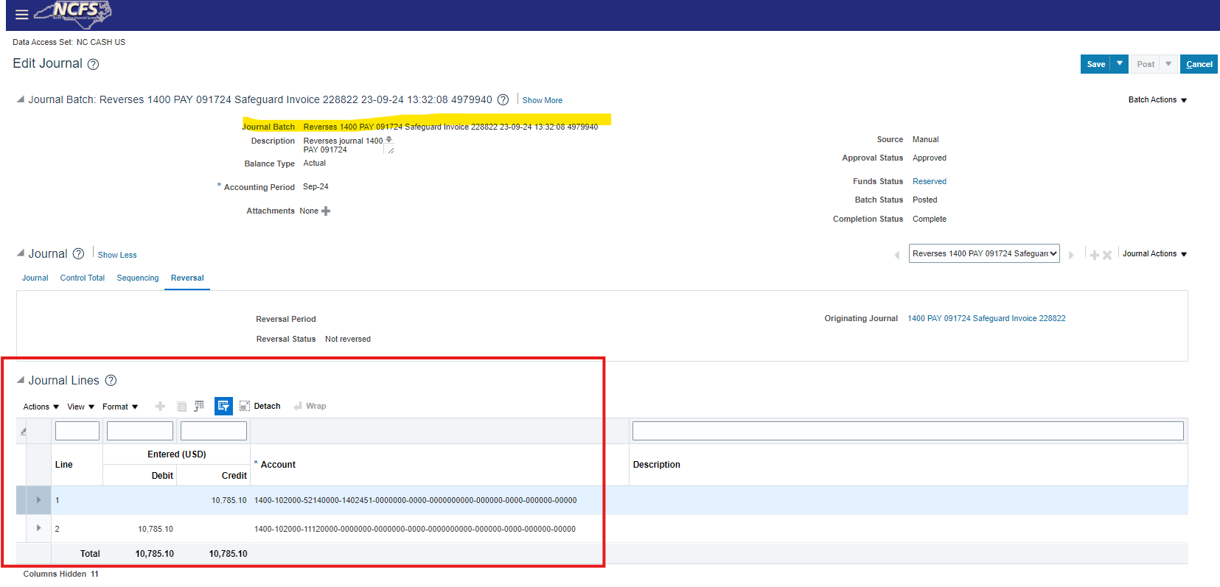
Reversal Journal Created to “Request Approval”
Slide 17

Slide 18
5. IC Transactions
IC Transactions for previous periods should be submitted by the 10th working day of the next period.
If your entity needs to submit an IC transfer for the prior month and it is past the certification deadline (10th workday), you are required to submit a ticket to NCFS@ncosc.gov providing written confirmation and approval from the Receiving agency for OSC Central Compliance to approve the Batch.
OSC Central Compliance will be monitoring these transfers closely and will reject any that do not have a corresponding NCFS ticket.
Slide 18

Slide 19
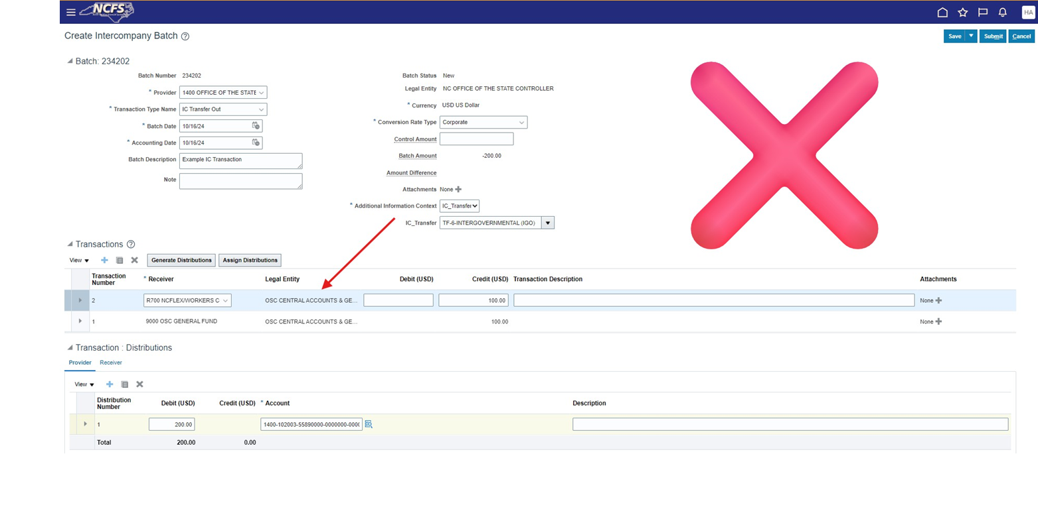
IC Transactions Provider and Receiver
When entering a manual IC transfer as the provider agency only one line should be entered for the receiving agency. The receiving agency can enter multiple lines, as needed, for their distributions.
Slide 19

Slide 20
5. IC Transactions Accounts
Do not use the cash account when entering or receiving IC batch. The system adds the cash account automatically for both the provider and receiver agencies once the transfer has been completed.
Incorrect and Correct Transfer examples shown on next two slides.
Slide 20

Slide 21
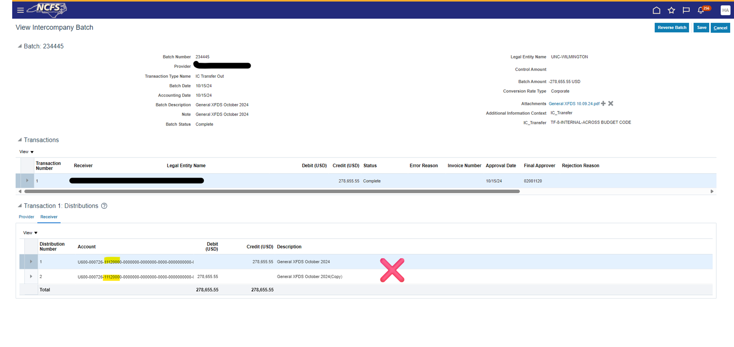
IC Transactions Incorrect Example
Incorrect Example
Slide 21

Slide 22
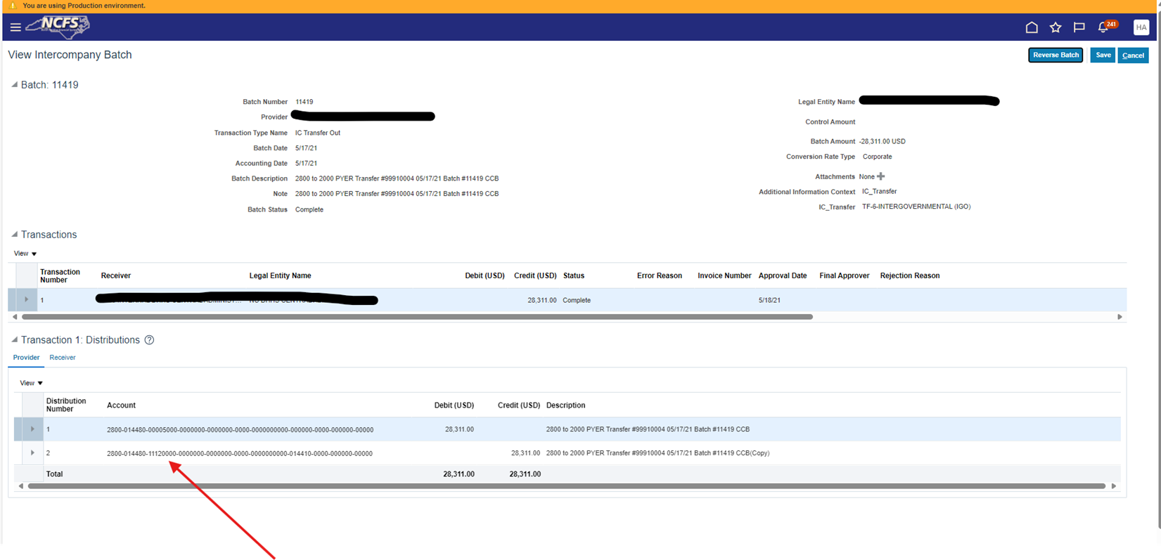
IC Transactions Correct Example
Correct Example
Slide 22

Slide 23
Enhancements
NC Daily Cash Transaction Detail Report (RPT-CM-049) can be run by monthly period to assist in identifying incorrect transactions for reconciliation.
Any thoughts or additional enhancements can be submitted through the
Change Control Board linked below.
NCFS Change Control Board Link
Slide 23

Slide 24
NCFS Contact
Please direct all questions to the NCFS contact center and not a direct employee.
Email: NCFS@ncosc.gov Phone: 919-707-0795
Website: www.ncosc.gov
Slide 24

Slide 25
Questions & Answers
Slide 25

Slide 26
Resources
NCFS Functional Calendar
NCFS System Information | NC OSC
OSBM Checklists & Guidance available on OSC webpage Job Aids | NC OSBM
OSC Month End Certification (which Includes checklist and all guidance from OSC) Month End Certification | NC OSC
Reconciliation Templates (which include)
Precert Diff Report-Month End Reconciliation for Federal Special Trust Fund Template
Precert Diff Report-Month End Reconciliation for CI Template
Precert Diff Report-Month End Reconciliation for General Fund Template Reconciliation Templates | NC OSC
Online Month End Certification Form
Office of the State Controller Month End Certification Quarter End Certification
Quarter End Certification | NC OSC
Slide 26

