Slide 1
NCFS Insights
March 4, 2026

Slide 2

Welcome
Housekeeping
Introductions

Slide 3
Agenda
Welcome
Functional
Technical
Security
Training
OCM
Closing/Q&A

Slide 4


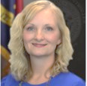
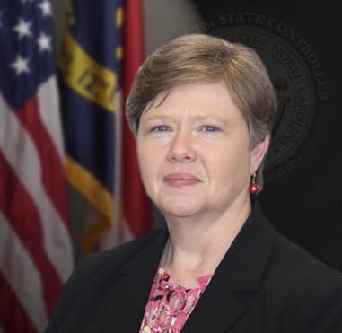

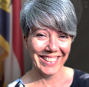
NCFS Insights - Presenters
Lena Andrade
NCFS Engagement Lead
Frank Newsom
Business Systems Analyst
Gwen Earp
Materials Manager
Darlene Langston
Finance Manager
Dawn Parrish Learning & Development Special Projects Coordinator
Thurman Ross
Security Manager

Slide 5
Icebreaker
Polling Question:
Have you had the opportunity to visit the NCFS 2026 Communications web page for a list of communications that have gone out this year?

Slide 6
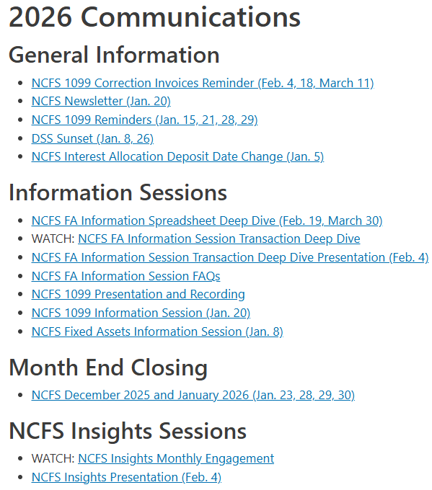
NCFS 2026 Communications Page

Slide 7



Fixed Assets Inquiry
Frank Newsom
Business Systems Analyst
North Carolina Financial System
NC Office of the State Controller - OSC

Slide 8
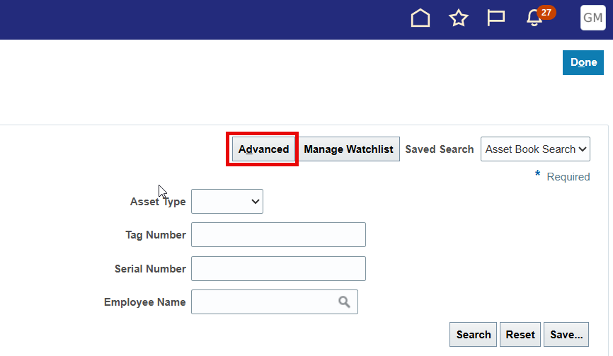
Advanced Search
Toggle Basic or Advanced Search by clicking the Advanced or Basic button
Advanced search enables more inquiry actions and fields
Advanced setting can be saved as default inquiry view

Slide 9
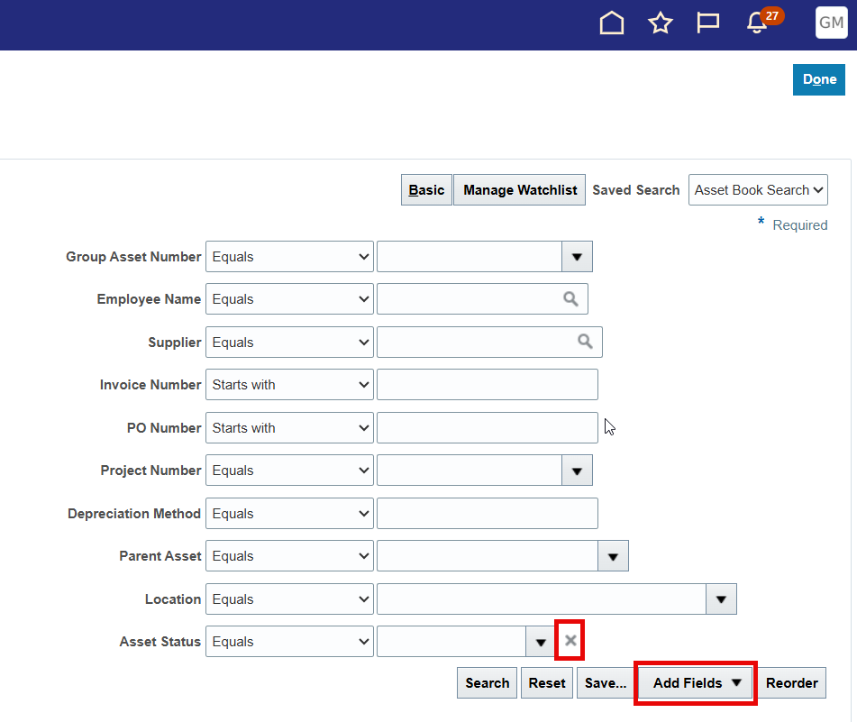
Adding Search Parameters
Use the Add Field list to include more search parameters
Most details on an asset can be searched for
Remove previously added fields by clicking the “x” next to it
Default fields cannot be removed

Slide 10
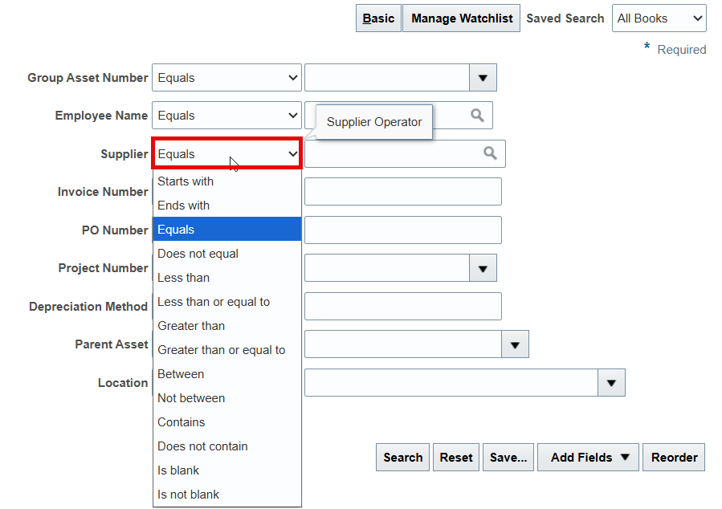
Inquiry Field Modifier
Drop-Down list of various modifies to each inquiry field
Changes the behavior of the search field
Available only in Advanced Search
Basic view is defaulted to "Starts With"
Options change based on the field type

Slide 11
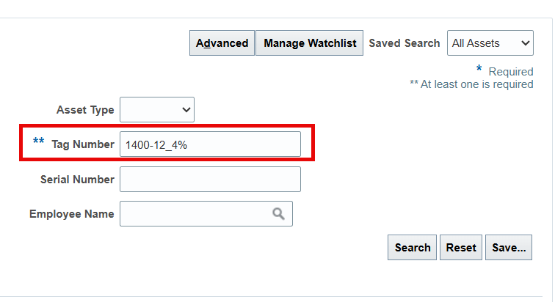
Using Wildcards
Wildcards are symbols which help search when the exact value isn’t known
% is used to represent any number of characters
E.x. 123456789 will show when searching 12345%
_ is used to represent a single missing character
E.x. 123456789 will show when searching 123_56789
Wildcards can be combined
E.x 123456789 will show when searching 12_45%

Slide 12
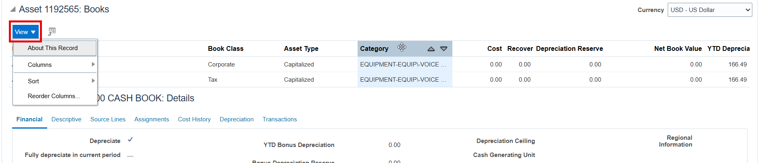
Editing your Inquiry View
Changes to the output view are saved automatically
Additional column and column size and position are common changes made
Change Column Size Icon
Change Column Position Icon

Slide 13
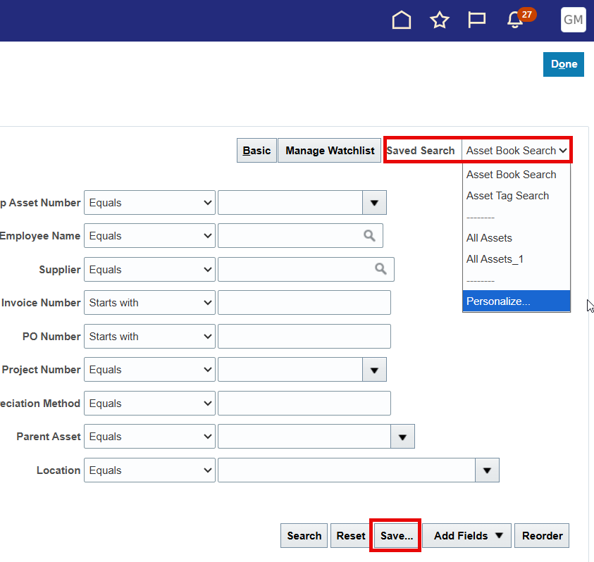
Saving Common Searches
Custom inquiry searches which can be run by default
Personal to you
Saved searches remember any additional fields added, modifiers, and input parameters
Demonstration

Slide 14
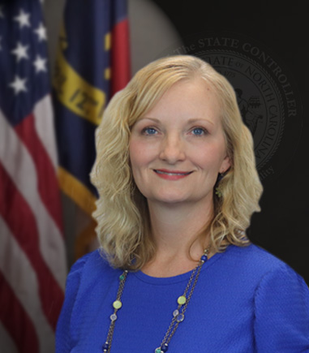
1099 Updates
Gwen Earp
Materials Manager
North Carolina Financial System
NC Office of the State Controller - OSC

Slide 15
1099 Reminders
Original 2025 1099 file has been accepted by the IRS
2025 1099 Corrections Period is open
Enter and pay zero-dollar invoices to record corrections QRG AP-41 1099 Zero Dollar Invoices
Use the RPTAP022 1099 Maintenance Report to validate updates
All zero-dollar invoices must be paid by midnight on March 29th (Sunday)
OSC will file the corrections file with the IRS on March 30th
Agencies to print and mail corrected 1099 forms as needed QRG AP-42 Printing 1099 Correction Form
The recordings and presentations from our 1099 Information Sessions can be found here 1099 Information Sessions

Slide 16
QRG Updates
Updated AP-07 Create and Manage Invoices | AP-07 | Updated to include guidance on the type of payments that should and should not be made from NCFS Accounts Payable.
New AP-47 Zero Dollar Invoices | AP-47 | Zero Dollar Invoice Entry for non-PO matched invoices (direct invoices) not for 1099 corrections.
New EX-18 Close Unapplied Cash Advances by Employee Reimbursement | EX-18 | Steps to close an unapplied cash advance once the employee has re-paid unused amount.
Updated PO-06 View Purchase Orders | PO-06 | Updated to include various tips and tricks for researching invoices and quantities matched to purchase orders.

Slide 17
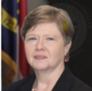
New Life to Date Budget Role for Grants
Darlene Langston
Finance Manager
North Carolina Financial System
NC Office of the State Controller - OSC

Slide 18
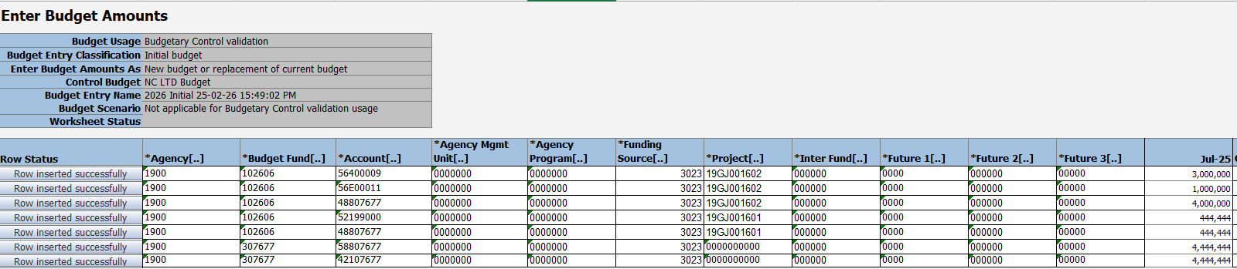
Grants: Life to Date Budgeting
In December 2025, Budget Role NC Budget Entry JR was added in NCFS.
Quick reference guide provides step by step guidance to load the budgets: BUD-26 Manage Grant Authorizations in Budgets | NCOSC
Example of Completed Budget upload form

Slide 19
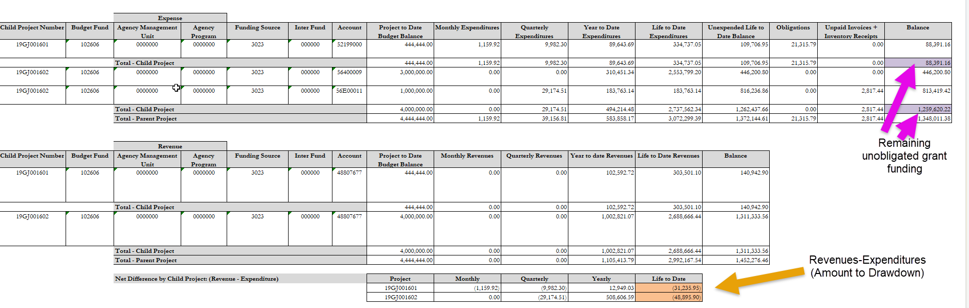
Grants: NC Cash Basis - Project Life to Date Balances Report (RPT-RTR-003)
Example of Report with budget entered

Slide 20
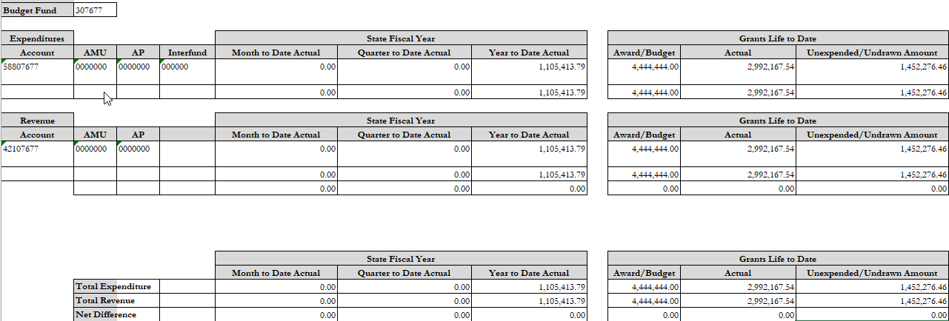
Grants: NC Life to Date Data for Grants Report (BD701F) (RPT-GM-011)
Example of Report with budget entered

Slide 21

Security Updates
Thurman Ross
Security Manager
North Carolina Financial System
NC Office of the State Controller - OSC

Slide 22
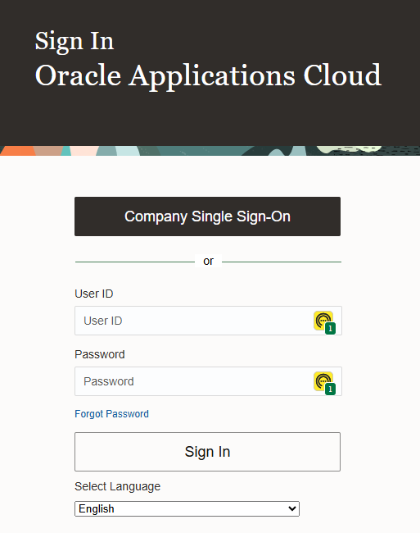
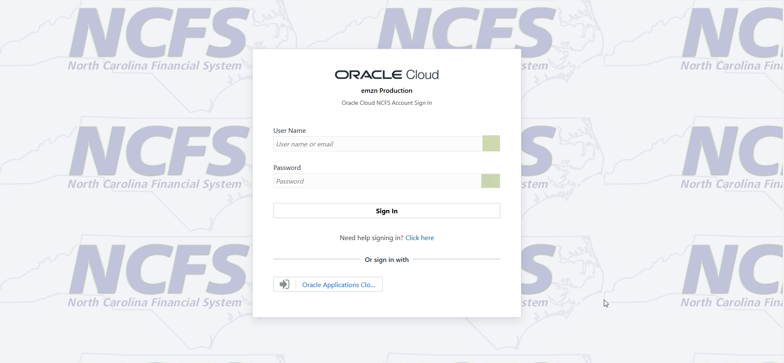

OCI IAM Upgrade
Changes in Oracle Fusion Cloud Applications Sign In Page (NCFS)
Before upgrade After upgrade

Slide 23
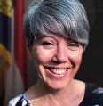
NCFS Training
Dawn Parrish
Learning & Development Special Projects Coordinator
North Carolina Financial System
NC Office of the State Controller - OSC

Slide 24
Training Updates
NCFS Reporting WBTs
GL206: General Ledger Reporting
INV206: Inventory Reporting
GM206: Grants Management Reporting
LMS Manager Approval for Training

Slide 25
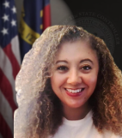
Organizational Change Management
Lena Andrade
NCFS Engagement Lead
North Carolina Financial System
NC Office of the State Controller - OSC

Slide 26
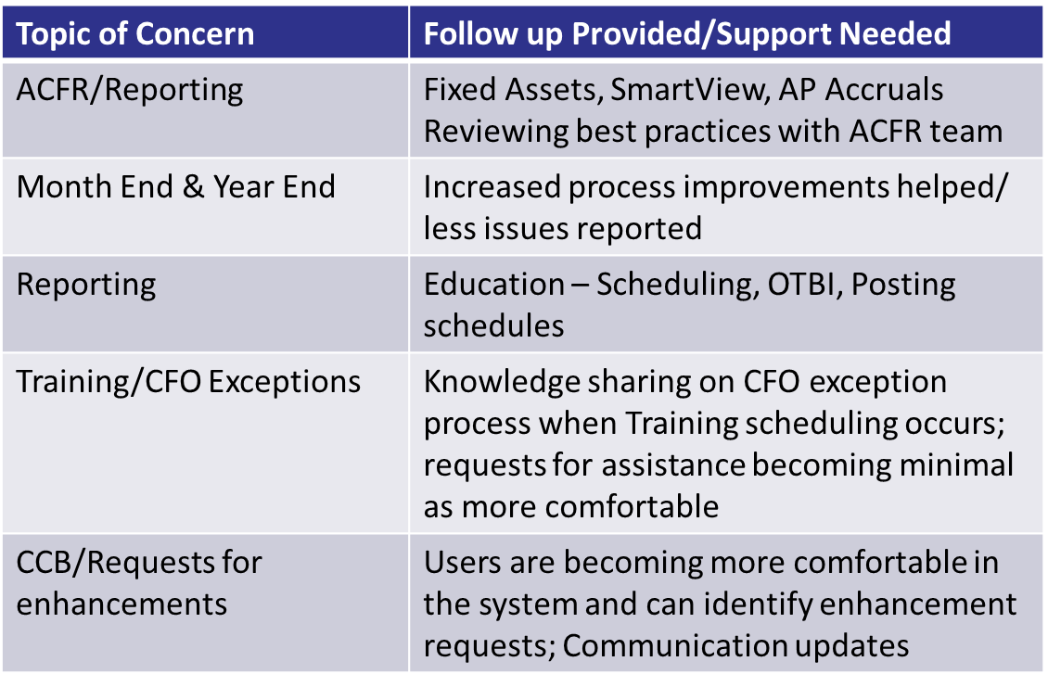
NCFS Touchpoints
Agency touchpoints are scheduled beginning the month of March
We will continue to discuss issues, share updates and review specific areas that agencies may still find challenging
Review examples with team members
Reminder: Complete the Touchpoint survey prior to the meeting

Slide 27
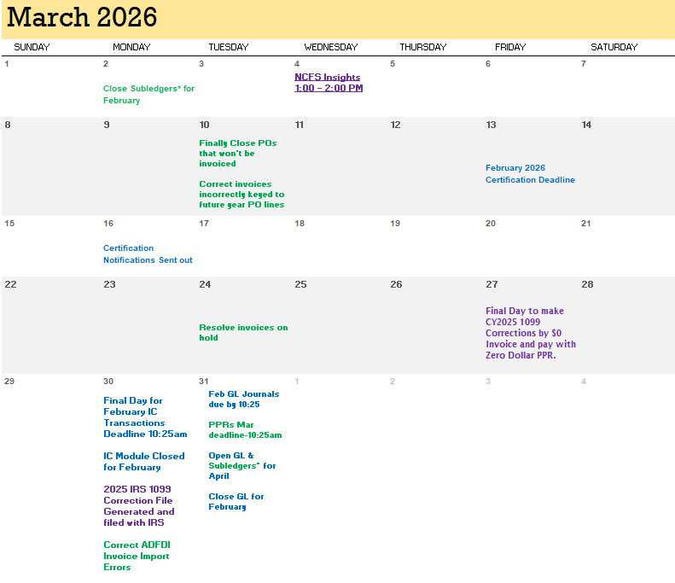
March Functional Calendar

Slide 28
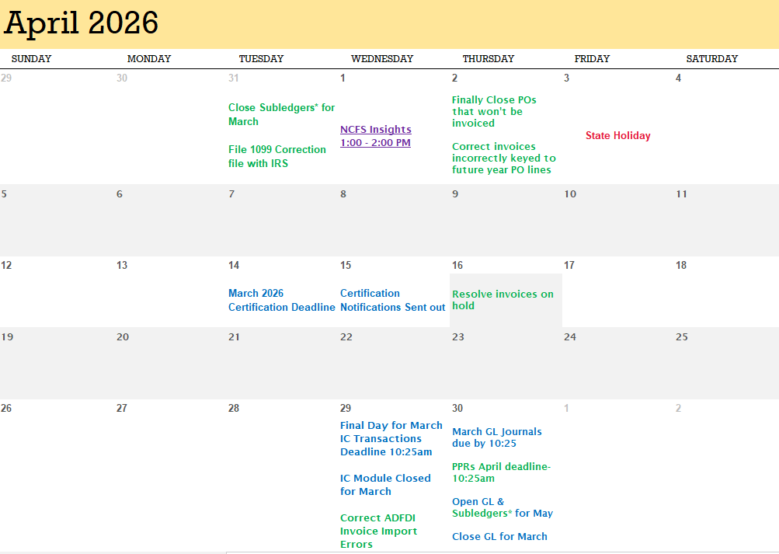
April 2026 Functional Calendar

Slide 29
Useful Links
NCFS Resources
NCFS 2026 Communications
NCFS System Training
NCFS Gen-11 Reference Links
NCFS Help Documents
1099 Information Sessions
QRG AP-07 Create and Manage Invoices
QRG AP-41 1099 Zero Dollar Invoices
QRG AP-42 Printing 1099 Correction Form
QRG AP-47 Zero Dollar Invoices
QRG BUD-26 Manage Grant Authorizations in Budgets
QRG EX-18 Close Unapplied Cash Advances by Employee Reimbursement
QRG PO-06 View Purchase Orders

Slide 30
What's Next?
Next NCFS Insights Session: April 1st at 1pm
Upcoming NCFS Information Sessions
NCFS Touchpoints – March/April
NCFS Newsletter – April
ACFR Planning Conferences - May

Slide 31

Q&A
Give us your feedback!
Contact us: ncfs@ncosc.gov

