Slide 1
NCFS Fixed Asset Information Session Transaction Deep Dive
February 4th, 2026

Slide 2
Level Setting
This Information Session is not a training and does not replace official NCFS trainings.
This meeting will be recorded and will be available online.
Please keep your microphone muted.
Please place any questions in the chat.
Questions will be addressed at designated stopping points.
Please keep questions general, not agency specific.
Unanswered questions will be logged for follow up.
This information session is scheduled for 2 hours.

Slide 3
FA Transaction Review Topics
Asset Inquiry
Additions
Adjustments
Transfers
Update Descriptive Details
Retirements & Reinstatements
Question and Answer

Slide 4
Fixed Asset Security Roles
Not all asset users will have access to all topics presented today.
Fixed Asset Security Roles include:
NCFS FA Inquiry
NCFS Asset Additions
NCFS Asset Accountant
Role | Transactions available
NCFS FA Inquiry | None
NCFS Asset Additions | Additions
NCFS Asset Accountant | Additions, Adjustments, Transfers, Retirements, Update Descriptive Details

Slide 5
Asset Inquiry
NCFS FA
Inquiry
NCFS Asset Additions
NCFS Asset Accountant

Slide 6
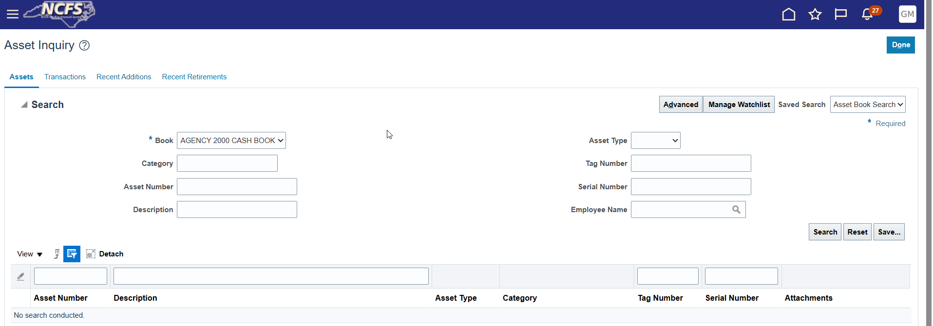
Asset Inquiry Overview
Asset Inquiry Details
Using advanced search
Adding search parameters
Searching based on transaction number
Using the Recent Additions tab
Editing your personalized views
Saving common searches

Slide 7
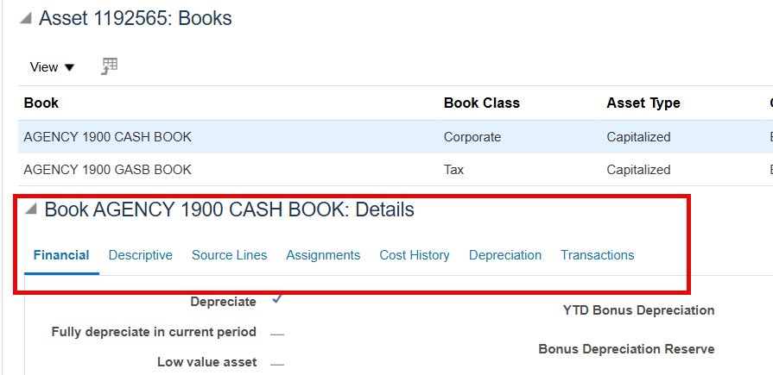
Asset Inquiry Details
Tabs show various information about the asset.
Information between Cash and GASB book may vary slightly.
Demonstration

Slide 8
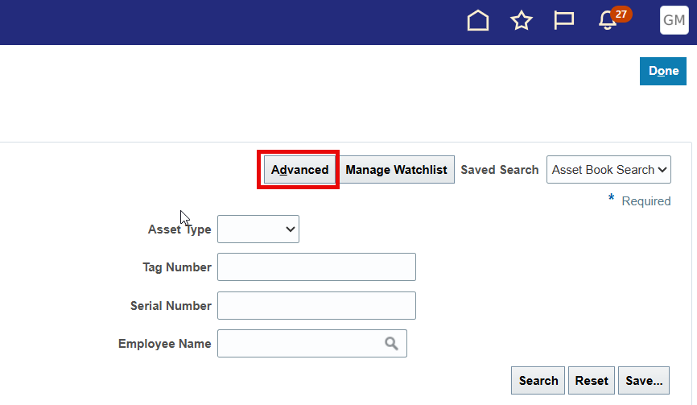
Advanced Search
Toggle Basic or Advanced Search by clicking the Advanced or Basic button.
Advanced search enables more inquiry actions and fields.
Advanced setting can be saved as default inquiry view.
Demonstration

Slide 9
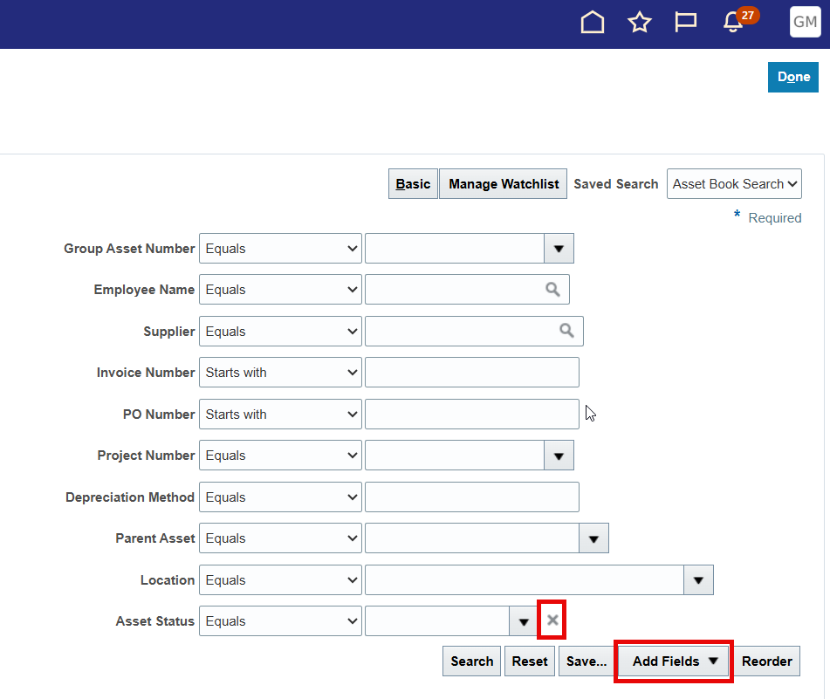
Adding Search Parameters
Use the Add Field list to include more search parameters.
Most details on an asset can be searched for.
Remove previously added fields by clicking the “x” next to it. Note: Default fields cannot be removed.
Demonstration

Slide 10
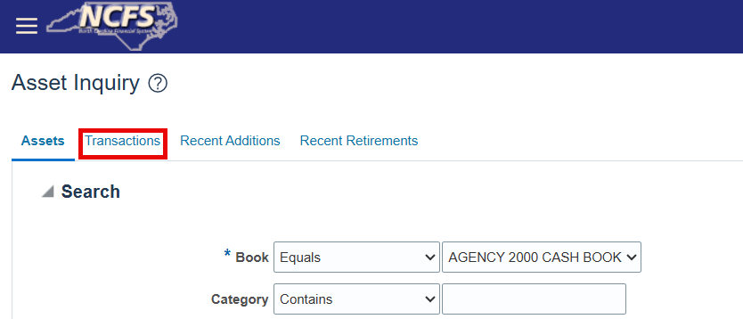
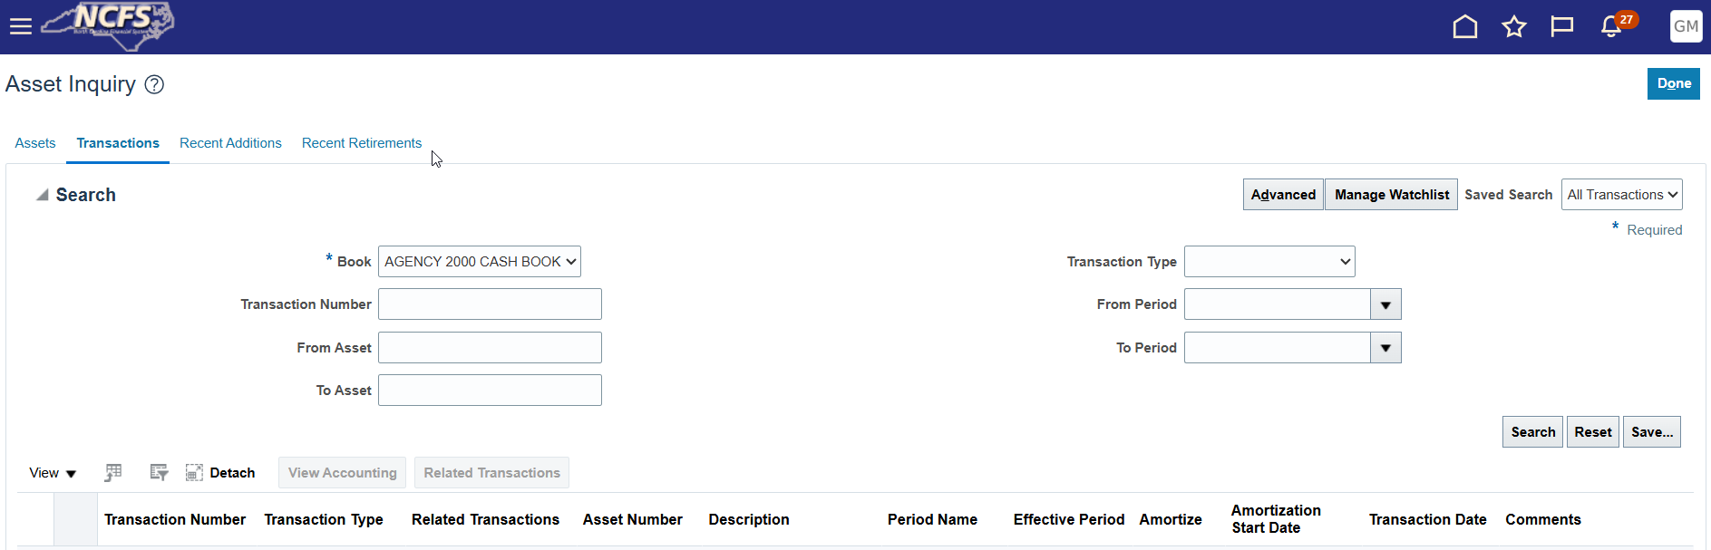
Search based on Transaction Number
Click the Transactions tab to perform transaction inquiry.
Advanced search enables other searchable fields.
Demonstration

Slide 11
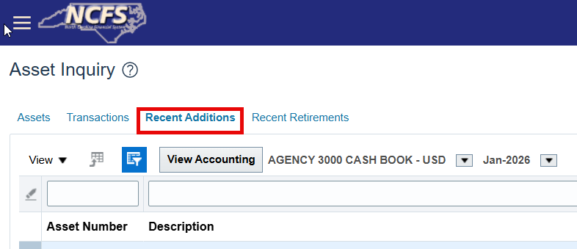
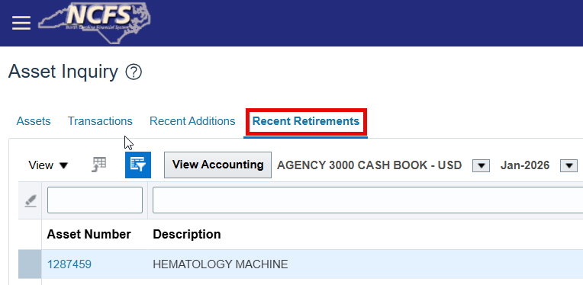
Recent Additions and Recent Retirements
Recent Additions and Recent Retirements shows new additions and retirements for a given period.
By default, it shows the currently open period.
Demonstration

Slide 12
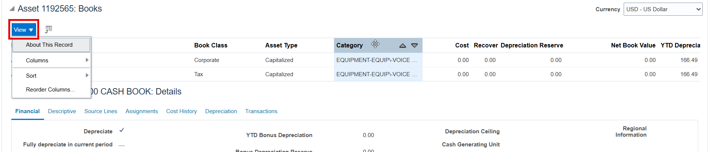
Editing your Inquiry View
Changes to the output view are saved automatically.
Additional column and column size and position are common changes made.
Change Column Size Icon
Change Column Position Icon
Demonstration

Slide 13
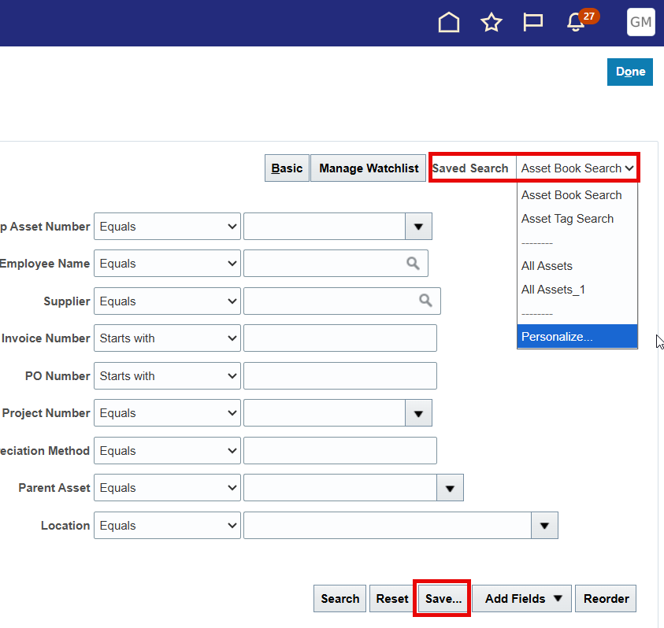
Saving Common Searches
Custom inquiry searches which can be run by default.
Personal to you.
Saved searches remember any additional fields added, modifiers, and input parameters.
Demonstration

Slide 14
Asset Additions
NCFS Asset Additions
NCFS Asset Accountant

Slide 15
Asset Additions Overview
Asset Dashboard
Additions Tips and Tricks
Managing Source Lines Tips and Tricks
Splitting and Merging source lines
Asset type and its relation to GASB Book
CIP Assets
Adding SBITA and RTU assets
Adding Grouped Assets

Slide 16
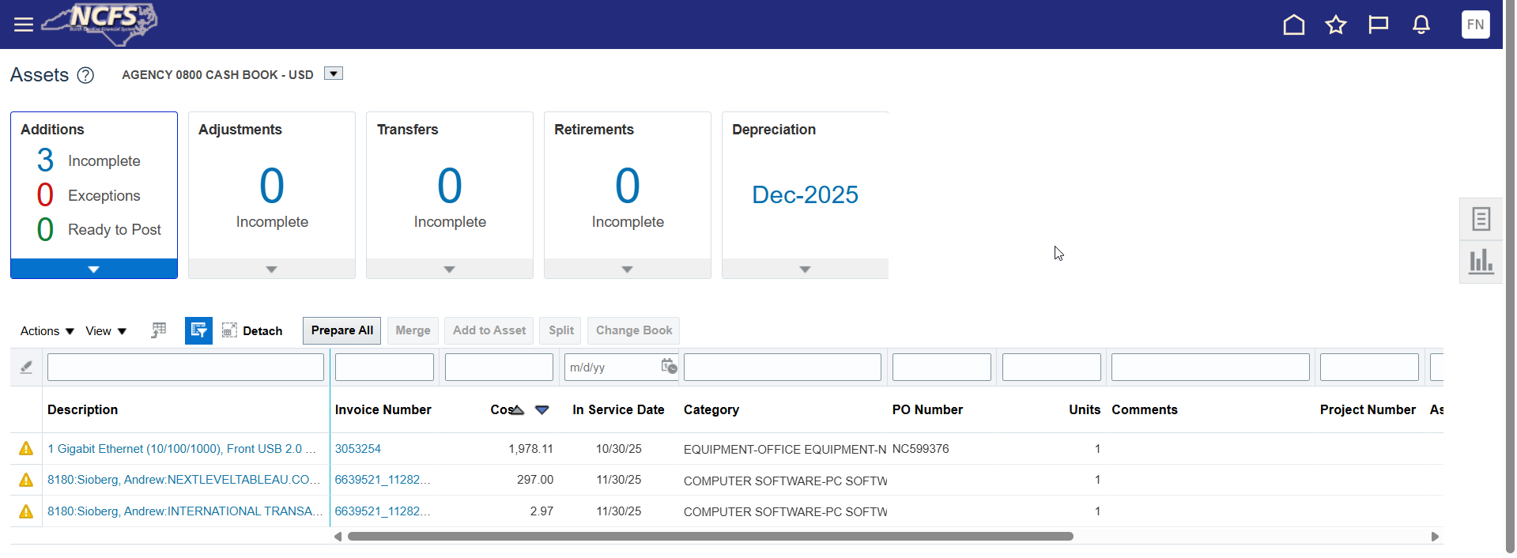
Asset Dashboard
The NCFS asset dashboard is the landing page for the Assets module in NCFS.
The page contains four “Tiles” showcasing pending asset transactions.
Note, the items on the asset dashboard are work-in-progress items.
You can review fully posted items via asset inquiry.

Slide 17
Queue Status
Queue Status | Description
New | The record is newly created and is yet to be finalized.
On Hold | Set by User. This status is a “flag” to hold on completing the transaction.
Delete | Upon setting this status, the transaction line will be deleted once submitted or posted.
Error | Set by the NCFS system. This status notes that NCFS prevented transaction submission due to missing information or other error.
Book Changed | Set by OSC. Transaction line was moved across books. Treat this status equivalent to “New”.
Post | Transaction is ready to be finalized. Upon posting/submission, transaction will process.

Slide 18
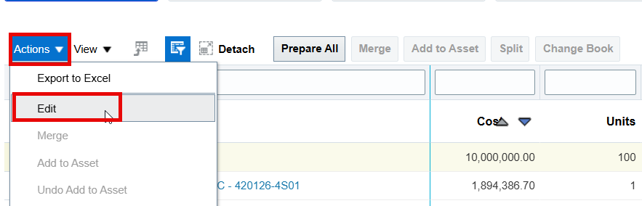
Additions Tips and Tricks
Addition is the best time to many any corrections to an asset. OSC does not recommend posting an asset until the record is correct and complete.
Edit Source Line or Edit Asset page gives access to every descriptive and financial field. Select line in the asset dashboard, Open the Actions Drop-Down List, Click Edit.
Demonstration

Slide 19
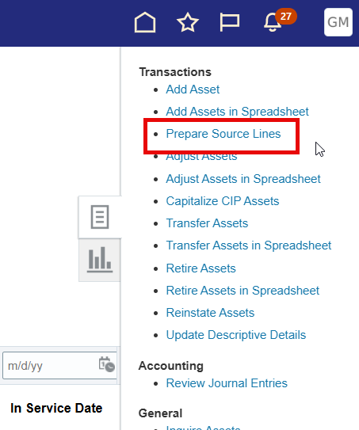
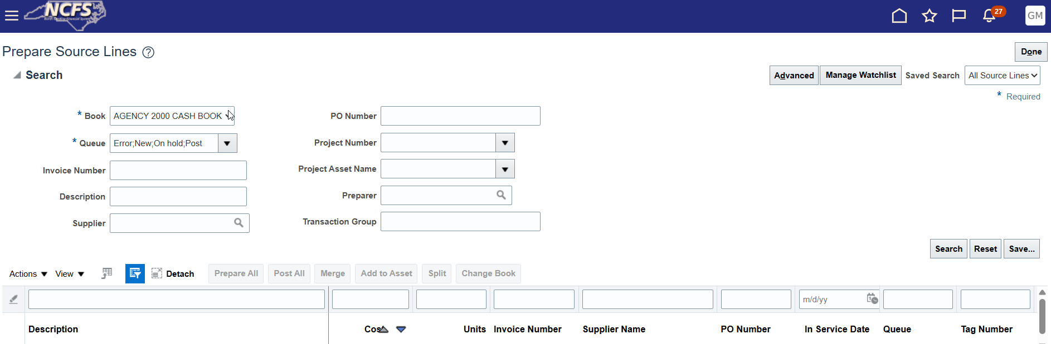
Prepare Source Lines
Prepare Source Lines task allows you to manage and edit all source lines.
QRG around editing previously deleted source lines: FA-22 Editing Previously Deleted Source Lines
Demonstration

Slide 20
Additions – Asset Type and Relation to GASB
Asset type in the GASB Book is determined based on its cost and category at the time of addition.
Statewide capitalization threshold is typically $5,000 per unit.
Select categories have different thresholds.
Contact OSC for type change requests.
Capitalization Threshold (If different from $5,000) | Major Category | Minor Category
100,000.00 | Computer software | Other computer software
100,000.00 | Other intangible assets | Other intangible assets
400,000.00 | Sbita network | Sbita outlay-network
400,000.00 | Sbita software | Sbita outlay-software
100,000.00 | Easement | Easement
Demonstration

Slide 21
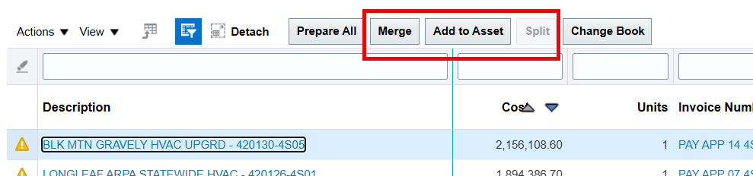
Additions – Splitting and Merging
For Source Lines only
Action | Description | Limitation
Merge | Combines two or more Source Lines into a single asset. | Parent line should be best description of asset. Cannot merge a previously split line. Must be same asset type and category.
Split | Splits a source line of >1 unit into lines of equal value. | Must have more than 1 unit. Cannot split a merged line.
Add to Asset | Adds source line cost to a previously posted asset. | Must be same asset type and category.
Demonstration

Slide 22
Capital Improvement Project Assets
Track outside of NCFS
Add asset to NCFS once project is complete.
Decrease from CIP once project is complete.
ACFR worksheet 202
102.08 - Statewide Accounting Policy - Buildings
Maintenance and Repairs
Expensed regardless of cost if it doesn’t meet criteria for a CIP.
102.03 - Statewide Accounting Policy - Maintenance

Slide 23
Additions – RTU and SBITA
Track within NCFS
Add asset and change useful life to lease term.
Notify OSC to correct the useful life in the GASB Book.
105.07 - Statewide Accounting Policy - Leases and SBITAs
FA-15 Adding an RTU Asset (Leased Asset)
Demonstration

Slide 24
RTU and SBITA – Manual Depreciation Strategy
Option to pause depreciation for RTU & SBITA which are unlikely to follow a STL and Half-Year depreciation schedule.
Add the asset with suspended depreciation. Place a ticket to OSC to suspend depreciation on a posted asset.
Track outlay outside of NCFS.
Place a ticket to OSC before Year-End with manual depreciation entry requests.
FA-23 Suspend Depreciation of an Asset During Asset Addition

Slide 25
Additions - Grouped Assets
Grouped Assets are assets whose individual costs are less than the capitalization threshold for an individual asset when purchased as a group of similar assets at or near the same time and the aggregate value is significant.
A manually added Capitalized Asset representing a group of under capitalization threshold assets where the aggregate value is significant.
All assets within a Grouped Asset must be of the same asset minor category.
Professional judgement will be required to determine if a Grouped Asset should be entered.
Grouped Asset Guidance
Grouped Asset should be added with the following description formula: GROUPED ASSET FY## “Minor Asset Category”. Example: GROUPED ASSET FY21 EQUIPMENT PC PRINTER

Slide 26
Other Asset Transactions
NCFS Asset Accountant

Slide 27
Transfers, Adjustments, and Update Descriptive Details
Asset Adjustment
Asset Transfer
Update Descriptive Details
Asset cost
Estimated life and in-service date
Change category
Transfer Source Lines
Depreciation expense account information
Location information
Assigned employee
Adjust number of units
Asset description
Tag number
Serial number, manufacturer, model number
Additional details
Attachments

Slide 28
Asset Adjustments
Change Financial Details
Allows edits to Cost, Useful Life, or Date Placed in Service.
Edits to Useful Life or Date Placed in Service require a ticket to OSC to correct the GASB Book.
Duplicate or erroneous asset deletion
In same period: contact OSC.
Different period: contact OSC.
Category change adjustments allow edits to the asset category.
Adjustments cannot be backdated.
Demonstration

Slide 29
Negative Adjustments vs Partial Retirements
FA-21 - Partial Retirements vs Negative Cost Adjustments
Negative Cost Adjustment
Used when the value of the asset decreases but the entire asset stays in service.
Can be due to incorrect initial valuation or other reasons.
For example, a truck was originally added as an asset with a value of $500,000 but should have been entered with a value of $50,000.
Partial Asset Retirement
Used when a portion of the asset leaves service.
Can be due to an end of useful life, sustaining damage enough to terminate use of a portion, surplus/sale of a portion of the asset, or other reasons.
For example, a permanent toolbox attached to a truck is damaged and needs to be removed but not replaced.

Slide 30
Asset Transfers
Transfer Asset allows edits to:
Employee Assignment
Depreciation Expense Account
Location
Limitations to backdating to a prior fiscal year:
Only once per asset
For location or employee assignment adjustments, use today’s date.
For accounting adjustments, use most accurate date.
Adjust Units allows corrections to units.
To Transfer Asset across Books or en masse (in bulk), contact OSC at NCFS@ncosc.gov
Demonstration

Slide 31
Update Descriptive Details
Updates available to many asset details including Tag, Description, Legacy information, adding attachments, and many more.
Federally Funded field available to be edited here.
Tag number updates available.
Asset Tags must be unique across the state.
OSC recommends a format of “Agency ID-Tag Number”. Example: OSC-12345
Contact OSC with requests to update details in bulk. During asset addition is the best time to update these details.
Demonstration

Slide 32
Asset Retirements and Reinstatements
Limitations to retirements and reinstatements. Year turnover limitation
Retire by Cost is recommended. Do not retire by cost and also retire by units.
Statewide standard retirement convention is Half-Year.
Surplus Process
Retire with Retirement Reason as “Surplus”.
Perform a JV or other entry to record funds received.
Demonstration

Slide 33
Questions?

Slide 34
Questions, Requests, or Other
Key Takeaway
When in doubt, contact NCFS@ncosc.gov!

Slide 35
Thank you!
Next FA Info Session to be held on 4/1/2026
FA Transactions by Spreadsheet Deep Dive.

