Slide 1
NCFS Fixed Asset Information Session
Spreadsheet Deep Dive
April 1st, 2026

Slide 2
Level Setting
This Information Session is not a training and does not replace official NCFS trainings.
This meeting will be recorded and will be available online.
Please keep your microphone muted.
Please place any questions in the chat.
  Questions will be addressed at designated stopping points.
  Please keep questions general, not agency specific.
  Unanswered questions will be logged for follow up.
This information session is scheduled for 2 hours.

Slide 3
FA ADFDi (NCFS Spreadsheet) Review Topics
ADFDi Tool
Additions
Adjustments
Transfers
Retirements & Reinstatements
Update Descriptive Details
Questions & Answers

Slide 4
Fixed Asset Security Roles
Not all asset users will have access to all topics presented today.
Fixed Asset Security Roles include:
  NCFS FA Inquiry
  NCFS Asset Additions
  NCFS Asset Accountant
  NCFS Centralized Asset Manager – OSC Only
Role | Transactions available
NCFS FA Inquiry | None
NCFS Asset Additions | Additions
NCFS Asset Accountant | Additions, Adjustments, Transfers, Retirements and Reinstatements
NCFS Centralized Asset Manager – OSC Only | All, including Update Descriptive Details with a ticket to NCFS@ncosc.gov

Slide 5
ADFDi Tool

Slide 6
What is the ADFDi Tool?
  ADFDi stands for Application Development Framework Desktop Integration.
  It is a Microsoft Excel plug-in that integrates with NCFS and allows bulk transaction uploads by using MS Excel.
  Available for most transaction types.
    Tasks available to Agencies:
      Add Assets in Spreadsheets.
      Adjust Assets in Spreadsheets.
      Transfer Assets in Spreadsheets.
      Retire Assets in Spreadsheets.
    Tasks available to OSC only:
      Update descriptive details in Bulk.

Slide 7
Where to download the ADFDi tool
  On the OSC Excel Add-On webpage, you will find:
    Excel Add-On .msi file
    Mandatory Update for the Oracle ADFdi Excel Add-in installation guide
    How to Enable Excel Plugin instructions
  Note: Installation may require the help of your agency IT staff.

Slide 8
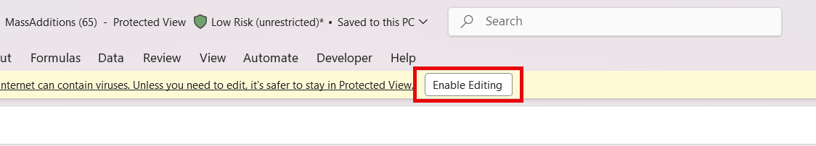
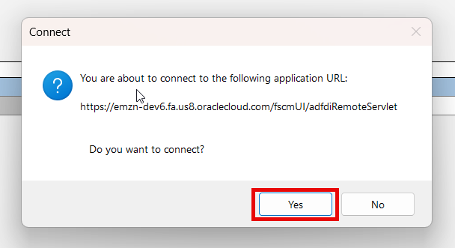
Connecting to an ADFDi Sheet
  Download the ADFDi sheet from the appropriate task.
  Open the sheet and select Enable Editing.
  Click “Yes” to the popup connection. request. If no request pops up, check if it appeared on another screen or behind another window.
  Log into NCFS using your credentials.

Slide 9
Queue Status
Queue Status | Description
New | The record is newly created and is yet to be finalized.
On Hold | Set by User. This status is a “flag” to hold on completing the transaction.
Delete | Upon setting this status, the transaction line will be deleted once submitted or posted.
Error | Set by the NCFS system. This status notes that NCFS prevented transaction submission due to missing information or other error.
Book Changed | Set by OSC. Transaction line was moved across books. Treat this status equivalent to “New”.
Post | Transaction is ready to be finalized. Upon posting/submission, transaction will process.

Slide 10
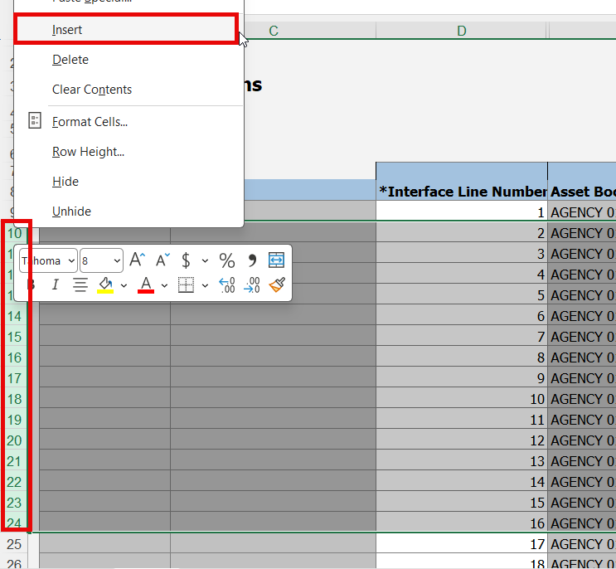
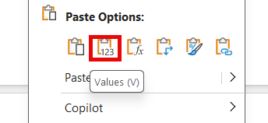
Tips/Tricks
  Always use a new spreadsheet for final posting. Helps stay connected to NCFS.
  Insert lines into the “active space” only. Select multiple lines at once to insert.
  Use NCFS’s formats, including capitalization, correct number of 0s, etc.
  Paste as values.

Slide 11
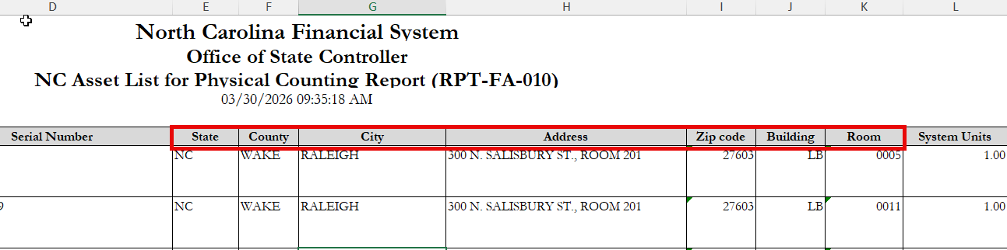
Using NCFS Reports to help
  Reports generated from NCFS present information in the NCFS format.
  We can use these reports to accurately copy necessary information to help complete the transfers by spreadsheets. Example: Use RPT-FA-010 to gather Location information for Transfer by Spreadsheet.
  OTBI reports can be built to assist with common data needs.

Slide 12
Excel Tips/Tricks
  It is best practice to consider the ADFDi upload sheets as a “submission form”.
  Data preparation is best completed in a separate worksheet. This allows us to use Excel formulas, data sorting, and other tools prior to posting.
  Common formulas used to assist include:
    Vlookup or Xlookup – searches reports to return results.
    Upper – Capitalizes the characters to match NCFS formatting.
    Left or Right – Returns a specific number of characters from the left or right.
  Column filtering is instrumental when using NCFS reports to assist.
  Text-to-Columns is often used to assist with copying Depreciation Expense Account information.
Demonstration

Slide 13
1. Questions?

Slide 14
Asset Additions
NCFS Asset Additions
NCFS Asset Accountant

Slide 15
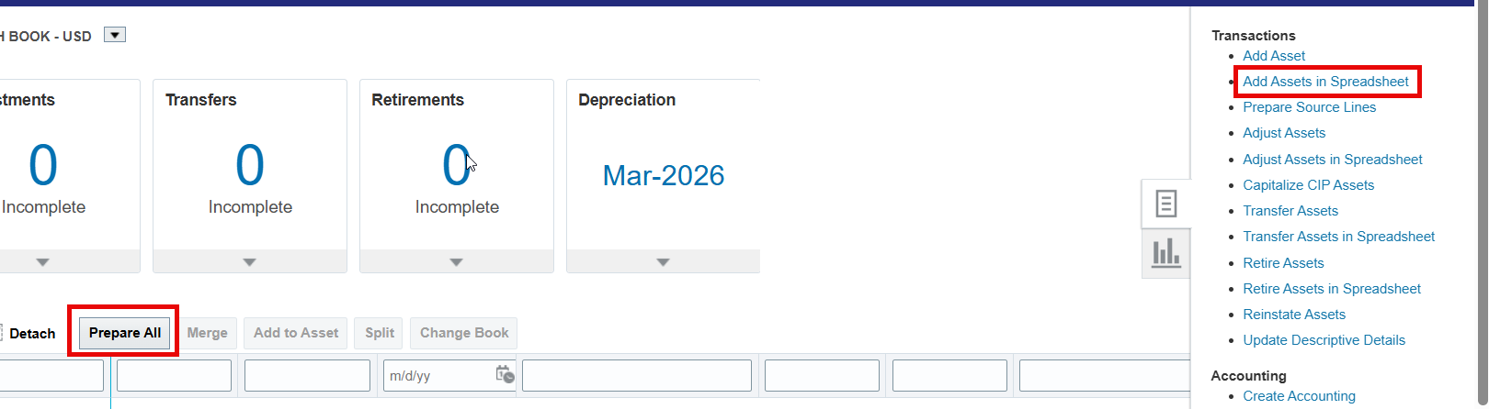
Add Assets in Spreadsheet Types
  Two main “Types” of Add Assets in Spreadsheet.
    Add Assets in Spreadsheet Task.
      Blank sheet for new additions
      Prompts for Asset Type (Capitalized or Expensed) and Book
    Prepare All button: Brings details for items in the Additions tile of the Asset Dashboard.

Slide 16
Additions Required Columns
  D – Interface Line Number
  G – Asset Type
  H – Queue Name
  I – Description
  K, L, M – Category; can be double clicked.
  N – Date Placed in Service
  O – Cost
  P – Units
  Q-W – Location; can be double clicked.
  Z-AJ – Depreciation Expense Account; can be double clicked.

Slide 17
Additions Recommended Columns
  AM – Tag Number
  AO – Serial Number
  BA – Manufacturer Name
  BB – Model Number
  BJ – Invoice Number
  BF – Depreciate (Yes/No)
  BT-BV – Useful Life (RTU/SBITA assets); can be double clicked.
  DK – PO Number
  DL-DM – Supplier Information; can be double clicked.
  DO – Invoice Date
  DZ – NCFS Custom DFF’s; can be double clicked. Legacy information, Federally Funded flag, Additional Descriptions, Asset Status, Asset Purchase Type

Slide 18
Additions Columns to Avoid
  E – Key column; hidden column
  F – Asset Book; System generated
  AL – Asset Number; System generated
  AM – Asset Key; System generated
  BK – Parent Asset Number; System generated
  CN – Group Asset Number; not used in NCFS

Slide 19
2.Questions?

Slide 20
Other Asset Transactions
NCFS Asset Accountant

Slide 21
Transfers, Adjustments, and Update Descriptive Details
Asset Adjustment
Asset Transfer
Update Descriptive Details
Asset cost
Estimated life and in-service date
Change category
Transfer Source Lines
Depreciation expense account information
Location information
Assigned employee
Adjust number of units
Asset description
Tag number
Serial number, manufacturer, model number
Additional details
Attachments

Slide 22
Asset Adjustments
NCFS Asset Accountant

Slide 23
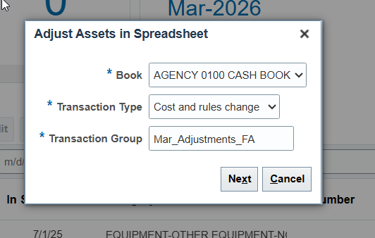
Adjust Asset in Spreadsheet Initiation Prompt
  Upon clicking the Adjust Assets in Spreadsheet task, you will be met with a pop-up prompt box.
  Book – Defaults to the currently active asset book. Ensure you are in the book you intend to be working in.
  Transaction Type – Set to Cost and rules change; all other types are OSC only.
  Transaction Group – The name for your transaction group. Spaces are not allowed, so use periods or underscores to separate words, if desired.

Slide 24
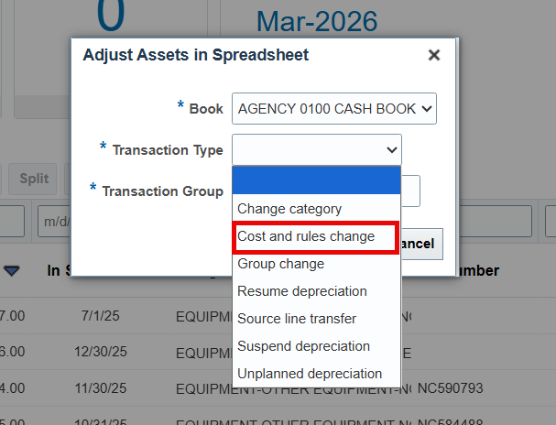
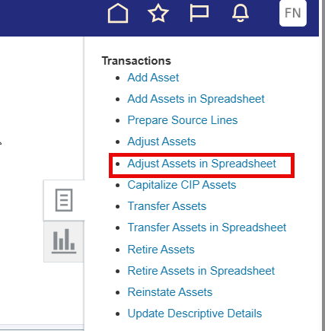
Adjust Assets in Spreadsheet Transaction Types
  One main Transaction Type for Adjust Assets in Spreadsheet.
  Cost and rules change: Includes changes to financial details like Cost, Date Placed in Service, and Life in Years.
  Other Transaction Types are not available to agencies due to security limitations. Contact OSC for use of any other type.

Slide 25
Adjustment Columns
  Required
    G – Asset Number
    J – Posting Status
  Avoid
    E – Book
    H – Key, Hidden column
  Useful Columns
    O – Cost
    Q – Life in years, double-clickable
    AG – Date Placed in Service
    L - Comments
  Note: You are not required to fill out all applicable columns. NCFS will know that a blank indicates no changes. Applies to Adjustments only.

Slide 26
1. Demonstration

Slide 27
Asset Transfers
NCFS Asset Accountant

Slide 28
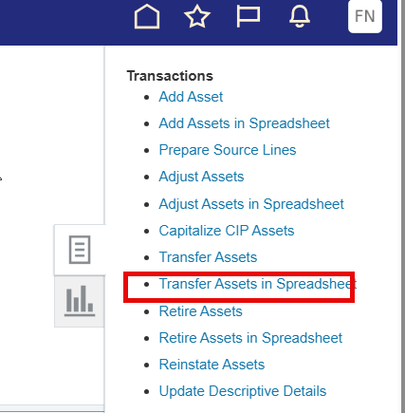
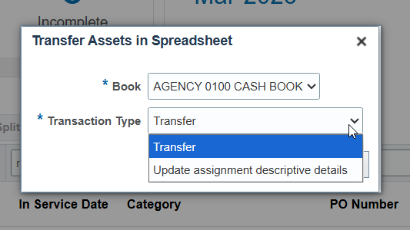
Transfer Asset in Spreadsheet Initiation Prompt
  Upon clicking the Transfer Assets in Spreadsheet task, you will be met with a pop-up prompt box.
  Book – Defaults to the currently active asset book. Ensure you are in the book you intend to be working in.
  Transaction Type – Set to Transfer, other type has no function in NCFS.

Slide 29
Transfer Columns
Required
Cell D9 – Transaction Group
G – Interface Line Number
H – Asset Number
J – Transaction Type
K – Posting Status
M – Transfer Date
O – FROM units
R – FROM Depreciation Expense Account, Double-clickable
S – FROM Location, Double-clickable
T– TO units
W-AG – TO Depreciation Expense Account, Double-clickable
AH-AN – TO Location, Double-clickable
  Note: You must fill out all applicable parts of a transfer. NCFS will assume a blank should be blank.

Slide 30
Transfer Columns to Avoid
  Avoid
  E – TransferInterfaceID – Key field, hidden
  F – Key, Hidden

Slide 31
2. Demonstration

Slide 32
Asset Retirements
NCFS Asset Accountant

Slide 33
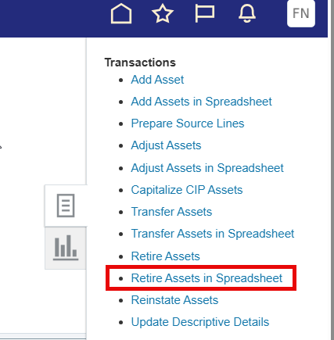
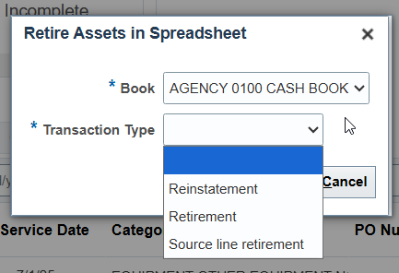
Retire Asset in Spreadsheet Initiation Prompt
  Upon clicking the Retire Assets in Spreadsheet task, you will be met with a pop-up prompt box.
  Book – Defaults to the currently active asset book. Ensure you in the book you intend to be working in.
  Transaction Type – Choose Reinstatement or Retirement.

Slide 34
Retirement Columns
  Required
    Cell D9 – Transaction Group
    E – Interface Line Number
    F – Asset Number
    H – Posting Status
    J – Retire Date
    Y – Retirement Convention
  By Cost
    K – Cost Retired
  By Units
    N – Units Retired
    P+Q – Employee information
    R – Depreciation Expense Account
    S – Location
  Note: You can retire by Cost or by Unit, not by both.

Slide 35
3. Demonstration

Slide 36
Update Descriptive Details
OSC Only

Slide 37
Bulk Update Descriptive Details
  Agency does not have access to bulk descriptive detail updates after asset addition.
    During asset addition is the best time to update these details.
    Only OSC is able to perform bulk Update Descriptive Details.
  Contact NCFS@ncosc.gov to initiate a bulk Update Descriptive Details.

Slide 38
3. Questions?

Slide 39
Questions, Requests, or Other
Key Takeaway:
When in doubt, contact NCFS@ncosc.gov!

Slide 40
Thank you!
Next FA Info Session to be held on 6/3/2026
FA Year End Preparation Session

