Slide 1
1099 Corrections Information Session
February 10, 2026 – 11am-12pm

Slide 2
Presenters
Gwen Earp, Business Systems Manager
Crystal Cole, Business Systems Analyst
Jennifer Pacheco, Audit, Risk & Compliance Services Director
Kathleen Tolbert, Tax and Cost Allocation Specialist Lead

Slide 3
Agenda
Welcome​
1099 Deadlines and Dates
Using the NCFS 1099 Maintenance Report for Corrections
Walk through 1099 Corrections QRGs
Agency questions

Slide 4
Key Dates for Tax Year 2025
Gwen Earp

Slide 5
1099 Processing Schedule For Calendar Year 2025
Key Dates | Required Processes
Jan 1- December 31, 2025 | Review 1099 AP-022 1099 Maintenance Report for 1099 flagging or changes.
October 15, 2025 | Link for 1099 Contact Form sent to agency users to provide a main 1099 contact for each agency and the agency’s phone number to print on the 1099 forms.
December 31, 2025 | 2025 calendar year reporting cycle ends.
January 29, 2026 | Last day to make changes to 1099 data in NCFS prior to OSC generating the original 1099 electronic IRS file. All changes should be completed by midnight.
January 1-31, 2026 | 2025 1099 forms are available for printing in NCFS. Forms must be postmarked to suppliers by January 31st. AP-39 Printing 1099 Form
January 30, 2026 | OSC will submit the electronic 1099 file to the IRS.
January 31, 2026 | IRS required deadline date for issuing printed 1099 forms to recipients and filing the IRS electronic file.
February 2, 2026 | Agencies may record 1099 changes in NCFS for 2025 1099s using zero-dollar invoices. AP-41 Zero Dollar Invoices
March 29, 2026 | Last day to enter 1099 corrections with zero-dollar invoices in NCFS. Zero-dollar invoices must be in paid status and accounted by midnight.
March 30, 2026 | 2025 1099 correction forms are available for printing in NCFS. OSC will submit the electronic 1099 corrections file to the IRS. AP-42 Printing 1099 Correction Form

Slide 6
NCFS 1099 Maintenance Report
Crystal Cole

Slide 7
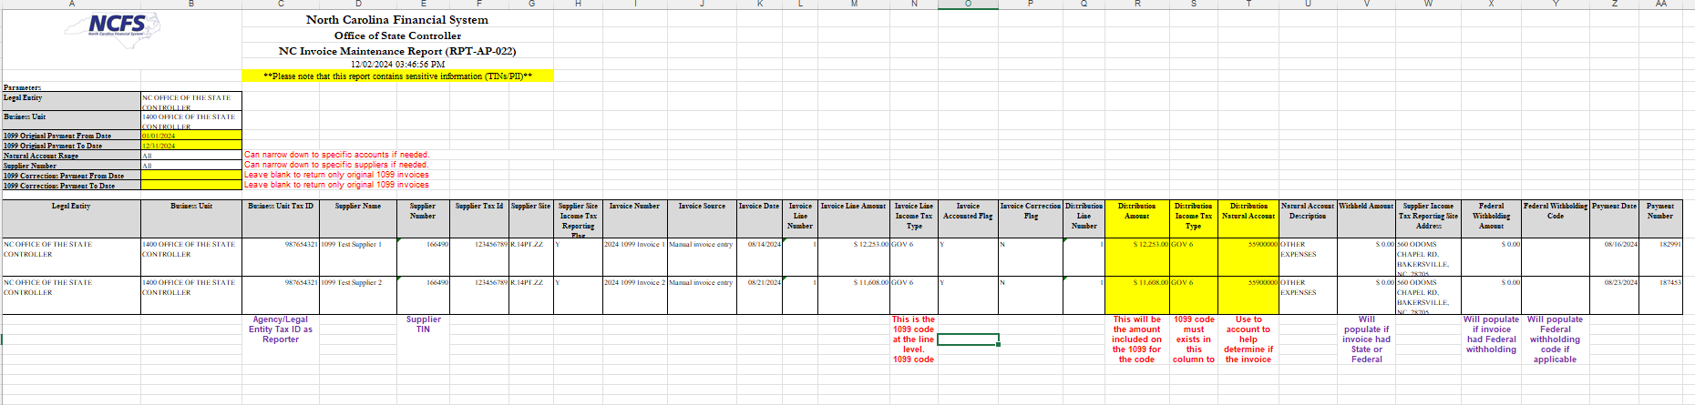
RPTAP022 – Key Columns
Key fields
  Supplier name/number
  Invoice Line Income Tax type
  Invoice Distribution Tax type
Filter suggestions
  Service accounts
  Suppliers without Inc
  Source for interfaced invoices
  Invoice Group

Slide 8
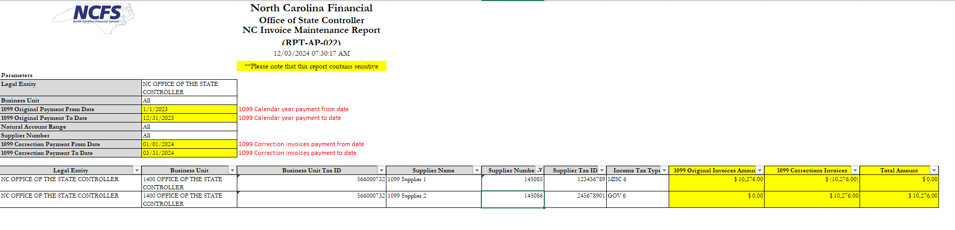
RPTAP022 - Original & Correction - Summary
  1099 Original Payment From and To date parameters for the 1099 original invoices.
  1099 Correction Payment From and To date parameters for the 1099 correction invoices to correct the original 1099s. (Corrections Payment dates will be 1/1/20XX-3/31/20XX for the year after the original 1099 invoice payment dates.)

Slide 9
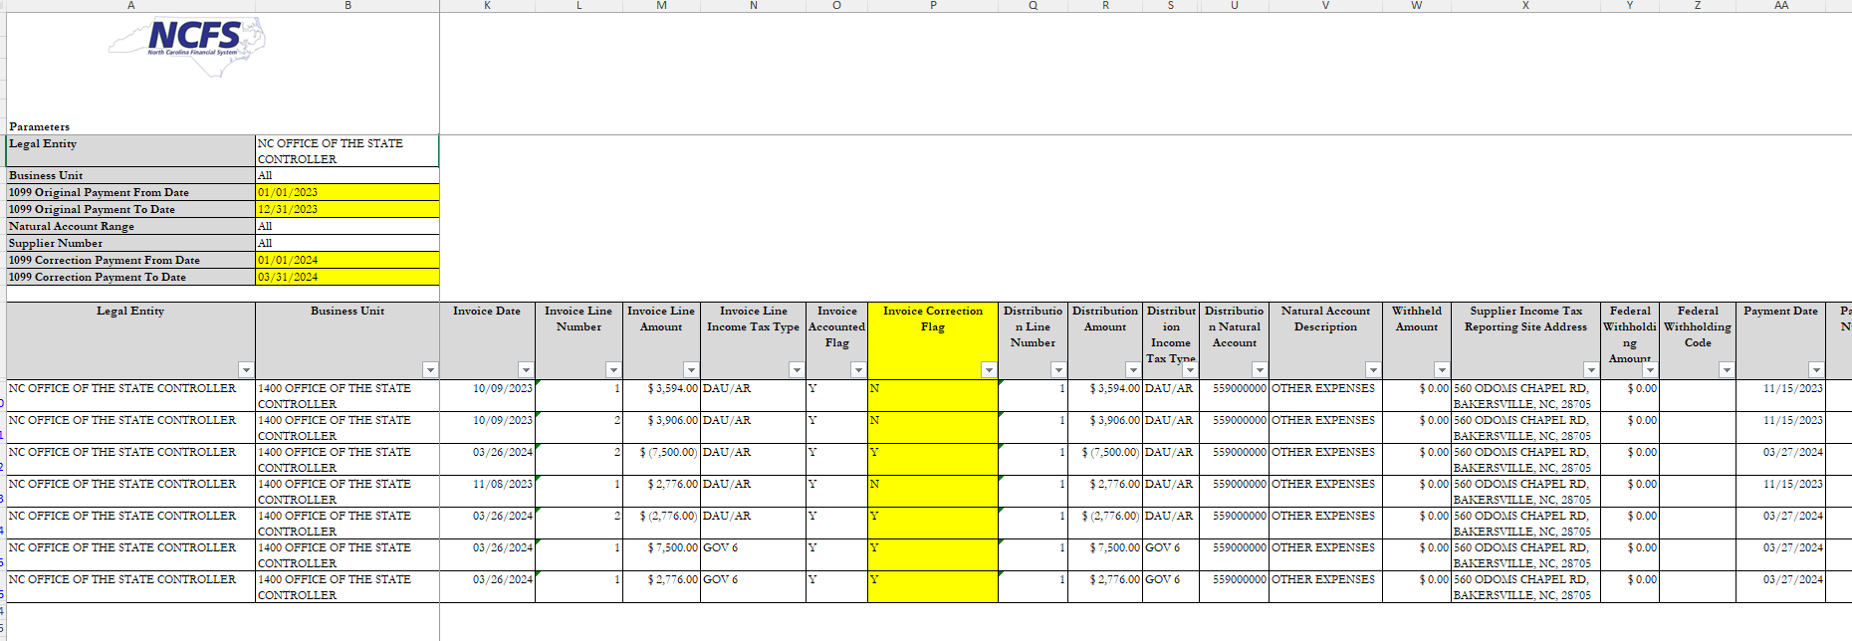
RPTAP022 - Original & Correction - Detail

Slide 10
QRG Training Links
Crystal Cole

Slide 11
Accounts Payable QRGs
AP-41 1099 Zero Dollar Invoices​
AP-42 Printing 1099 Correction Form

Slide 12
Questions?

