Slide 1
NCFS Insights
February 4, 2026

Slide 2
Agenda
Welcome
NCFS Highlights
NCFS Communication Updates
OSC Training Updates
Security Updates
Closing
Q&A
Notes:
Good Afternoon! We have a great agenda planned for you today! We will be sharing NCFS Highlights from the past year, Talk about OCM (Change Management)/Communications updates, followed by tips and reminders from our OSC Training team. We will then get some important NCFS security updates before we close out a sneak peek into upcoming events and allow some time for questions and answers regarding today’s topics.

Slide 3

Welcome
Housekeeping
Introductions
Notes:
A couple of quick housekeeping items for today…
We have a variety of representatives from our agencies who interact with NCFS. From CFO’s and controllers, to the analysts and cash management folks – we’ve got a mix. We hope that you will take the information we share with you in these sessions and pass it along to your teams.
We will be recording the sessions and sharing out following the meetings. At the end of the presentation, we will share a sneak peek of the upcoming topics that we will be presenting. Please note that all agendas/topics are subject to change, but we will be basing these topics off your feedback and to compliment the activities you have each month and throughout the year.

Slide 4
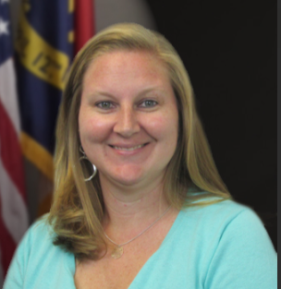
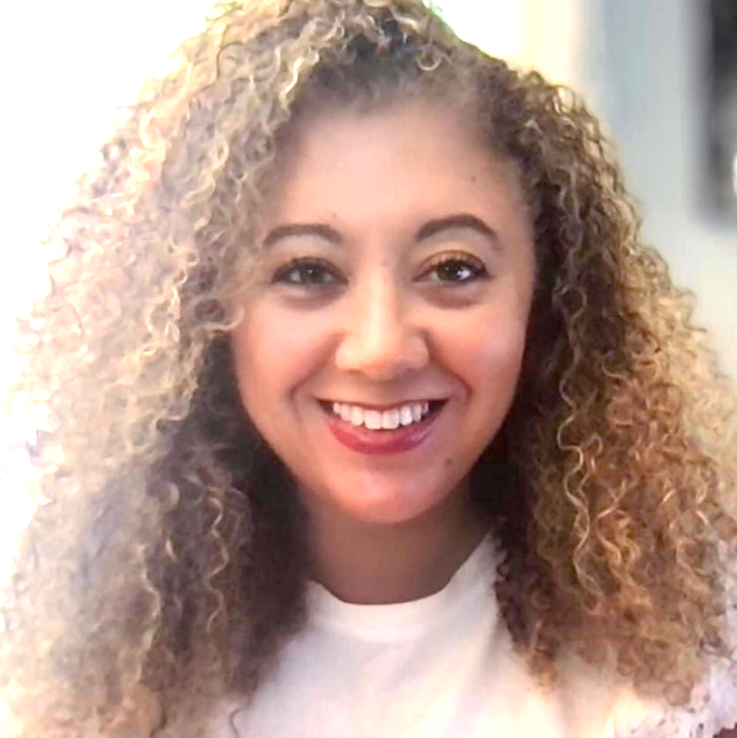
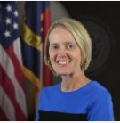

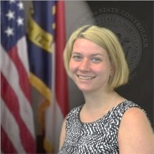
NCFS Insights - Presenters
Taylor Brumbeloe
NCFS Deputy State Controller
Lena Andrade
NCFS Engagement Lead
Jan Prevo
NCFS Project Coordinator
Thurman Ross
Systems Application
Manager
Laura Lee
OSC Training Lead
Notes:
Introduce speakers of the day
We would like for you to hold your questions for the end of the session to allow each presenter time to complete their sections.

Slide 5

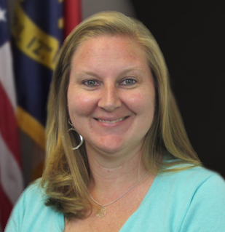

NCFS Highlights
Taylor Brumbeloe
Deputy State Controller, NCFS
North Carolina Financial System
NC Office of the State Controller - OSC
Notes:
Introduce speaker

Slide 6
2025 Highlights
4 New Agency Setups
in NCFS
New Manufacturing Module Added to NCFS
3 New Agencies on Accounts Receivable Module
New & Improved Escheats Process
NCFS Information & Training Sessions
More Efficient Supplier & ePay Setup Process
New Interfaces To and From NCFS
Fiscal Year End Success

Slide 7
2026 Goals
Communication
Engagement
Feedback
Training

Slide 8
Icebreaker
Polling Question:
How do you communicate NCFS information to your agency’s end users?
(Results shown at the end of the presentation.)
Notes:
Launch Poll
Refer to results at the end

Slide 9
NCFS Communications
Jan Prevo
NCFS Project Coordinator
North Carolina Financial System
NC Office of the State Controller - OSC
Notes:
Thank previous speaker and Introduce next speaker

Slide 10
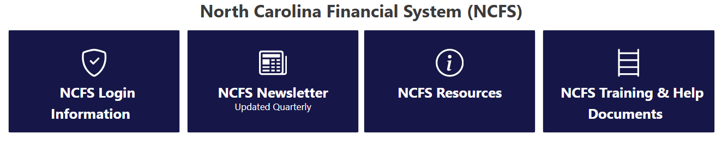
Website Information
NCFS Website – State Agency Resources
Communications
Distributed by email based on process area (example - AP) and security role held for the process area (example – NCFS AP Inquiry)
Published Communications
NCFS Newsletter

Slide 11
NCFS Resources and Help Documents
GEN-02 Acronym List – A Quick Reference Guide (QRG) of frequently used acronyms. Very helpful!
GEN-11 NCFS Reference Links – A Quick Reference Guide (QRG) to frequently used links and resources.
NCFS Resources
Agency Year-End Activity Checklist and Instructions
NCFS System Status
1099 Important Information
NCFS Chart of Accounts
NCAS_NCFS COA Chart of Accounts Mapping
NCAS_NCFS Reporting
NCFS Functional Calendar
NCFS Daily Processing Schedule Job Runs
Month End Certification
NCFS Change Request Intake Form
Agency IC Contacts
NCFS Newsletter
NCFS Training and Help Documents
NCFS Help and Quick Reference Guide Documents
NCFS Security Roles
NCFS Security Administrators
NCFS Security Request Quick Reference Guide SEC-01
NCFS Security Exception Request
NCFS Security Pre_Built Reports Quick Reference Guide
NCFS Course Catalog
Pre_Built Reports All Process Areas
OTBI Video Tutorials
PCard Video Tutorials
NCFS Acronym List

Slide 12
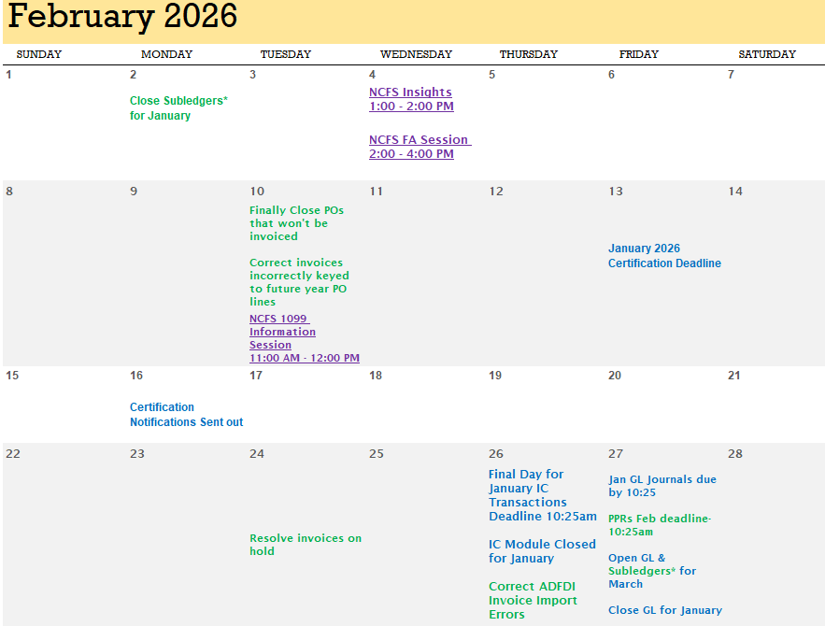
Calendar
February 2026 Functional Calendar

Slide 13
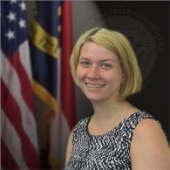
NCFS Training
Laura Lee
OSC Training Manager
North Carolina Financial System
NC Office of the State Controller - OSC
Notes:
Thank previous speaker and Introduce next speaker

Slide 14
Training Registration
LMS Training Registration
Training Checklist Training_Success_NCFS_Checklist_112125.pdf
Important LMS Training Registration Information
Registration Close
Registration closes 7 days prior to the session date
If spaces are available reach out to OSC.Training@ncosc.gov
Registration Status
Registered (has a spot in the training session)
Approved (Supervisor Approved after registration close, does not have a spot in training)
Waitlisted (registered but the class is full may or may not have a spot)
Pending Prerequisite (prerequisite class needs to be complete prior to the class session start)
Pending Approval (Awaiting Employee’s Supervisor to approve the training request)
Waitlists (Apply for waitlist and another session with availability)

Slide 15
Training Courses & Security Roles
NCFS Training
NCFS Course Catalog | NCOSC
New Trainings:
ACC300 (GAAP, GASB Statement No. 54, and ACFR Reporting Deficiencies)
GL Reporting class (Reporting Classes will be created for each process area)
INV Reporting class
INV105 Additional Prerequisite
AP200 Party Payment
Security Roles
NCFS Security Roles | NCOSC
Process
Agency Security Administrator Submits Security Role requests following (SEC01 NCFS Security Request)
Employee requests classes in LMS in order with prerequisites requested first
Employee’s Supervisor Approves training Requests
Employee Receives class information from OSC Training Instructors
Employee Receives security role upon completion of class and Administrator security role ticket submission

Slide 16
Training Updates
AP200 Party Payment Course Registration Process
CFO/Controller must submit request for employee to take AP200
Email goes to OSC Training and Agency Security Administrator
OSC Training follows up with CFO/Controller to validate request
Validated requests prompt OSC to assign AP200 to participant if prerequisites are met
Agency Data Owner submits security request
Employee completes AP200
Employee receives security role
*ONLY OSC Training can assign AP200!
INV105
New prerequisite for March 17th course
Will be released and enacted on 2/20

Slide 17

NCFS Security
Thurman Ross
Systems Application Manager
North Carolina Financial System
NC Office of the State Controller - OSC
Notes:
Thank previous speaker and Introduce next speaker

Slide 18
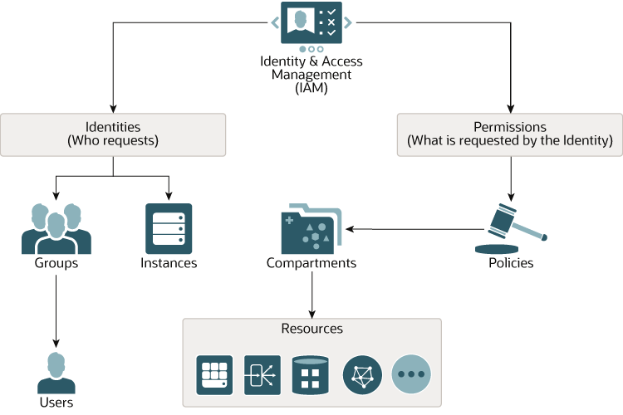
OCI IAM Upgrade
Oracle Cloud Infrastructure Identity Access Management
Feature Description:
Oracle Cloud Infrastructure (OCI) Identity and Access Management (IAM) is a cloud-native, IDaaS platform that manages user identities, authentication, and authorization for OCI resources, Oracle SaaS applications, and hybrid environments. It uses identity domains to organize users, supporting single sign-on (SSO) and multi-factor authentication (MFA) to enforce zero-trust security.
Benefits when Enabled:
This feature will force multi-factor even if you don’t use the (already enabled) MFA through Company Single Sign-On. This release makes it available for configuration to the Oracle Cloud Infrastructure (OCI) Identity and Access Management.
Currently the state is already using MFA through Company Single Sign-On. The Company Single Sign-On button is replaced with the Identity Provider (IDP) name at the bottom of the Sign In page.
Access Control - Uses policies to define which groups can access specific resources.
Compartments - Used to organize and isolate OCI resources for security.
Notes:
Identity access management

Slide 19
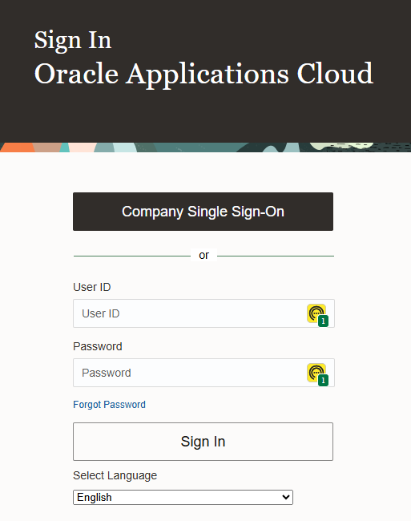
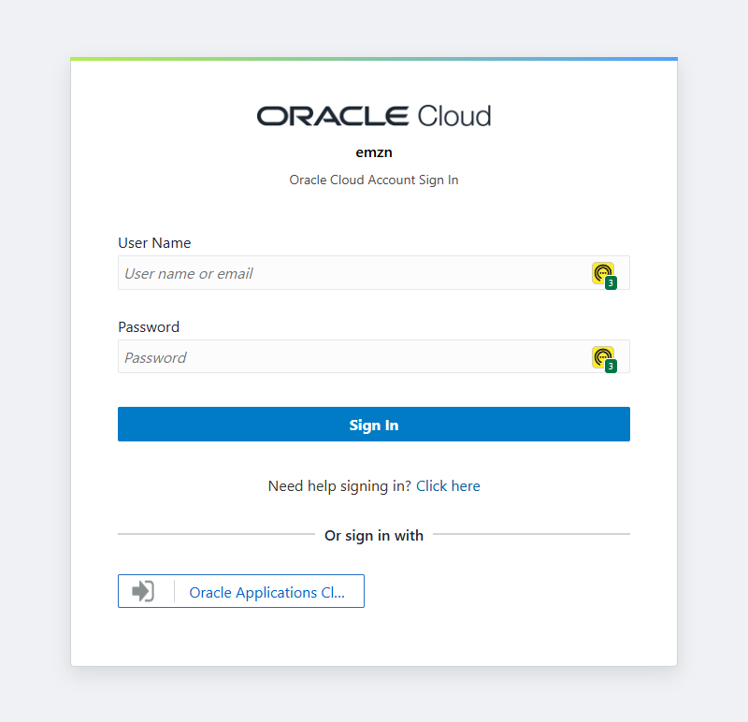

OCI IAM Sign In
Changes in Oracle Fusion Cloud Applications Sign In Page (NCFS)
Before upgrade
After upgrade
Notes:
Identity access management

Slide 20
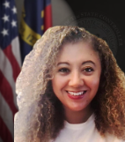
Closing
Lena Andrade
NCFS Engagement Lead
North Carolina Financial System
NC Office of the State Controller - OSC

Slide 21
What's Next?
Next NCFS Insights Session: March 4th at 1pm
Upcoming NCFS Information Sessions
FA Session: Feb 4th at 2pm
1099 Session: Feb 10th at 11am
NCFS Touchpoints
Notes:
Drop link to FA session in chat: https://teams.microsoft.com/l/meetup-join/19%3ameeting_N2NmNDg0NmUtZWFkMS00YjFkLTljMzQtM2Q5ZDI4OGU2ZDJl%40thread.v2/0?context=%7b%22Tid%22%3a%22a1f43f48-54fe-433f-9378-968b45bc6665%22%2c%22Oid%22%3a%22a97f2b47-fee0-4f84-a663-b1d45b4d0254%22%7d
Communications to go out later this month and those will begin soon. Feel free to send us names of folks who you would like added to those sessions after th invites go out.

Slide 22
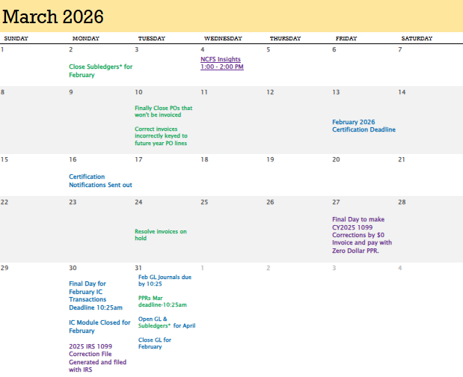
March NCFS Activities
March Functional Calendar

Slide 23

Q&A
Give us your feedback!
Contact us: ncfs@ncosc.gov
Notes:
Drop feedback form in the chat:
https://forms.office.com/pages/responsepage.aspx?id=SD_0of5UP0OTeJaLRbxmZbUw8WZqj85MlNkQx_m10YBUNTlFN1Q3OTZCU1ZIQlk4WDJNM1E1VkhEWS4u&route=shorturl
Allow opportunities for questions regarding topics presented today. If there are additional topics that wish to see, please share in the form.

Slide 24
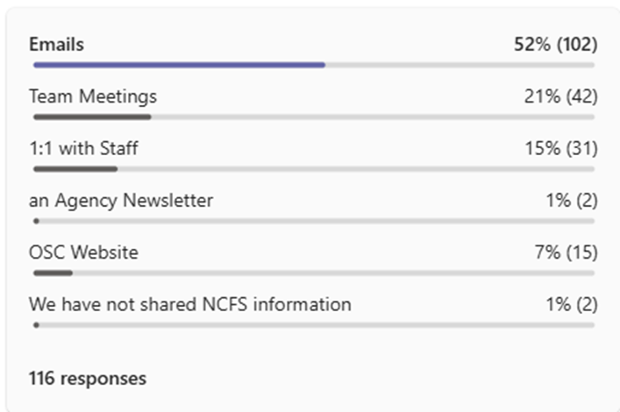
Communications Icebreaker Results
Method | Percentage | Responses
Emails | 52% | 102
Team Meetings | 21% | 42
1 on 1 with Staff | 15% | 31
OSC Website | 7% | 15
Agency Newsletter | 1% | 2
Don’t share | 1% | 2

Slide 25
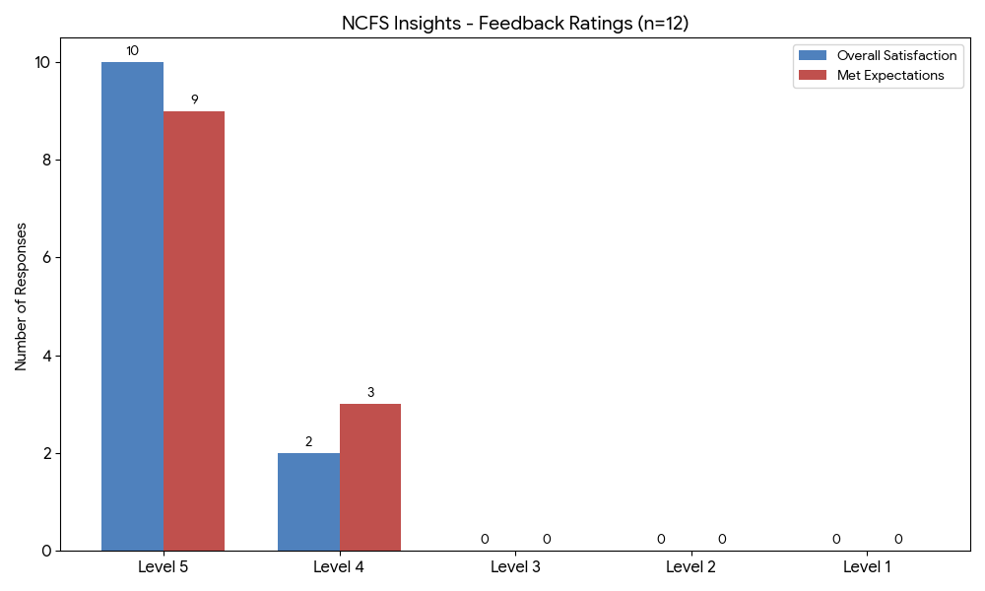
Communications Satisfaction Results

Slide 26
Communications Polling Details
Survey Summary (12 Responses)
Overall Satisfaction Average: 4.83 / 5.0
Meeting Expectations Average: 4.75 / 5.0
Key Takeaways
Satisfaction: The vast majority (83%) of participants rated their satisfaction as a "Level 5."
Meeting Expectations: 75% of participants felt the content fully met their expectations (Level 5), with the remaining 25% rating it a "Level 4."
Positive Feedback: Participants highlighted the "great information" and found it helpful to learn about login changes and system updates.
Future Topics: Requests for future sessions include topics like FRS ACFR Reports, Analyst Reports, and Year-End/ACFR Analysis.

Slide 27
Communications Polling Feedback
1. What participants liked most
The feedback was overwhelmingly positive, focusing on transparency and practical resources.
System Updates: Participants valued hearing about upcoming changes, the new login process, and the timeline for system updates.
Resources: Multiple users highlighted the usefulness of the Quick Reference Guides (QRGs), the website resources, and the new calendar feature.
Engagement: Attendees appreciated "hearing from different people" and the opportunity to interact with the OSC Team.
Accessibility: Users mentioned that seeing where things are located within NCFS made for "easier access".
2. Topics for future sessions
While some newer users are happy with any training provided, others have requested deep dives into reporting:
Financial Reporting: Specific interest in FRS ACFR Reports, Analyst Reports, and Due to/Due From Report Analysis for Year-End.
System Access: A request to review user access procedures.
1099 Processing: Interest in more detail regarding the upcoming 1099 sessions.

Slide 28
Communications Polling Contacts
Name | Organization | Email Address
Heide Rumble | NC Courts | heide.w.rumble@nccourts.org
Brice J. | WSSU | bricej@wssu.edu
Elizabeth Lane | OSC | elizabeth.lane@ncosc.gov

